Slide 1
Animated Explanation of Living Donation Options: Direct Donation, Paired Exchange, Closed Chains, Domino Chains

Slide 2
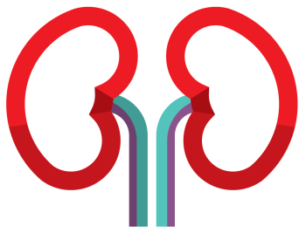
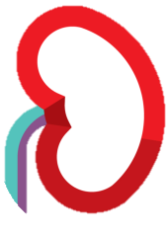
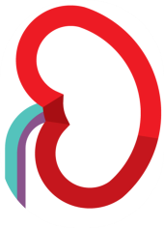
Direct Donation
With direct donation, the donor knows the recipient and wants to donate directly to them.
✓
The donor is medically compatible with the recipient and can go ahead and donate a kidney to them.
Unfortunately, donors are often incompatible or poorly compatible with their intended recipient, and so directed donation may not be the best option. Finding a better matching donor may be better for the recipient.
Living Donor
Transplant Candidate

Slide 3
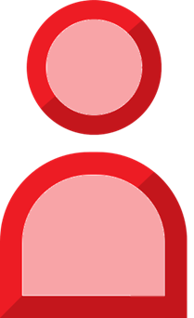
PAIR A
PAIR B
Paired Exchange
An incompatible donor can still help their intended recipient get a transplant by participating in a paired exchange.
In this example, the donor and recipient in Pair A are incompatible. So are the donor and recipient in Pair B.
Living Donor A
Living Donor B
x
✓
x
In a paired exchange, donors are swapped so that each recipient can receive a compatible kidney transplant.
In this exchange, the donor from Pair A donates to the recipient in Pair B, and the donor in Pair B donates to the recipient in Pair A.
Even pairs that are compatible can enter into a paired exchange if their doctor feels that a better matched donor will lead to better transplant outcomes, or if the pair just wants to help others.
Transplant Candidate A
Transplant Candidate B

Slide 4
PAIR A
PAIR B
PAIR C
Closed Chain
A closed chain is similar to a paired exchange, but has 3 or more donor swaps.
In a closed chain, the donor of the last pair donates to the recipient of the first pair.
Living Donor A
Living Donor B
Living Donor C
x
x
x
In this example, donors are exchanged between three incompatible pairs, but there is no limit to the number of pairs that can participate in a chain.
Approximately 40% of KPD transplants are through paired exchanges and closed chains.
Transplant Candidate A
Transplant Candidate B
Transplant Candidate C

Slide 5
NDAD
PAIR A
PAIR B
Domino Chain
Domino chains (or domino exchanges) are possible when an altruistic donor volunteers to donate a kidney to a stranger. These donors, called non-directed anonymous donors (NDADs), can initiate a chain of transplants that help multiple patients get transplanted and facilitate better donor-recipient matches.
NDAD
Living Donor A
Living Donor B
x
x
The NDAD donates to the transplant candidate of a registered pair, with the donor from that pair making a donation to another recipient, and so on.
The exchange is complete when the donor of the last registered pair donates to a transplant candidate on a provincial transplant waitlist.
Transplant Candidate A
Transplant Candidate B
Waitlist
Recipient
Notes:
Please make the X’s appear with the slide and only box one showing.
Next click: add box 2 and the green arrows

