Slide 1
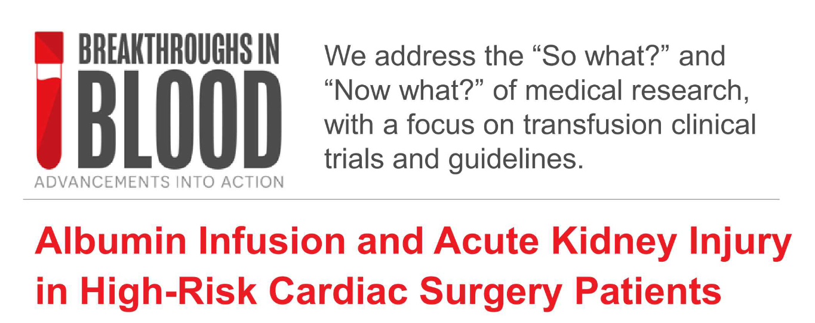
Yahya Shehabi
Prof Intensive Care Medicine
Monash University – University New South Wales

Slide 2

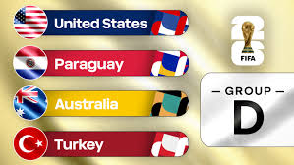
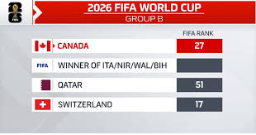

The eyes are all on
Australia vs Canada

Slide 3

Funding & Disclosures
Unrestricted seed grant from CSL Melbourne
  CSL was not involved in the design, conduct, data collection, analysis or preparation of this presentation
  ALBICS-AKI participated in CSL pharmacovigilance program
Unrestricted grant from the Prince of Wales Hospital Foundation Randwick – NSW – Australia
Monash University Institutional fund – School of Clinical Sciences, Clayton – Victoria – Australia
Nil other related COI

Slide 4
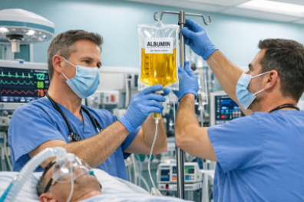
Critical Care Physicians
Albumin is a fluid, not a blood product

Slide 5
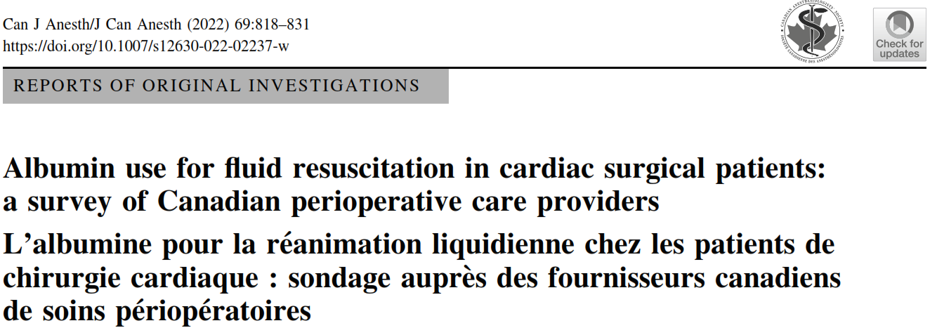
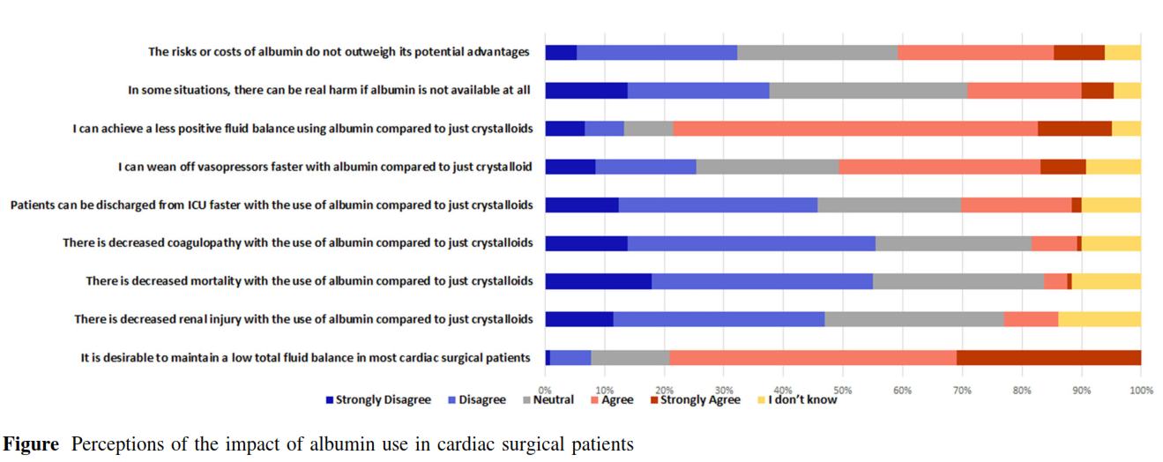

Slide 6
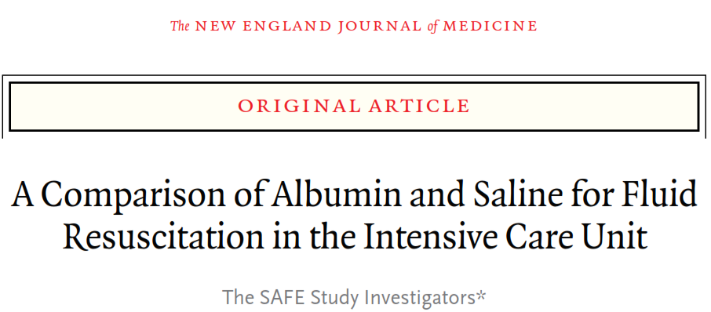
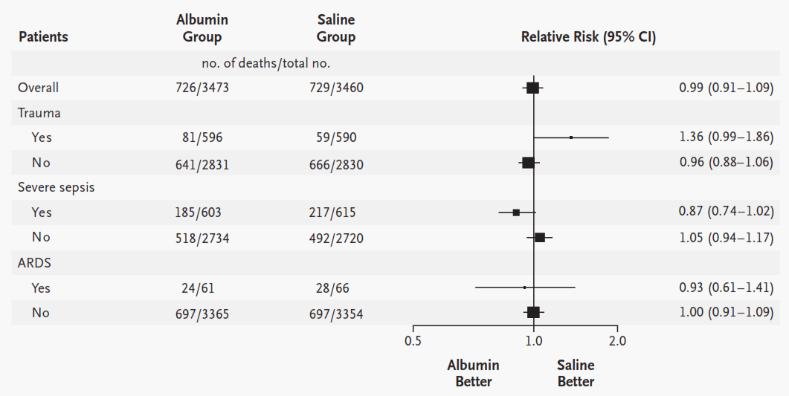
Defending albumin – an Australian sport
The SAFE trial
2004
6997 patients
64% ventilated
APACHE II 18.8(±8)
4% albumin vs normal saline
Resuscitation in ICU
28-day mortality
Organ failure
ICU/hospital stay

Slide 7
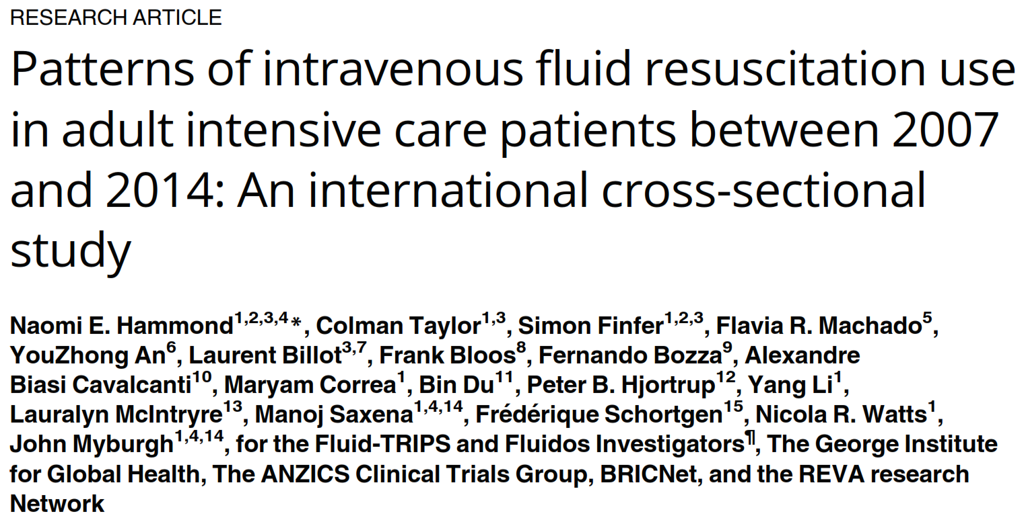
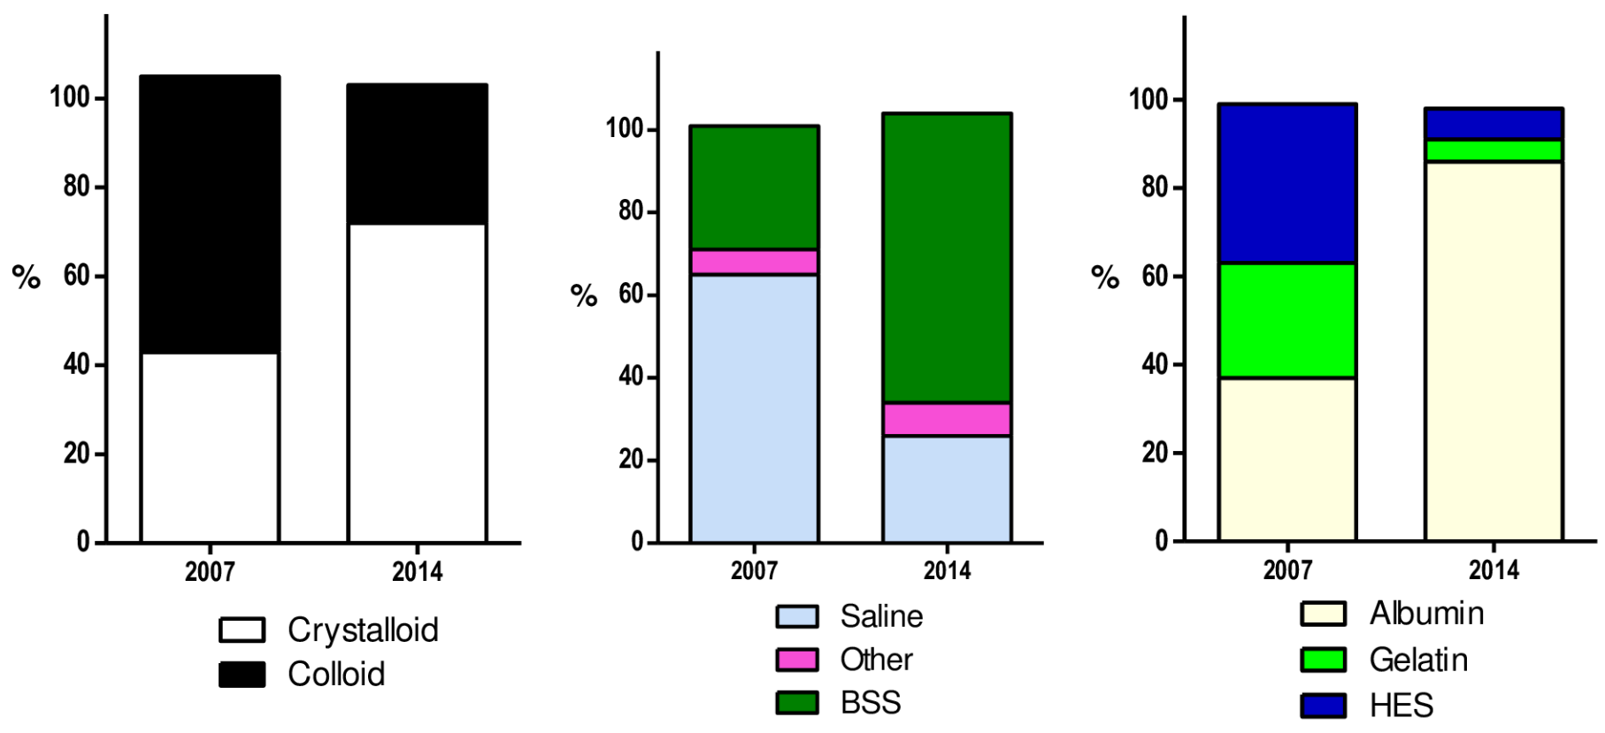
Albumin is the dominant colloid used in resuscitation
Country / region
Days in ICU
Traumatic Brain Injury

Slide 8
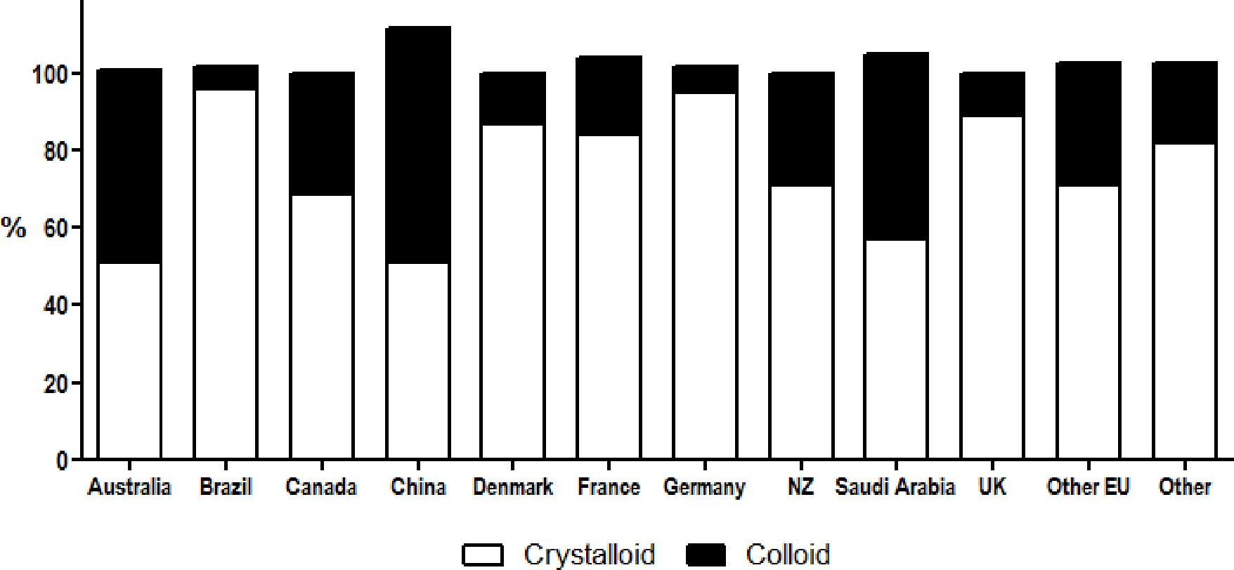
Crystalloids vs
colloids

Slide 9
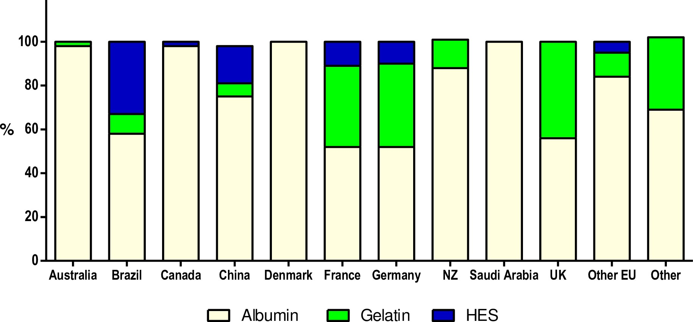
Crystalloids vs
colloids
What
Colloid?

Slide 10
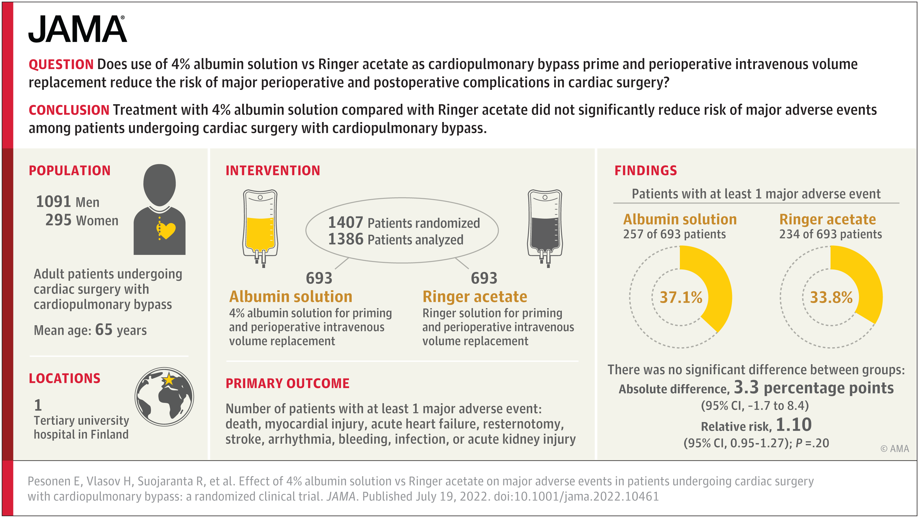
ALBumin In Cardiac Surgery RCT 2022
Single centre
Low risk pts
EuroSCORE II 1.7(1-2.8)
eGFR 80(17)
CABG 45%
CPB 110 min
Post op AKI 2.9%
Death 0.5%

Slide 11
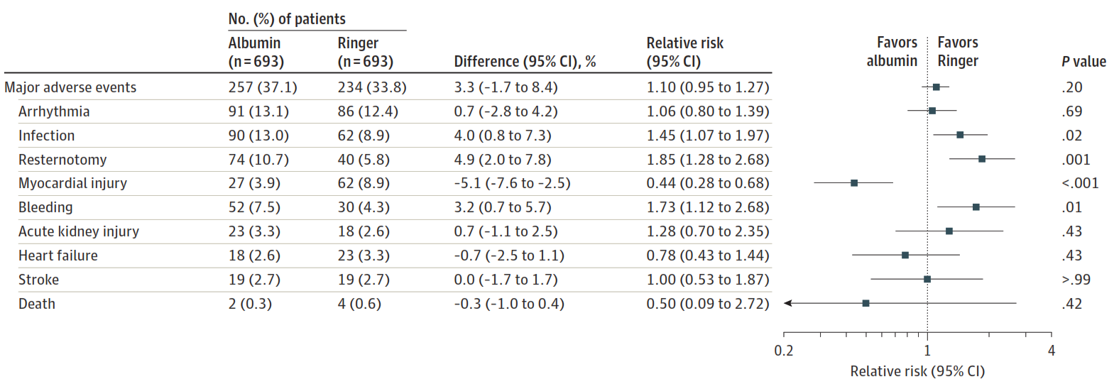
ALBumin In Cardiac Surgery RCT 2022

Slide 12
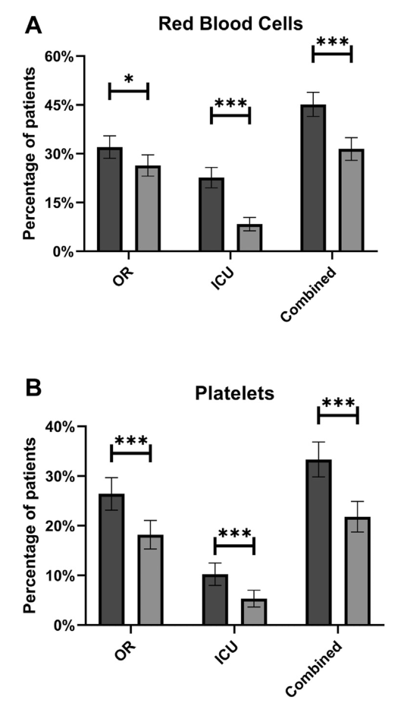
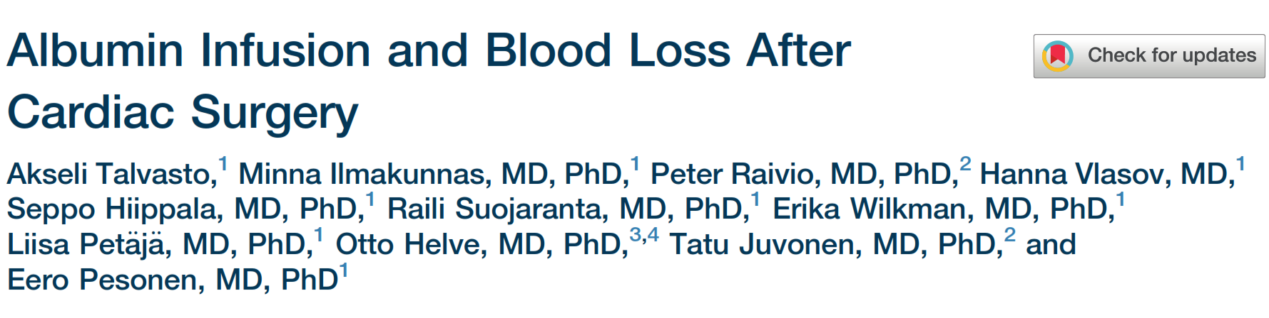
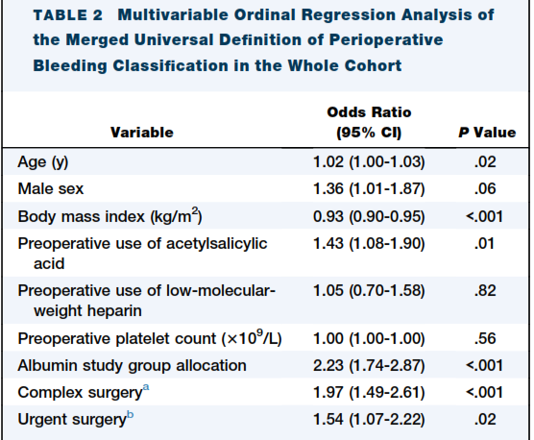
Excess transfusion with albumin - ALBICS trial

Slide 13
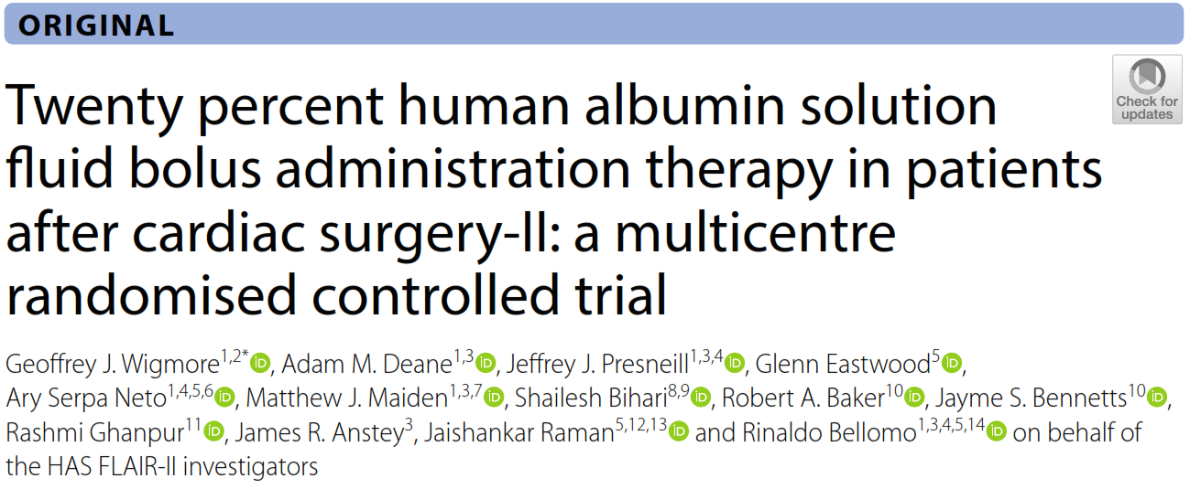
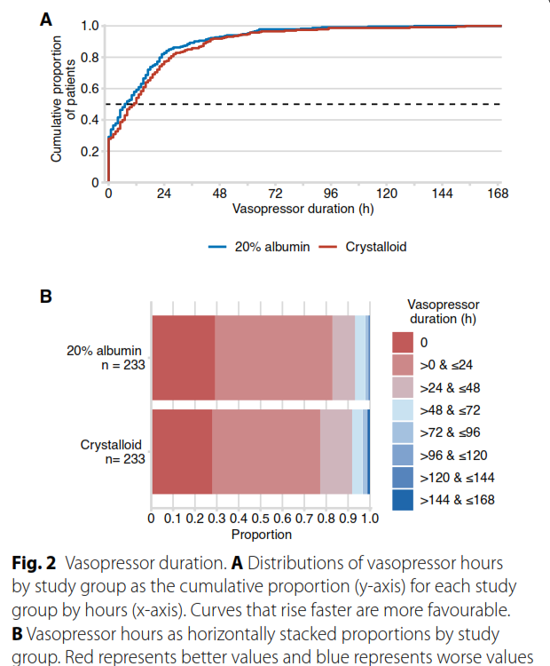
Multi centre open label
Low risk pts
EuroSCORE II 1.5(0.9-2.8)
Creat 79(68-96)
CABG 63%
Cross Clamp 85(68-110) min
Post op AKI 22%
Death 0.2%

Slide 14


Slide 15









Postoperative 20% Albumin Infusion for Acute Kidney Injury in High-Risk Cardiac Surgery

Slide 16



Determinants of Cardiac Sx Associated AKI
Age
CKD
Diabetes
Surgical complexity
Patient factors
Hypoperfusion
Inflammation
Oxidative stress
Endothelial damage
And factors related to cardiopulmonary bypass

Slide 17
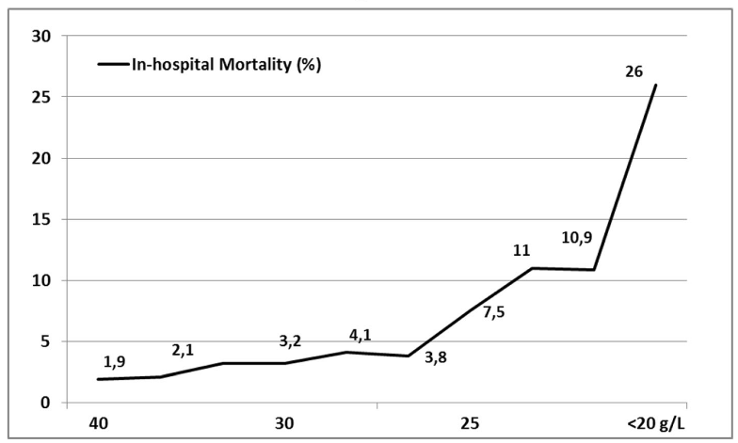
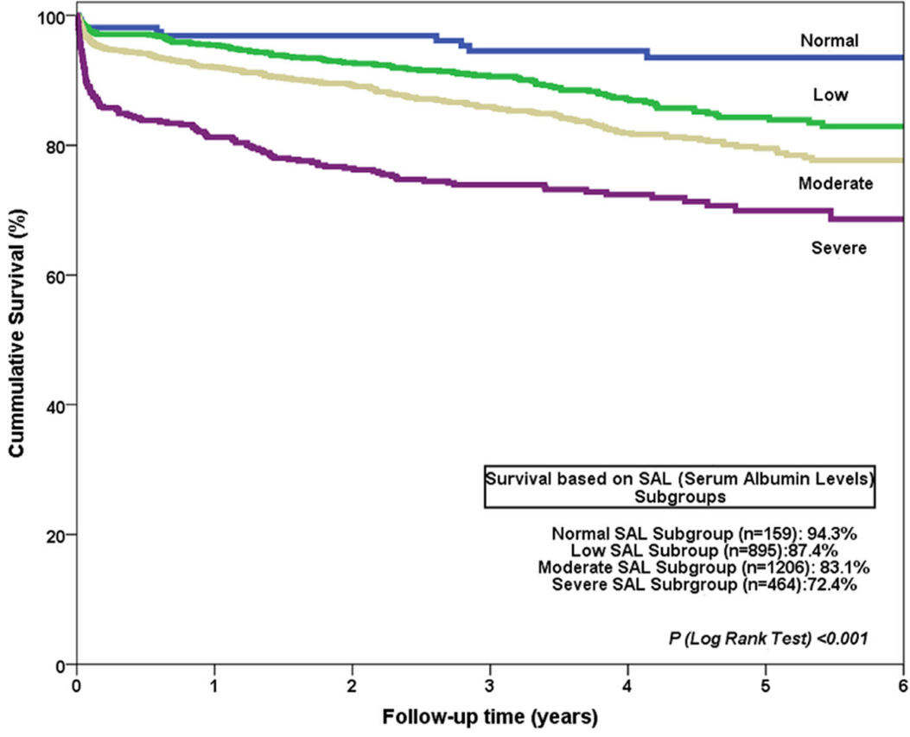
Hypoalbuminaemia, dose dependent badness
Postoperative serum albumin level (g/L)
 | Normal ≥35 g/l | Low deficit 30-34.9 g/l | Mild deficit 25-29.9 g/l | Severe deficit <25 g/l | p
AKI (%) | 3.1% (5/162) | 4.4% (41/924) | 9.7% (121/1249) | 21.7% (105/483) | <0.001
Berbel-Franco et al. J Cardiothorac Surg (2020)

Slide 18
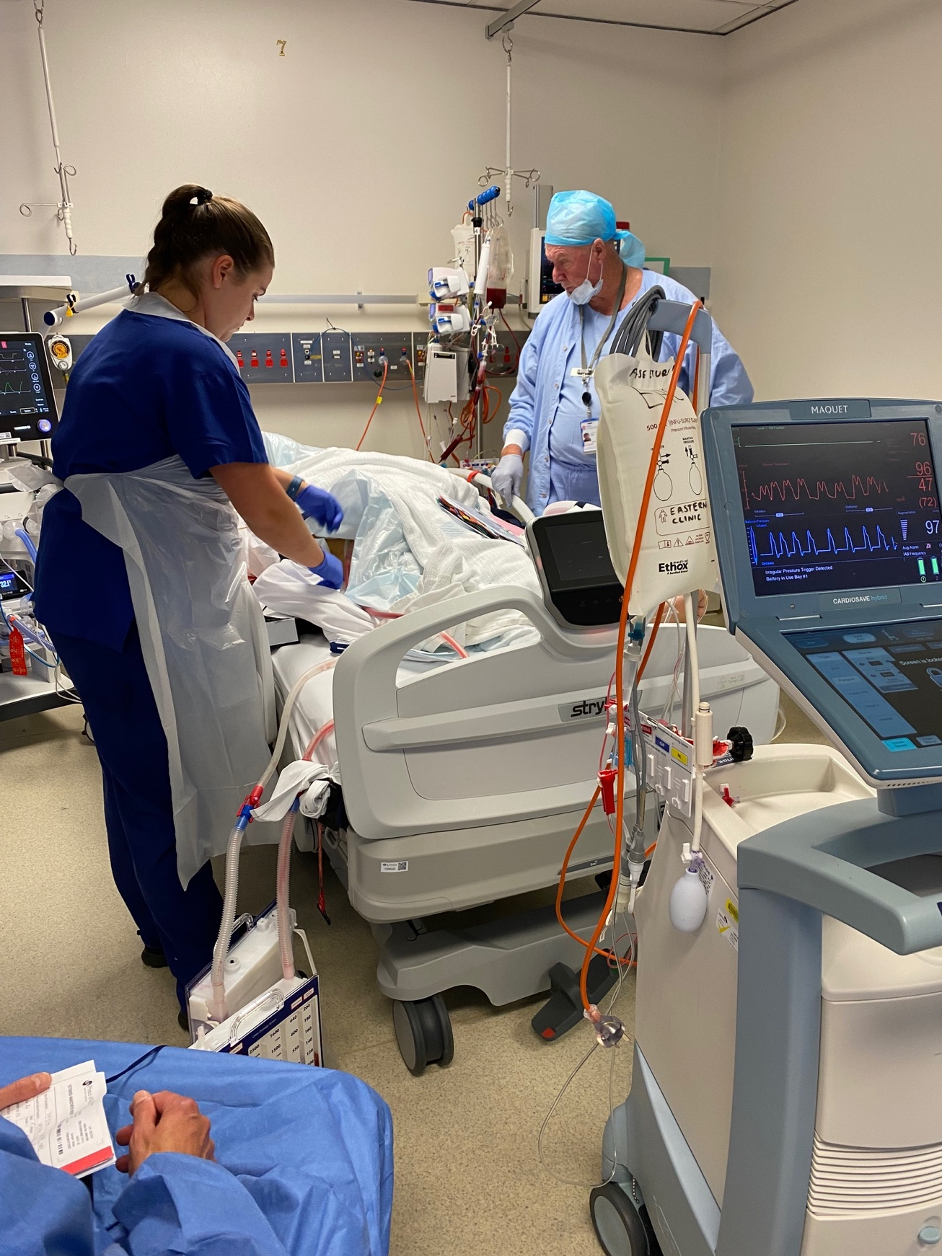

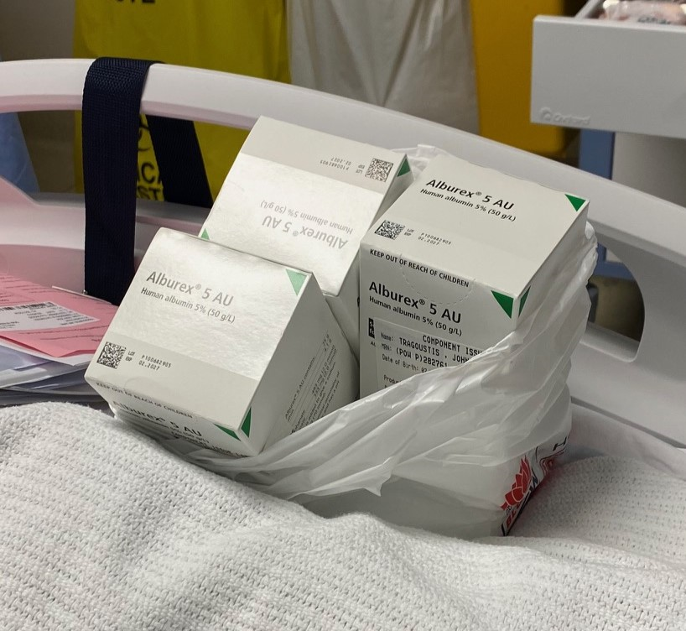

Rationale for albumin
Frequently used volume expander
An attempt to offset vasopressors
Minimises postoperative fluid balance*
A clinical imperative to consider for albumin replacement in CS
More albumin seems desirable
*Wigmore et al. Intensive Care Med (2024); Pesonen et al. JAMA (2022);

Slide 19

Recent guidelines on the use of IV albumin in critical care, highlighted the lack of trials in high-risk cardiac surgery patients
Callum et al. CHEST (2024)
A continuous infusion of 20% albumin after high-risk cardiac surgery reduces the risk of postoperative AKI
H₁
Notes:
we also expected that this would improve the resuscitation of the patient and reduce vasopressor requirements

Slide 20


Trial design
Multicentre, open-label, parallel-group randomised controlled trial
Inclusion criteria
Any of:
1. Combined cardiac surgery
2. Surgery on the thoracic aorta
3. Any cardiac surgery with eGFR <60ml/min/1.73m²
Exclusion criteria
Admitted to ICU > 6h post surgery
eGFR <15ml/min/1.73m²
Albumin < 20g/l
Dialysis dependent / transplant
Off-pump surgery
ECMO / VAD

Slide 21

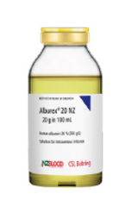

Randomisation and Intervention
Prior consent from participant or SDM
Web randomisation, stratified by site and
eGFR <60 or ≥60ml/min/1.73m²
20% albumin
vs
Usual care
  20 ml/h infusion over 15 hours

Slide 22

Primary outcome
The occurrence of AKI during the first 7 days after surgery
Overall and in those with eGFR>60 or <60ml/min/1.73m²
Using creatinine-based KDIGO criteria
KDIGO creatinine criteria
Stage I | 1.5-1.9 times baseline; OR ≥0.3mg/dL (≥26.5umol/L) increase in 48h
Stage II | 2.0-2.9 times baseline; OR
Stage III | 3 times baseline; OR Increase to ≥4.0g/dL (≥353.6umol/L); OR Initiation of RRT

Slide 23

Secondary outcomes
Major Adverse Kidney Events (MAKE) at day 28
  composite of AKI stage ≥ 2, RRT, mortality
AKI stage II or III
RRT
Hospital mortality
Hospital and ICU LOS
Duration of mechanical ventilation
Vasopressor/inotrope free days at day 14

Slide 24

Tertiary and safety outcomes
Serum albumin level at 24h
Fluid balance at D2
Blood transfusion requirements at D2
Fluid overload
Reintubation
Re-admission to ICU
Arrhythmias resulting in significant CV compromise

Slide 25



Statistical principles
Sample size
Assumed AKI in controls 30%
620 participants to detect 10% difference
  ɑ=0.05, 80% power, 5% inflation for dropouts
mITT = All consented patients – ineligible participants
Primary outcome
Adjusted for site and eGFR → relative risk (95% CI)
  Generalized linear mixed models with a binomial distribution and log link

Slide 26

Prespecified sub-groups
Baseline eGFR >60 vs <60 ml/min/1.73m²
Patient age, above vs below median
Diabetes status, yes vs no
Preoperative use of ARB/ARA or ACEi, yes vs no
Sex, male vs female
Cardiopulmonary bypass time >120 minutes vs <120 minutes
Left ventricular function, moderate to severe dysfunction vs normal
Site and region, Australian sites vs Italian site

Slide 27
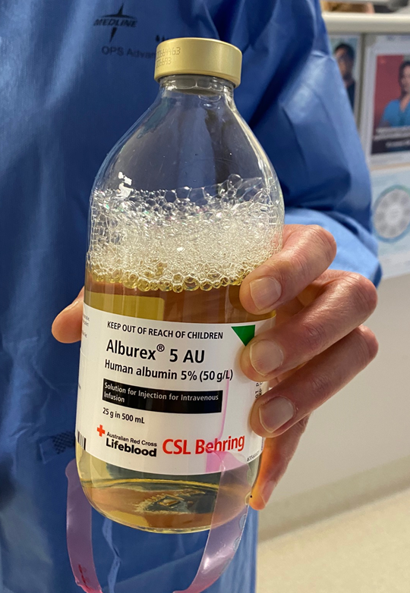


Sensitivity analysis
For the primary outcome:
Exclusion of usual care patients who received ≥ 500ml iso-oncotic albumin by D2

Slide 28
Results

Slide 29
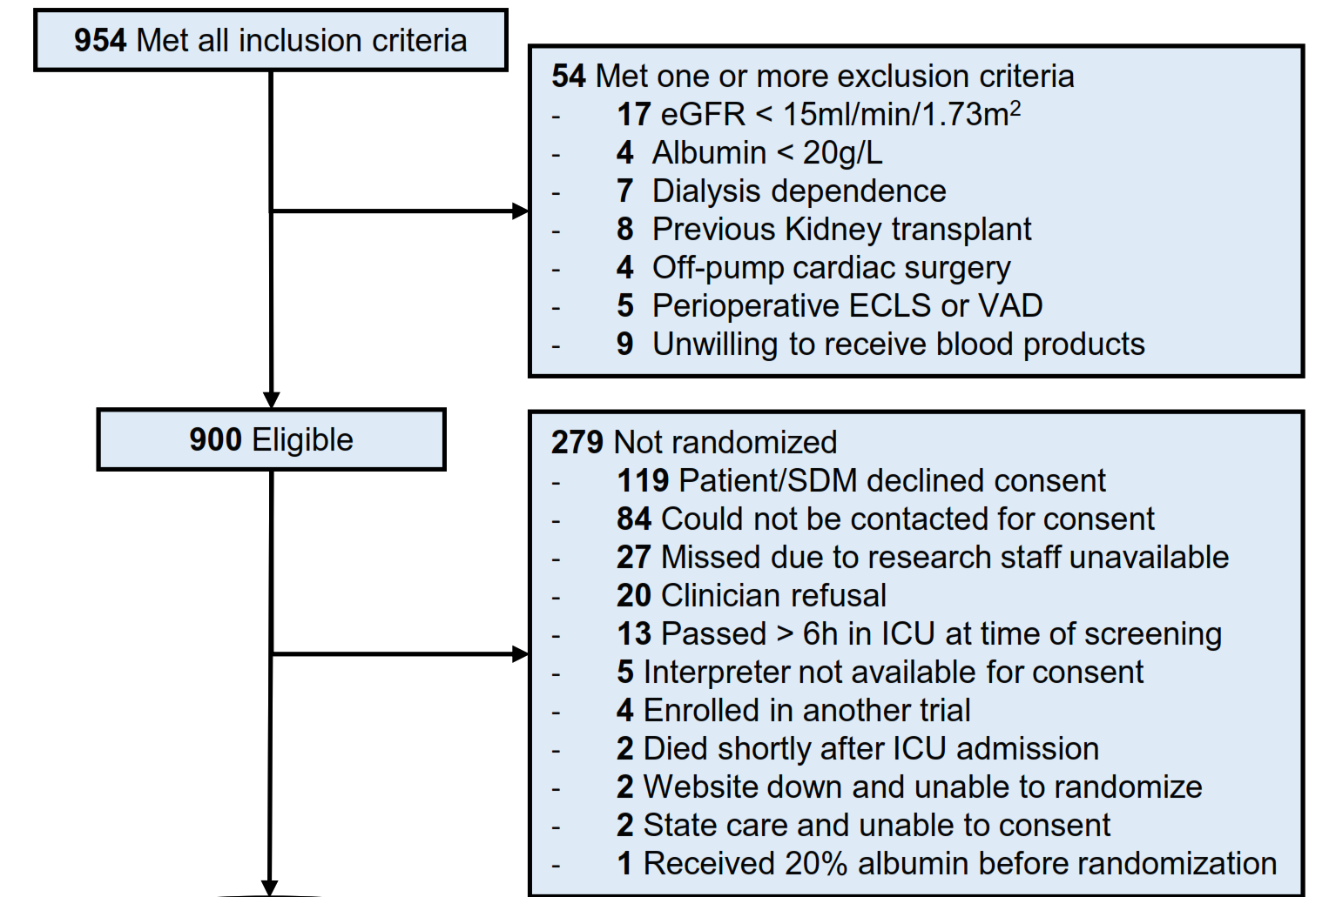
Participants
Met all inclusion criteria 954
Total excluded 54
  Main exclusion eGFR < 15 ml/min/1.73m²
  Total eligible 900
Not randomised 279
  Declined consent 119
  Could not be contacted 84
Total randomised 621
  281 eGFR < 60 ml/min/1.73m²
621 Randomised
281 eGFR < 60

Slide 30
Patient characteristics
Co-morbidities
Demographics
Severity Indexes
20% Albumin Usual Care
Hypertension | 74.6% | 73.4%
Diabetes mellitus | 26.7% | 32.2%
History AMI | 13.7% | 16.1%
Angio within 7d | 12.7% | 12.5%
COPD | 6.8% | 10.2%
PVD | 6.5% | 6.3%
Previous CVA | 4.6% | 4.3%
LVEF = Normal | 68.5% | 70.4%
LVEF = Mild | 15.9% | 15.3%
LVEF = Moderate | 9.6% | 8%
LVEF = Severe | 6% | 6.3%
 | 20% Albumin | Usual Care
Age | 69.1 (11) | 68.9 (10.6)
Male | 70.7% | 74.7%
Weight | 81.7 (19) | 83 (19.1)
 | 20% Albumin | Usual Care
ASA IV (%) | 74.9% | 74.3%
APACHE III | 50.7 (15.1) | 51.8 (14.4)
EuroSCORE II | 3.2 [1.9-5.2] | 3.3 [1.9-5.3]
Regular Medications prior to ICU admission 20% Albumin Usual Care

Slide 31
Patient characteristics
CV Support end CBP
Renal data
Operative Data
20% Albumin Usual Care
Epinephrine | 24.1% | 23.7%
Dobutamine | 19.5% | 15.1%
Levosimendan | 2.6% | 2%
Milrinone | 7.8% | 7.9%
Norepinephrine | 73.6% | 72%
Dopamine | 1.0% | 0%
Vasopressin | 2.6% | 2.3%
Phenylephrine | 0.3% | 0.7%
IABP | 2% | 3%
Intraoperative filtration | 2.6% | 2.3%
 | 20% Albumin | Usual Care
Sr Cr | 100 (33.3) | 103 (36.8)
eGFR >90 | 14.3% | 17.8%
eGFR <60 | 46.2% | 45.7%
eGFR# | 61 (16.7) | 59.4 (17.7)
Album g/l | 37.2 (4.7) | 36.4 (5.4)
Hb g/l | 132 (18.5) | 130 (19.7)
 | 20% Albumin | Usual Care
CABG only | 20.8% | 22%
CABG + Valve | 36.8% | 34.5%
Multiple valves | 15.3% | 11.5%
Aortic surgery | 26.4% | 33.2%
CBP time min | 137 (49.6) | 138 (56.4)
X-clamp min | 105 (40.5) | 106 (45.6)
End CPB Ht% | 30.4 (5.0) | 30.5 (5.1)
# Excluding eGFR>90
Intraoperative fluids 20% Albumin Usual Care

Slide 32
Process Outcomes

Slide 33
Postoperative fluids to the end of D2
P<0.0001
P<0.0001
P=0.04

Slide 34
Postoperative fluids by D2
20% albumin (Study Intervention)
98 % patients received full dose in intervention arm
2.3% usual care received some 20% albumin

Slide 35
Safety Outcomes

Slide 36
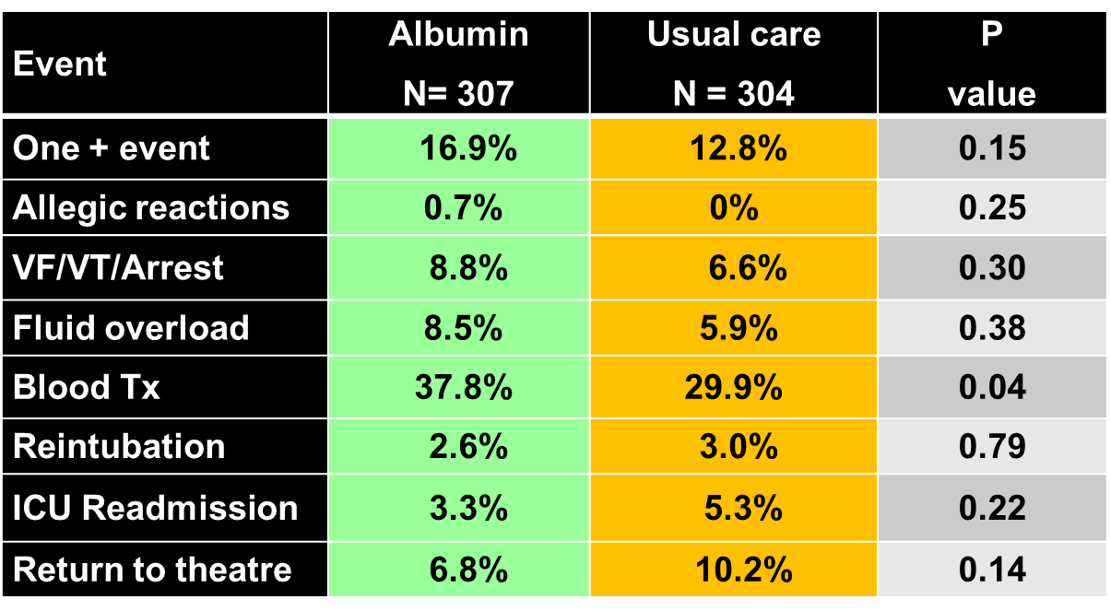
Safety outcomes (% of patients)

Slide 37
Primary Outcome

Slide 38




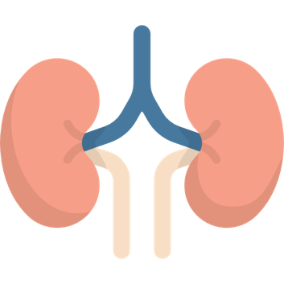

KDIGO defined AKI I-III
48.9%
43.4%

Slide 39
KDIGO defined AKI I-III

Slide 40
KDIGO defined AKI I-III

Slide 41
Event | Albumin N (307) | Usual care N (304) | Risk Diff (95% CI) | Unadj RR (95% CI) | Adj RR # (95% CI) | Adj RR P value
AKI I to III | 150/307 (48.9%) | 132/304 (43.4%) | 5.4% (-2.5 to 13.3) | 1.13 (0.95 - 1.34)
AKI I to III eGFR ≥ 60 | 56/165 (33.9%) | 52/165 (31.5%) | 2.4% (-7.7 to 12.5) | 1.08 (0.79 - 0.47)
AKI I to III eGFR < 60 | 94/142 (66.2%) | 80/139 (57.6%) | 8.6% (-2.7 to 20) | 1.15 (0.96 - 1.38)

Slide 42
Event | Albumin N (307) | Usual care N (304) | Risk Diff (95% CI) | Unadj RR (95% CI) | Adj RR (95% CI) | Adj RR P value
AKI I to III | 150/307 (48.9%) | 132/304 (43.4%) | 5.4% (-2.5 to 13.3) | 1.13 (0.95 - 1.34) | 1.12 # (1.04-1.21) | 0.003
AKI I to III eGFR ≥ 60 | 56/165 (33.9%) | 52/165 (31.5%) | 2.4% (-7.7 to 12.5) | 1.08 (0.79 - 0.47)
AKI I to III eGFR < 60 | 94/142 (66.2%) | 80/139 (57.6%) | 8.6% (-2.7 to 20) | 1.15 (0.96 - 1.38)
# Adjusted for site and baseline eGFR

Slide 43
Event | Albumin N (307) | Usual care N (304) | Risk Diff (95% CI) | Unadj RR (95% CI) | Adj RR # (95% CI) | Adj RR P value
AKI I to III | 150/307 (48.9%) | 132/304 (43.4%) | 5.4% (-2.5 to 13.3) | 1.13 (0.95 - 1.34) | 1.12 # (1.04-1.21) | 0.003
AKI I to III eGFR ≥ 60 | 56/165 (33.9%) | 52/165 (31.5%) | 2.4% (-7.7 to 12.5) | 1.08 (0.79 - 0.47) | 1.07 (0.83-1.38) | 0.59
AKI I to III eGFR < 60 | 94/142 (66.2%) | 80/139 (57.6%) | 8.6% (-2.7 to 20) | 1.15 (0.96 - 1.38) | 1.14 (1.07-1.22) | <0.0001
# Adjusted for site and baseline eGFR
Notes:
RR driven by patients with eGFR < 60

Slide 44
1.12 (1.04-1.21) | P=0.003
1.07 (0.83-1.38) | P=0.59
1.14 (1.07-1.22) | P<0.0001

Slide 45
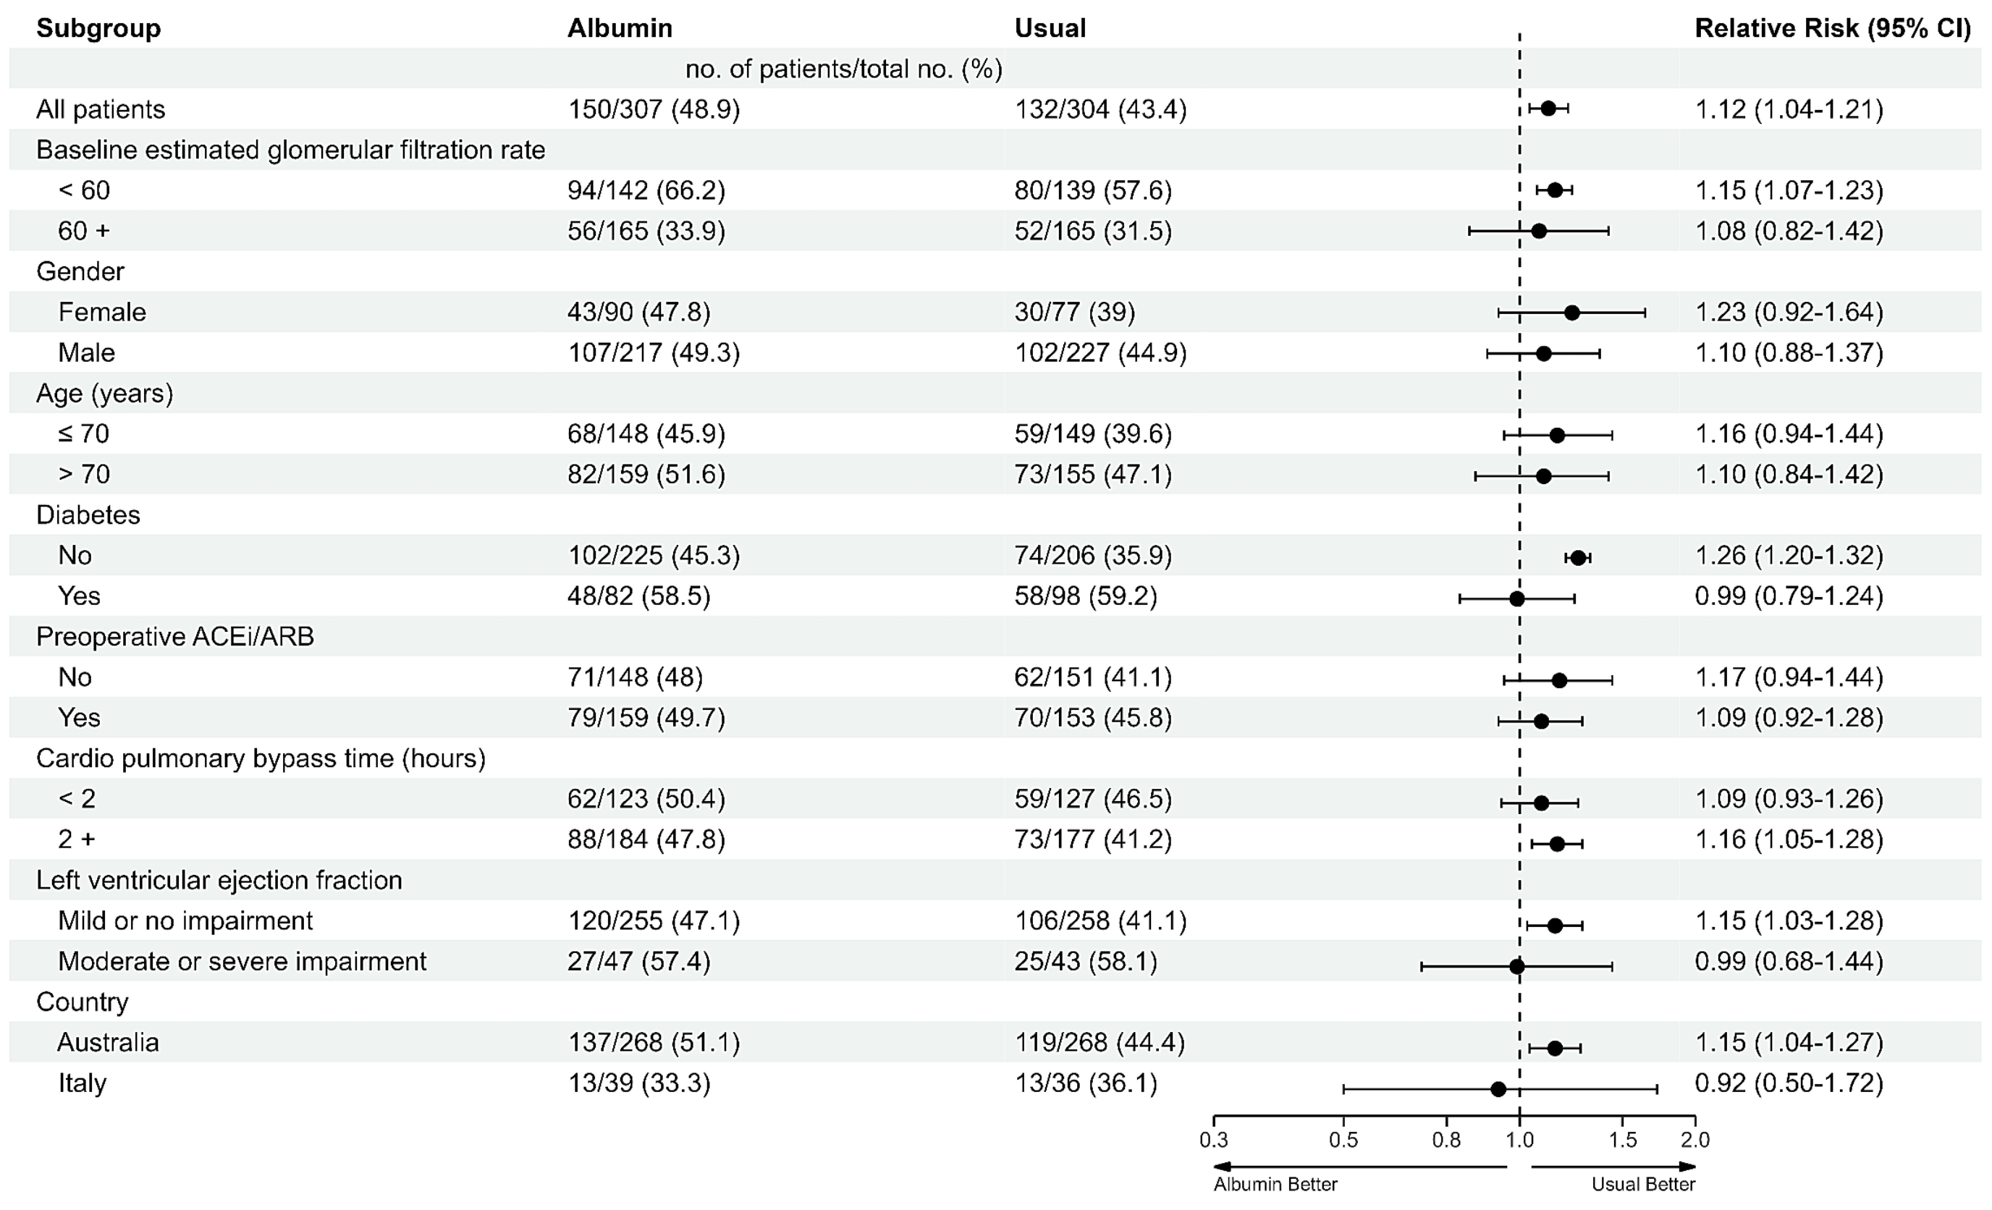
Prespecified subgroups
care
Notes:
No p due to multiple comparisons
No statistical evidence of heterogeneity between subgroups including diabetes, despite the result. May have been underpowered for diabetes subgroup

Slide 46
Planned sensitivity analysis
Effect of any albumin on the primary outcome
  Excluding patients in the usual care arm who received ≥ 500 ml of iso-oncotic albumin by the end of D-2 after surgery

Slide 47
Effect of albumin on the primary outcome
Event | Albumin N (307) | Usual care N (104) | Unadj RR (95% CI) | Adj RR (95% CI) | Adj RR P value
AKI I to III | 150/307 (48.9%) | 45/104 (44.2%) | 1.10 (0.87-1.41) | 1.14 # (1.01-1.30) | 0.04
AKI I to III eGFR ≥ 60 | 56/165 (33.9%) | 17/57 (29.8%) | 1.14 (0.72-1.79) | 1.28 (1.02-1.62)
AKI I to III eGFR < 60 | 94/142 (66.2%) | 29/47 (61.7) | 1.07 (0.83-1.38) | 1.07 (0.95-1.21)
# Adjusted for site and baseline eGFR

Slide 48
Secondary Outcomes

Slide 49
Secondary
outcomes
Event | Albumin N (307) | Usual care N (304) | Adj RR # (95% CI)
MAKE @ D-28 | 10.7% | 9.5% | 1.13 (0.81-1.56)
MAKE @ D-28 eGFR ≥ 60 | 17/165 (10.3%) | 18/165 (10.9%) | 0.94 (0.67-1.33)
MAKE @ D-28 eGFR < 60 | 16/142 (11.3%) | 11/139 (7.9%) | 1.43 (0.84-2.43)
Mortality @ D-28 | 2% | 0.7% | 2.55 (1.05-6.24)
CRRT to D-28 | 3.3% | 2.3% | 1.41 (0.79-2.49)
Sustained AKI II/III | 9.1% | 9.2% | 0.99 (0.69-1.42)
# Adjusted for site and baseline eGFR

Slide 50
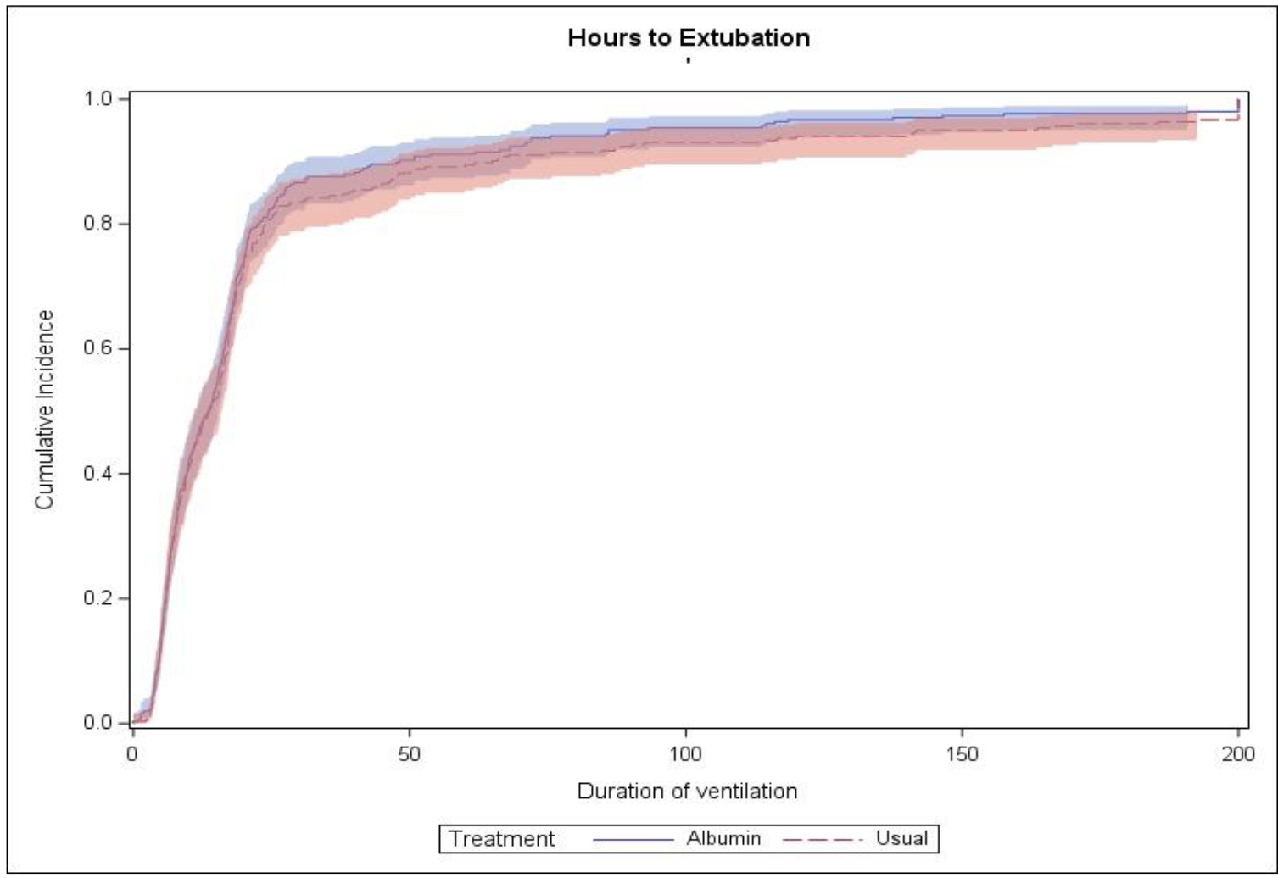
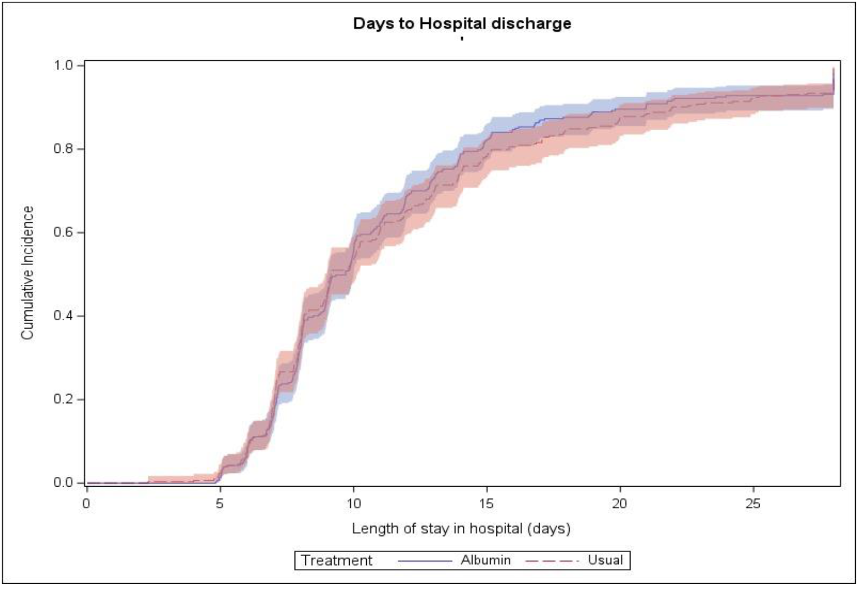
Secondary outcomes:
Time to extubation & Hosp LOS
Adjusted hazard ratio 1.11 (0.94 to1.30)
20% Albumin vs usual care
Adjusted hazard ratio 1.02 (0.87 to 1.20)
20% Albumin vs usual care

Slide 51
Daily pressors and inotropes % patients

Slide 52
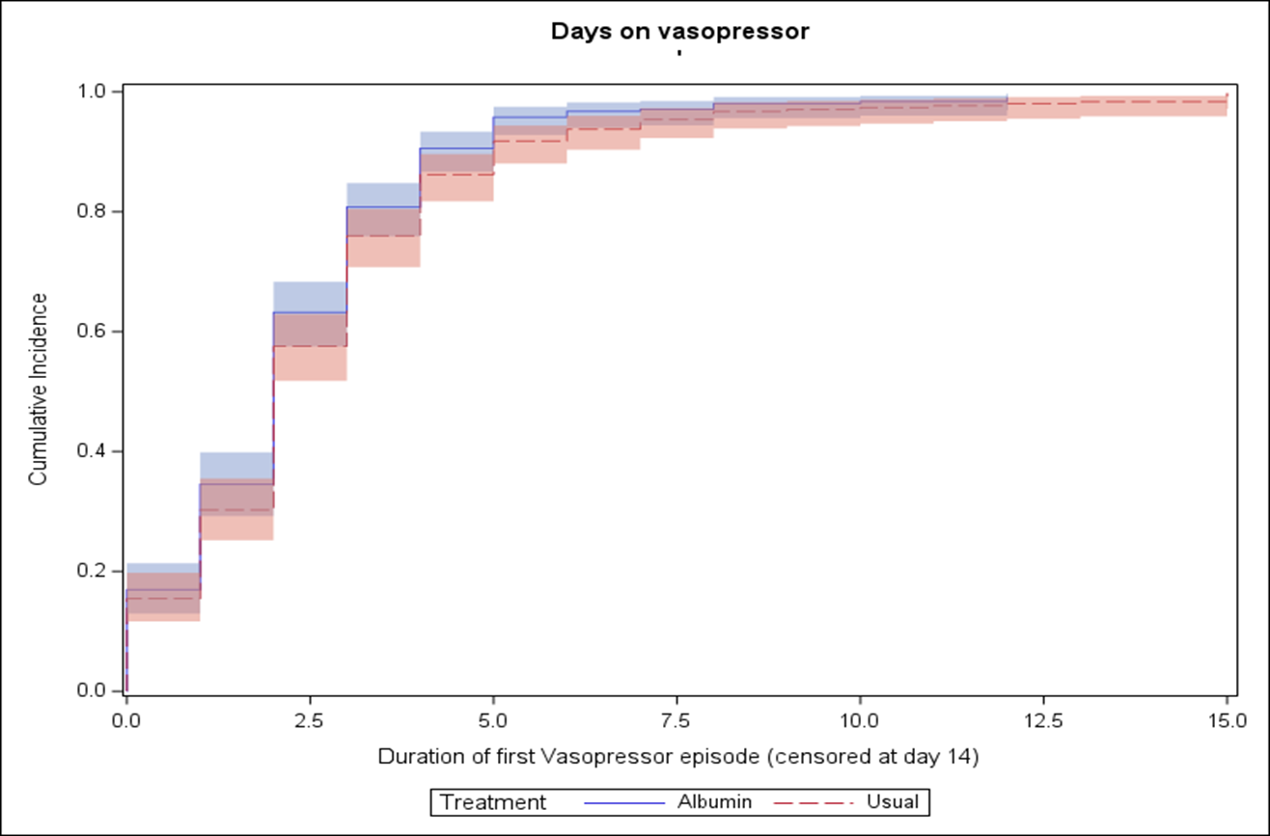
Pressors and inotropes up to D-14
Vasopressors free days @14-D
Median [IQR] Days
20% Alb 12 [11-13] vs 12 [10-13]
Adj HR 1.0 (-0.57 to 0.57)
Duration of first Vasopressor episode (censored at day 14)
Median [IQR] 2 [1-3]
in both groups
Adjusted HR (95% CI) for risk of vasopressor weaning,
20% Albumin vs usual care
Adj HR 1.14 (0.99-1.3)
Adj P = 0.06

Slide 53
Why and how ?

Slide 54
Population ?
Timing of the intervention ?
Dose given ?
Is 20% albumin toxic ?
Intrinsic renal mechanisms ?
Site variability in kidney protection ?

Slide 55
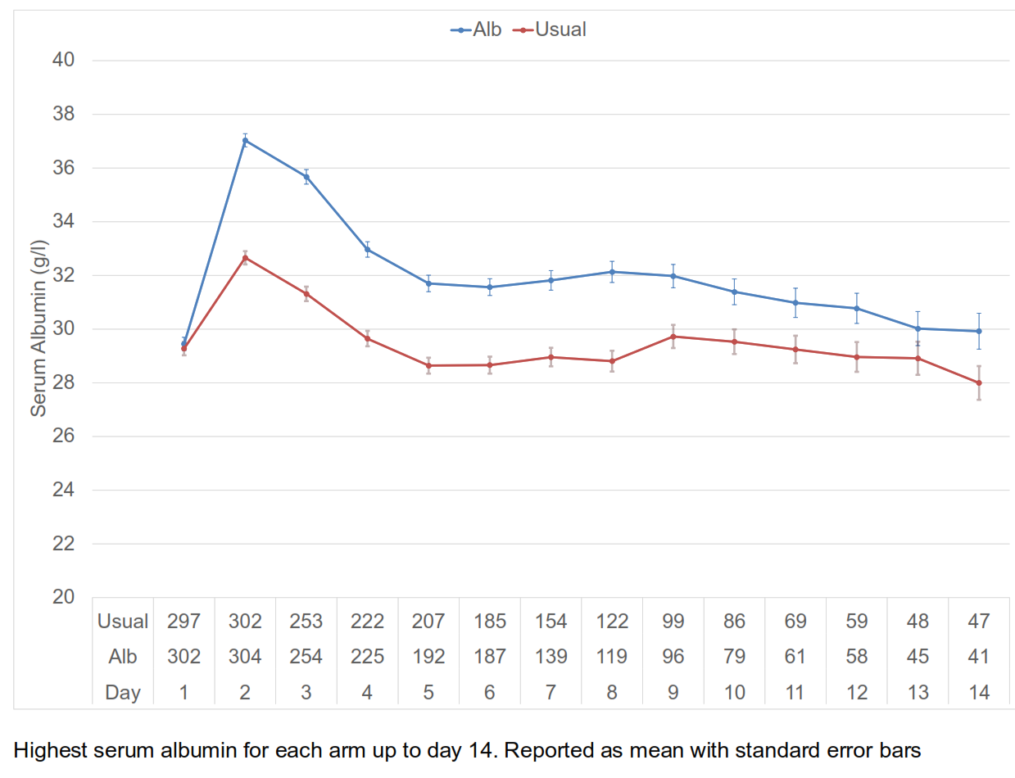
Albumin level – the first 14 days

Slide 56
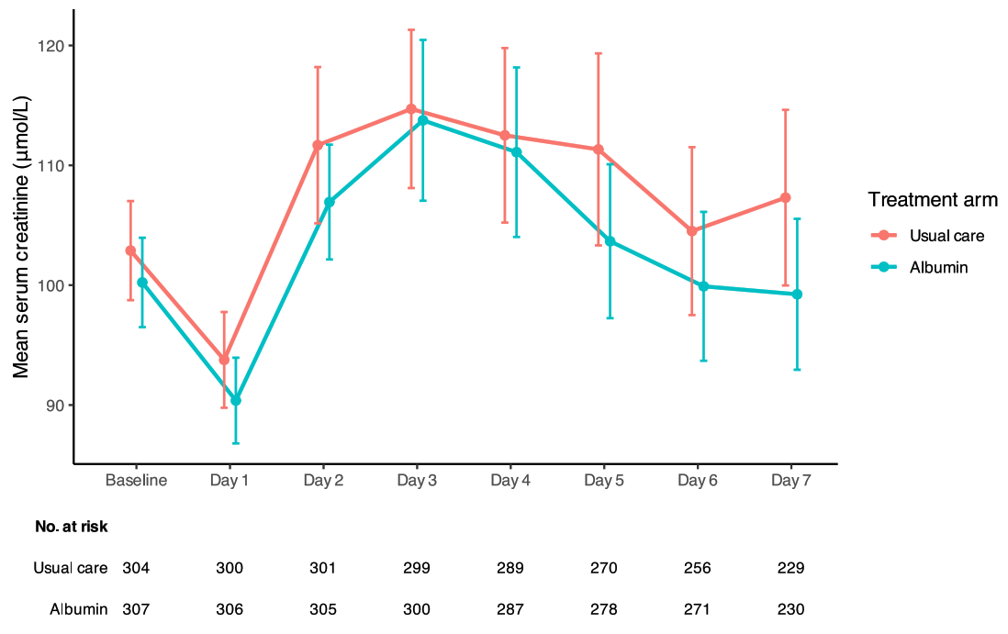
Mean (SE) of daily creatinine
Days 1-7

Slide 57
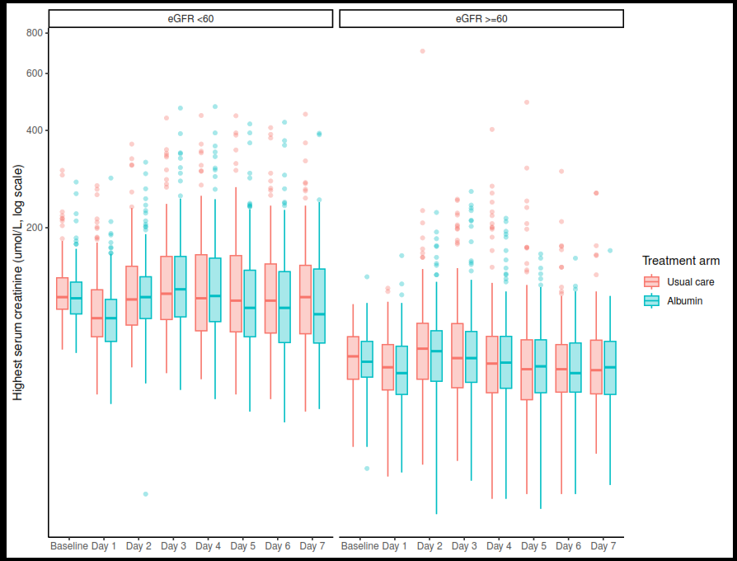
Box Plot of daily creatinine
Days 1-7
Patients that triggered AKI were outliers with
very high early creatinine
Notes:
May be there is a group of patients that do better with albumin and a group that do much worse that we failed to identify

Slide 58
Post hoc analysis
Association with serum albumin
No association between serum albumin during days 1-2 and outcome of AKI
Adjusted analysis also ruled out starting serum albumin as a significant covariate in post op AKI
The harm observed may not be related to serum concentration of albumin but rather an independent mechanism

Slide 59
Prespecified subgroups
care
Notes:
No p due to multiple comparisons
No statistical evidence of heterogeneity between subgroups including diabetes, despite the result. May have been underpowered for diabetes subgroup

Slide 60
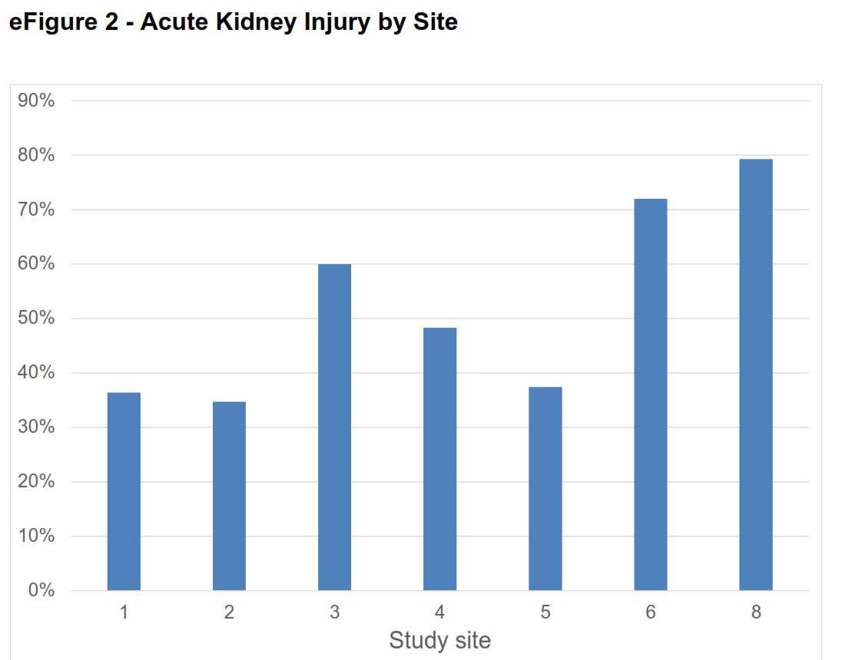
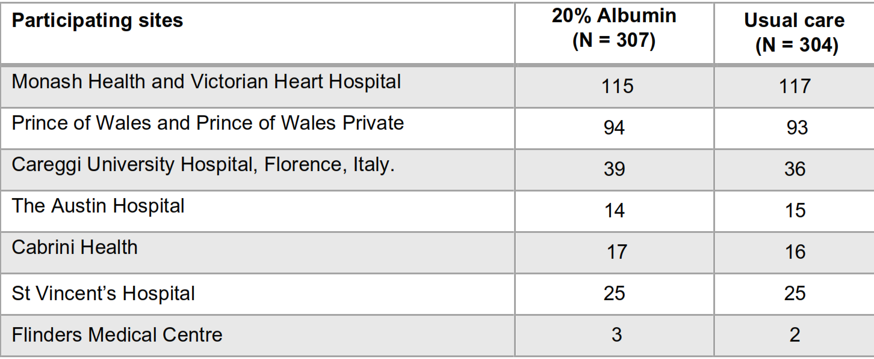
Recruitment numbers by site

Slide 61
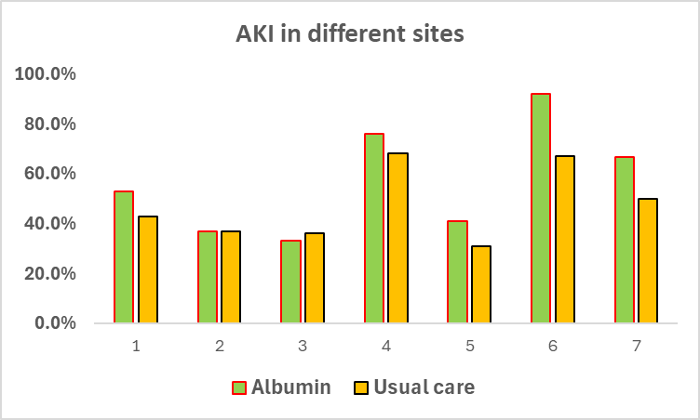
Significant site variability
Notes:
Sites 4 and 6 recruited 36 patients and 23 patients respectively

Slide 62
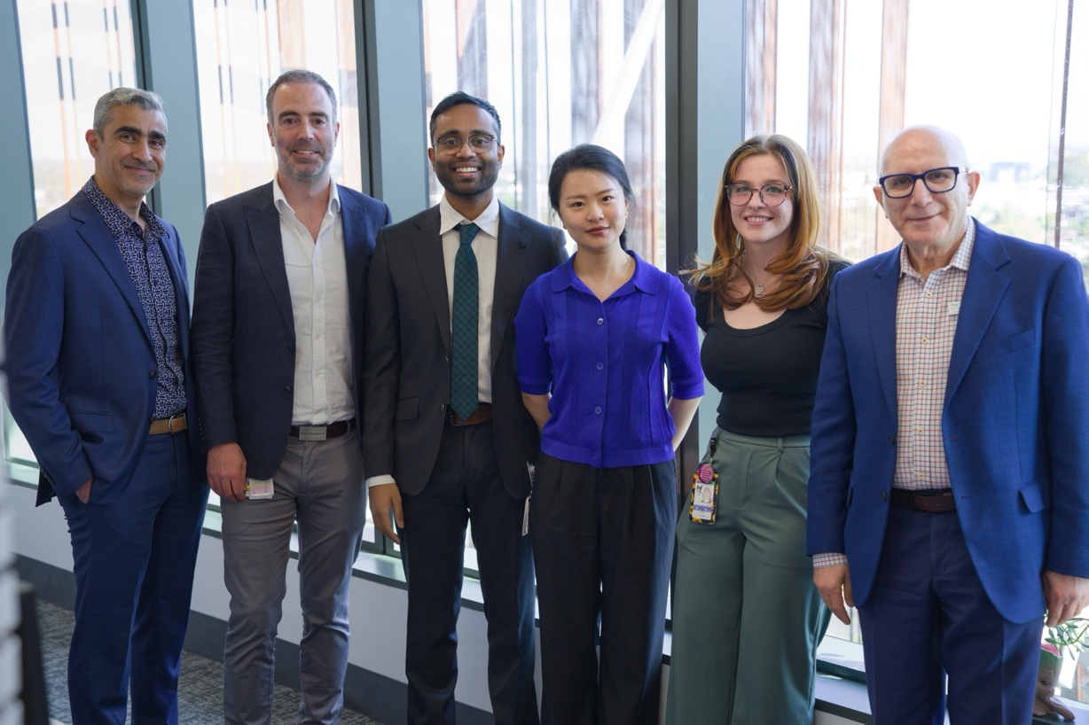
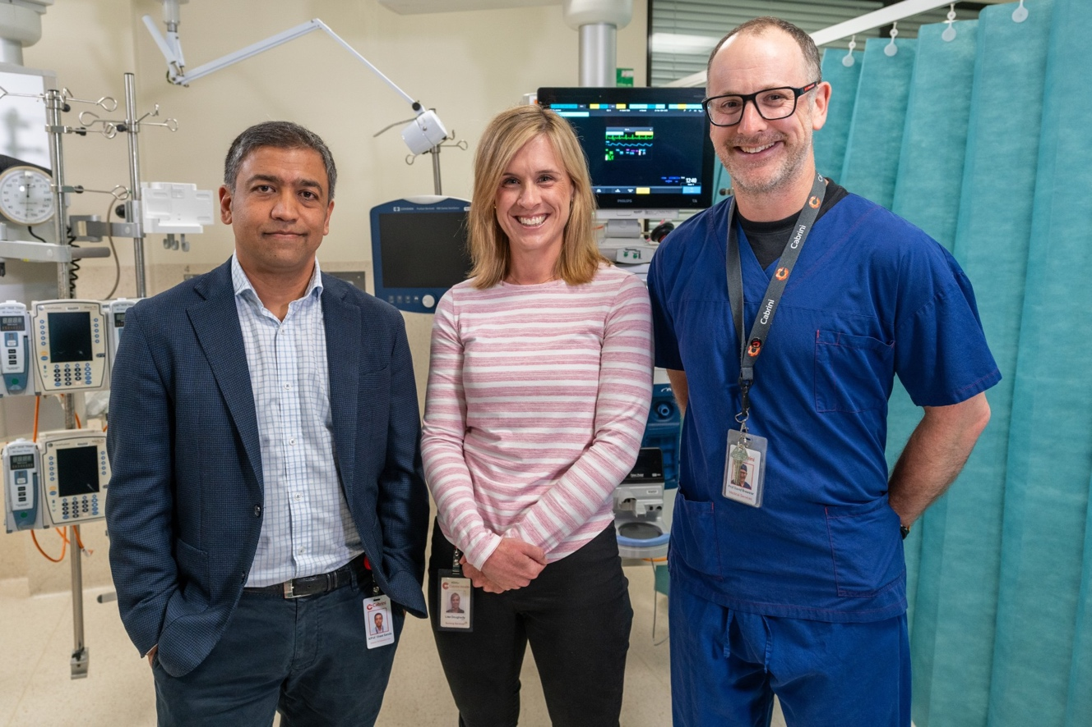
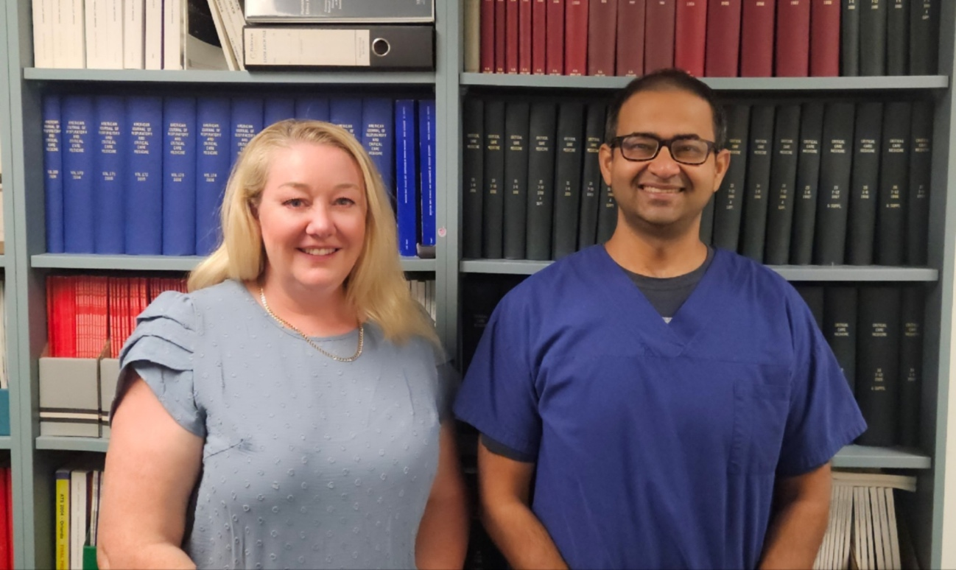
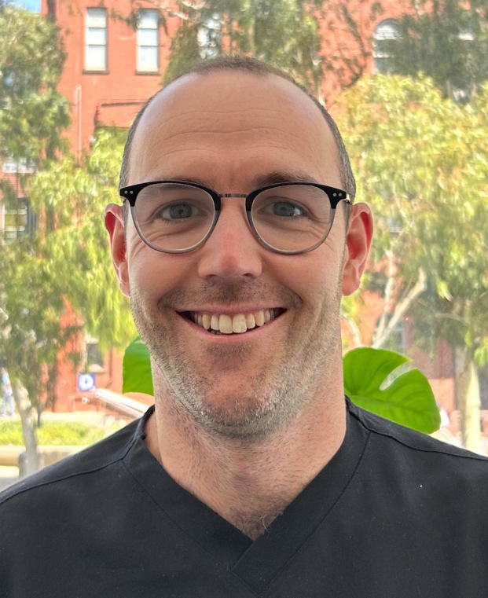

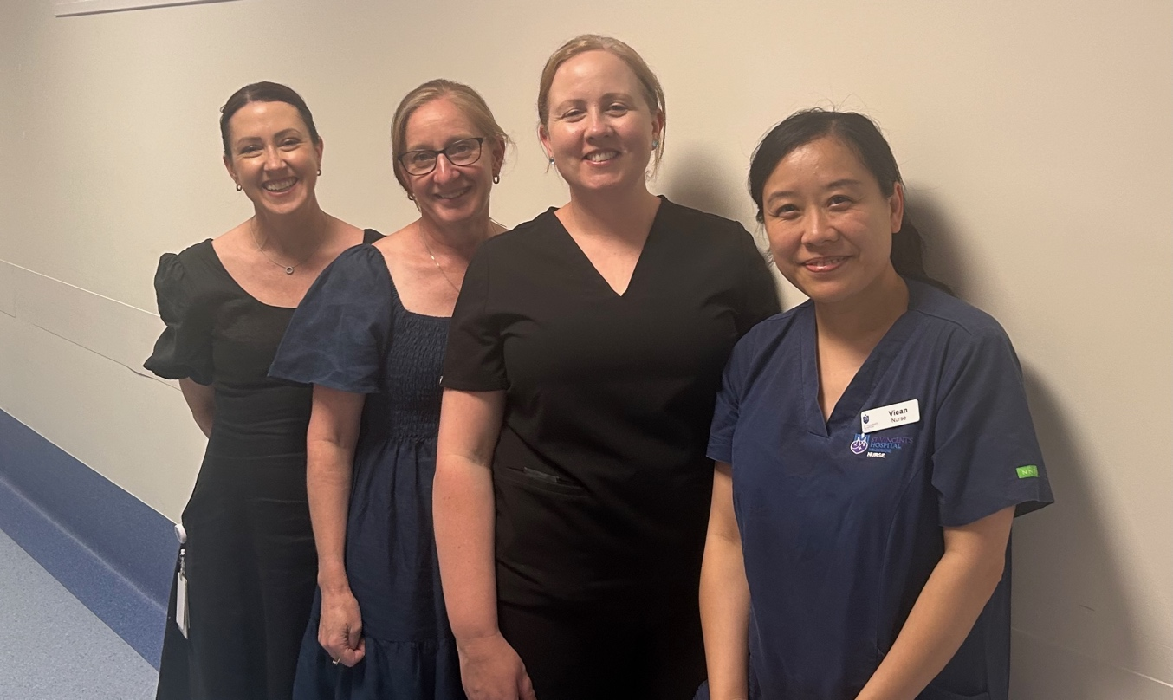
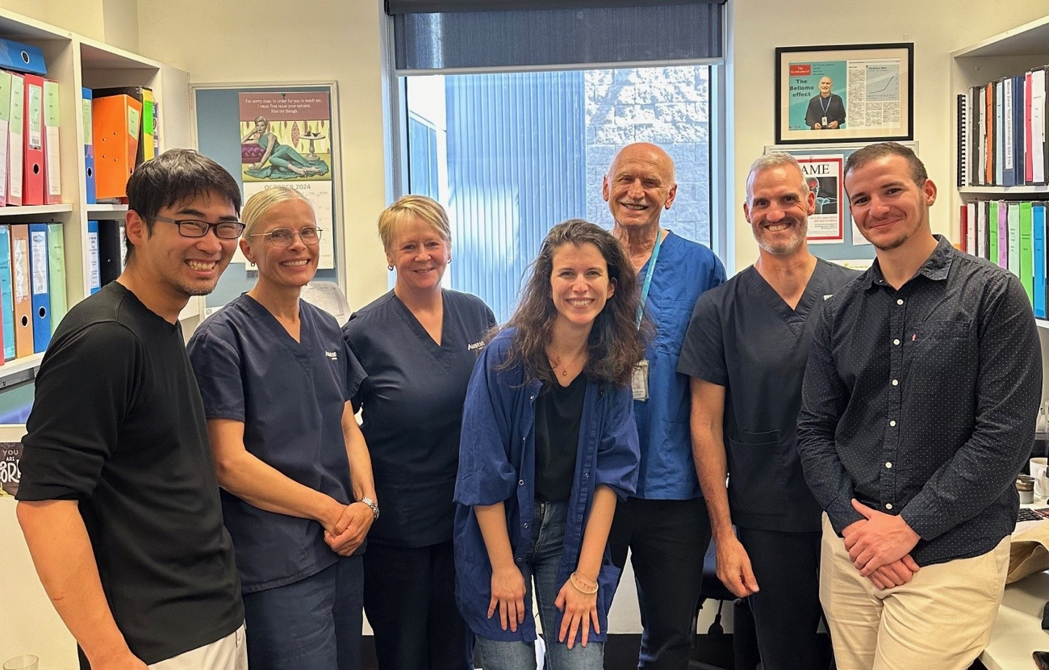
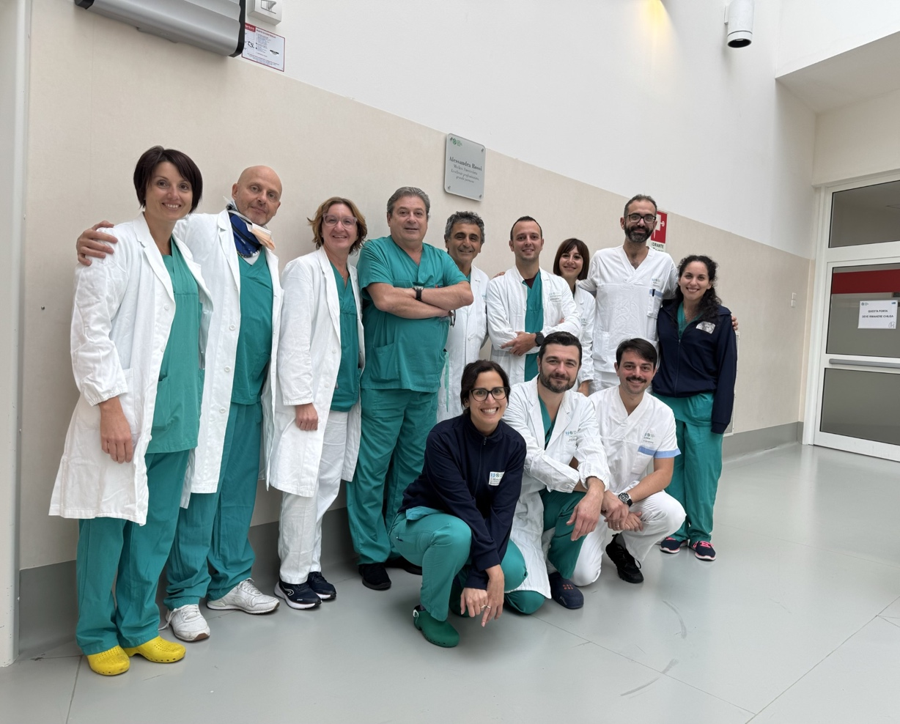
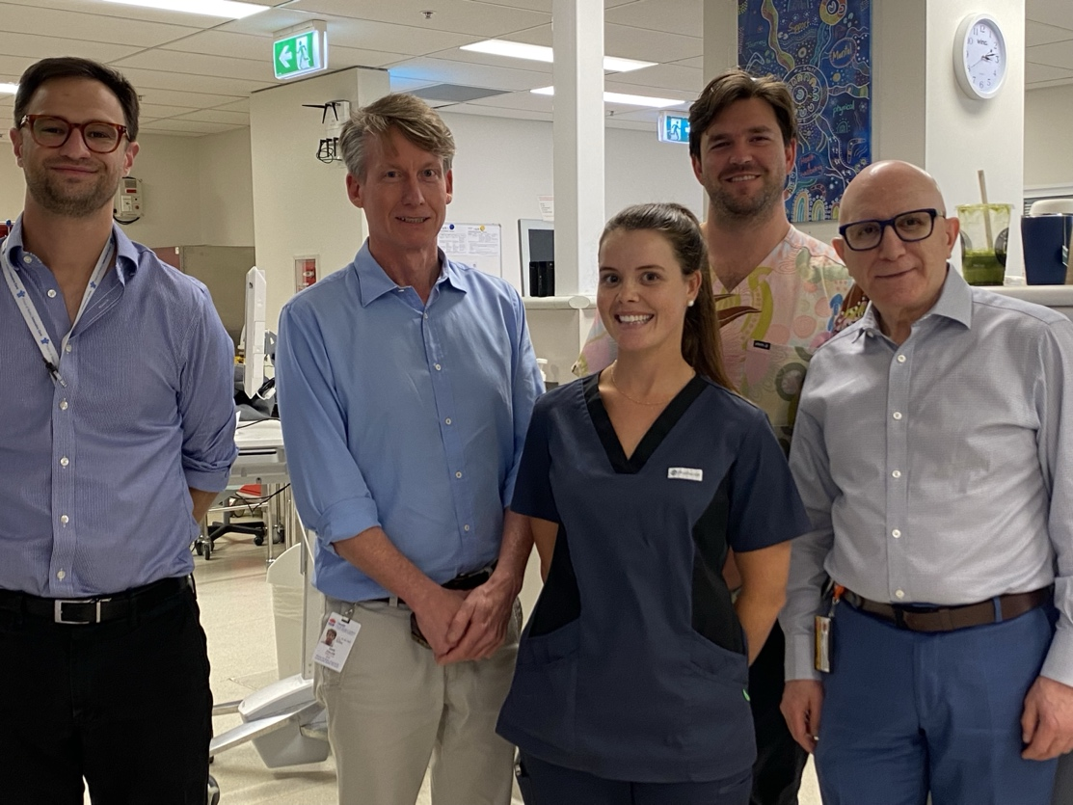

Photos of all sites teams

Slide 63


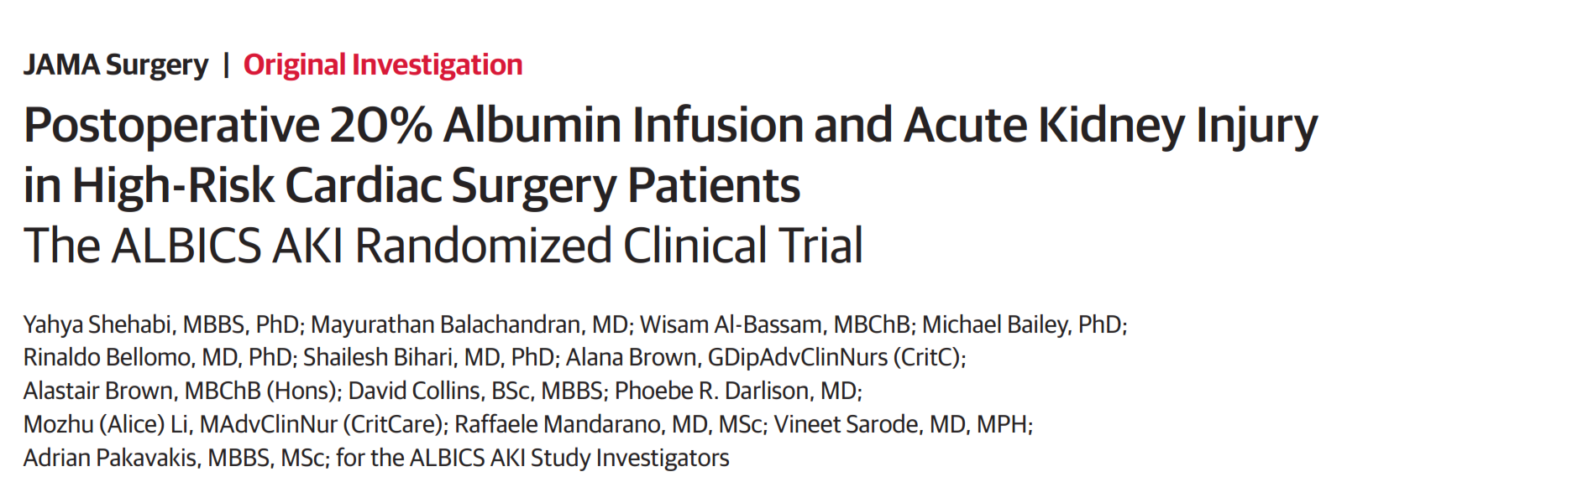

Slide 64
Excess transfusion with albumin – Why?
Seems to be related to the albumin concentration
  Aspirin resistance with low serum albumin
  Increased thrombogenicity
The use of viscoelastic assays in cardiac surgery
  Hb trigger
  Influence transfusion practice
Albumin
  Haemodilution of clotting factors
  Impair platelet aggregation
  inactivate thrombin and platelet activation

