Slide 1

The HEMOTION trial
Alexis F. Turgeon MD MSc FRCPC
Professor, Department of Anesthesia and Critical Care Medicine, Université Laval, Québec City, Québec, Canada
Canada Research Chair in Critical Care Neurology and Trauma

Slide 2
















Academic Disclosures and Acknowledgements

Slide 3
Trial management
Executive Committee
Alexis Turgeon, Dean Fergusson, François Lauzier,
Marie-Pier Patton, Lucy Clayton
Steering Committee
Lucy Clayton, Marie-Pier Patton, Timothy S. Walsh, Annemarie Docherty, Luiz M. Malbouisson, Sébastien Pili-Floury, Shane W. English, Ryan Zarychanski, Lynne Moore, Paule Lessard Bonaventure, Vincent Laroche, Michael Verret, Damon C. Scales, Andreas Kramer, Vanesa Garnelo Rey, Ian Ball, Kosar Khwaja, François Lamontagne, Russell Chabanne, Almunder Algird, Andrea Rigamonti, Karen E. A. Burns, John Marshall, Donald E. Griesdale, Demetrios James Kutsogiannis, Robert Green, Emmanuel Charbonney, Paul C. Hébert, Michael Chassé, Alan Tinmouth, Maude St-Onge, François Lauzier, Dean Fergusson, Alexis Turgeon
Data safety & Monitoring Committee
Darrell Triulzi, chair (University of Pittsburgh), Claude Hemphill (University of California in San Francisco), Jonathan Cook (University of Oxford)

Slide 4
Anemia in critical care
Very common upon admission (60%) and during the ICU stay (85%)
Independent predictor of death in critical illness regardless of admitting diagnosis
  Raasveld et al. JAMA Network 2023
  Vincent et al. Crit Care Med 2018
  Corwin et al. Crit care med 2004
  Vincent et al. JAMA 2002

Slide 5
RBC transfusions in critical care
One large RCT in critically ill adult patients
Restrictive (7.0 g/dL) vs. Liberal (9.0 g/dL) thresholds
  TRICC trial in adults (N=838) (Hébert et al. NEJM 1999)
No beneficial effect on mortality of using higher thresholds
7.0 g/dL became standard threshold

Slide 6
Are TBI patients similar from other critically ill populations ?
Not only about mortality, but about long-term function
The injured brain is vulnerable to hypoxia

Slide 7
The injured brain
Impaired autoregulation
  Incapacity to modify CBF by changing CVR to compensate for changes in CPP
Brain DO₂ = CBF x ([Hb x SaO₂ x 1.39] + [PaO₂ x 0.0031])
Decrease in Hb may impair oxygen delivery to the brain

Slide 8
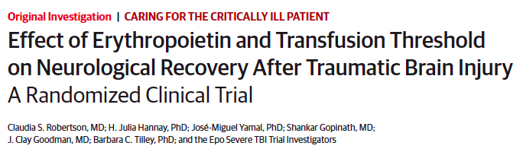
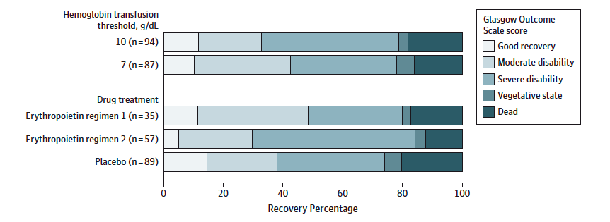
JAMA 2014
Dichotomized GOS
  OR 0.75, 95%CI: 0.36 – 1.55
Limitations
  Two centres / same institution
  Small sample size
  Large expected relative increase in favorable GOS (50%)
  Anemia was not an inclusion criteria
  Several patients did not get the intervention
    70% in the 10.0 g/dL
  Hb levels were not different between groups

Slide 9


Objective
To evaluate whether a liberal RBC transfusion strategy as compared to a restrictive strategy could improve clinically important and patient-centred outcomes in critically ill patients with TBI
  Funded by the Canadian Institutes of Health Research (CIHR)
  Sponsor: CHU de Québec-Université Laval and Université Laval
  ClinicalTrials.gov : NCT03260478

Slide 10
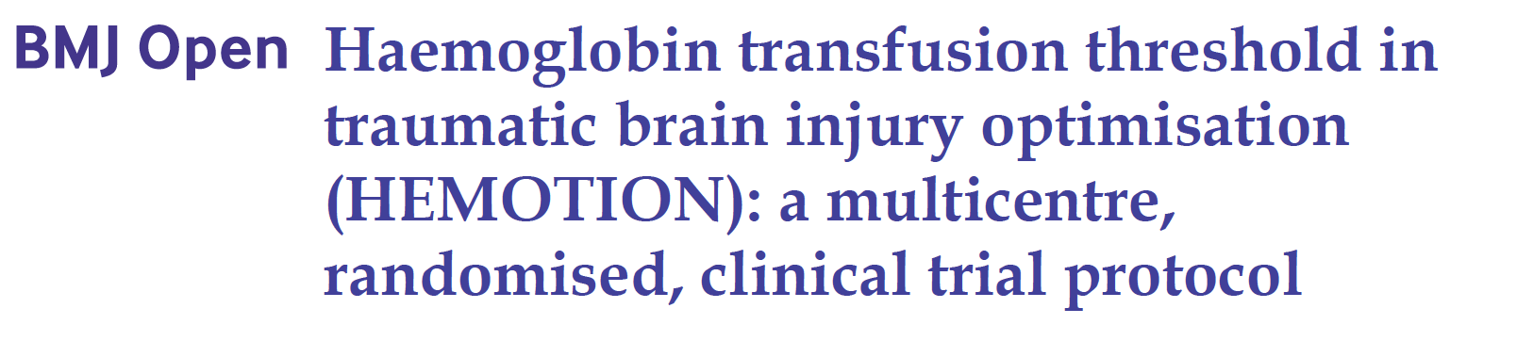
Design/Setting
  Multicenter open-label randomized control trial (Pragmatic Randomized Open Blinded Endpoint)
  34 centres in 4 countries (Canada/UK/France/Brazil)
BMJ Open 2022

Slide 11
Eligibility Criteria
Inclusion criteria
  Adult patients
  Admitted to an ICU
  Acute moderate or severe blunt TBI (Glasgow Coma Score [GCS] ≤ 12)
  Hb level ≤ 10.0 g/dL

Slide 12
Eligibility Criteria
Exclusion Criteria (at time of randomization)
  Active life-threatening bleeding with hemorrhagic shock or active life-threatening bleeding requiring an urgent surgical procedure
  Contraindications or known objection to transfusions
  RBC transfusion initiated after ICU admission (OK if transfused in the ER/OR)
  Brain-based definition of death
  GCS of 3 with bilateral fixed dilated pupils
  Decision to withhold or withdraw life-sustaining therapies
  No fixed address

Slide 13
Interventions
Study groups
  Liberal strategy (threshold of Hb ≤ 10.0 g/dL) or
  Restrictive strategy (threshold of Hb ≤ 7.0 g/dL)
  Transfusion strategy
  Within 3 hours after meeting the transfusion threshold
  A single unit at a time
  Until ICU discharge

Slide 14
Primary outcome measure
Glasgow Outcome Scale extended (GOSe) at 6 months
  1 = Dead
  2 = Vegetative state
  Absence of awareness of self & environment
  3 = Lower severe disability
  Full assistance in activities of daily living
  4 = Upper severe disability
  Partial assistance in activities of daily living
  5 = Lower moderate disability
  Independent, but cannot resume work/school or previous social activities
  6 = Upper moderate disability
  Some disability, but can partly resume work/school or previous social activities
  7 = Lower good recovery
  Minor physical / mental deficits affecting activities of daily living
  8 = Upper good recovery
  Full recovery

Slide 15
Secondary outcome measures
  Overall functional outcome (Functional Independence Measure-FIM)
  Overall quality of life (EQ-5D-5L)
  TBI-specific quality of life (Qolibri)
  Depression scale (PHQ-9)
  Mortality*
  Outcome assessment done centrally at 6 months
  *Mortality also assessed at ICU and hospital

Slide 16
Tertiary outcome measures
  Number of RBC units transfused
  Lowest daily Hb
  Infections
  Duration of mechanical ventilation
  ICU and hospital length of stay
  Outcome assessment done at each site
  No adjudication of tertiary outcomes or adverse events

Slide 17
Sample size
  Based on the proportion of patients with an unfavorable outcome (GOSe ≤ 4)
  712 patients
  Absolute risk reduction of 10%
  40% risk of unfavorable outcome in the restrictive group
  Power of 80% and a type 1 error of 5%

Slide 18
Interim analyses
  Primary outcome
  At 50% of enrolment
  Blinded assessment
  Haybittle-Peto criteria (P<0.001)
  Study metrics
  At 25, 50 and 75% of enrolment
  Pooled data
  DSMC recommended to continue
  Sample size augmented to 742 to account for 2% lost to follow-up

Slide 19
Analytic plan
  Main analysis of the primary outcome
  Sliding dichotomy approach
    Baseline prognostic assessed by the TBI-IMPACT prognostic score
      Age, pupils, GCS motor score, CT scan Marshall score, epidural hematoma, traumatic subarachnoid hemorrhage, hypotension, hypoxemia, Hb, glucose
Notes:
To analyze our primary outcome, we used the sliding dichotomy approach in which we have to calculate the probability of an unfavorable outcome for each patient based on a validated model and split them into distinct categories.

Slide 20
Sliding dichotomy
 | Glasgow Outcome Scale extended (GOSe) at 6 months
 | 1 | 2 | 3 | 4 | 5 | 6 | 7 | 8
 | Dead | Vegetative state | Lower severe disability | Upper severe disability | Lower moderate disability | Upper moderate disability | Lower good recovery | Upper good recovery
Worst prognosis group
Intermediate prognosis group | Unfavorable Outcome |  |  |  | Favorable Outcome
Best prognosis group

Slide 21
Results

Slide 24
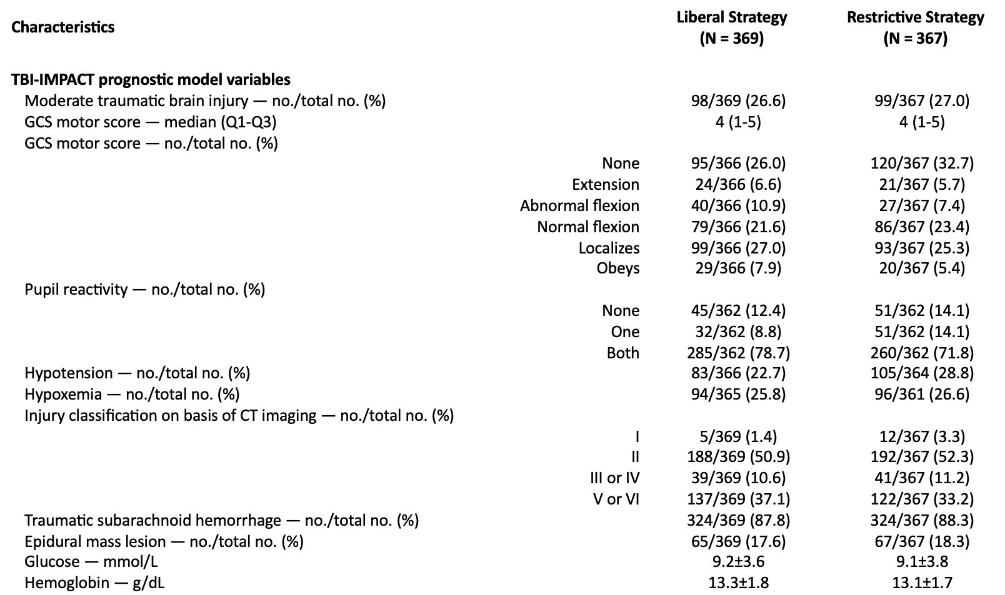
Patient characteristics

Slide 25
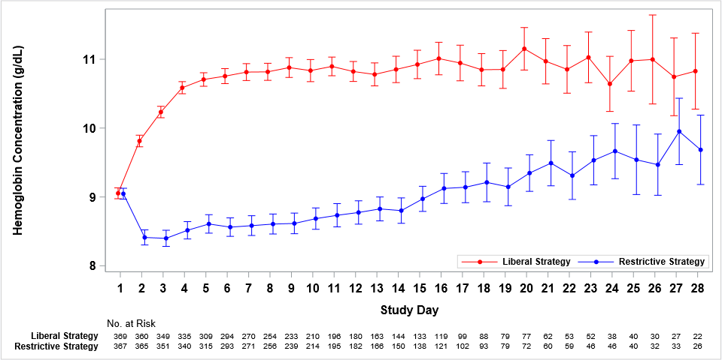
Daily hemoglobin levels

Slide 26
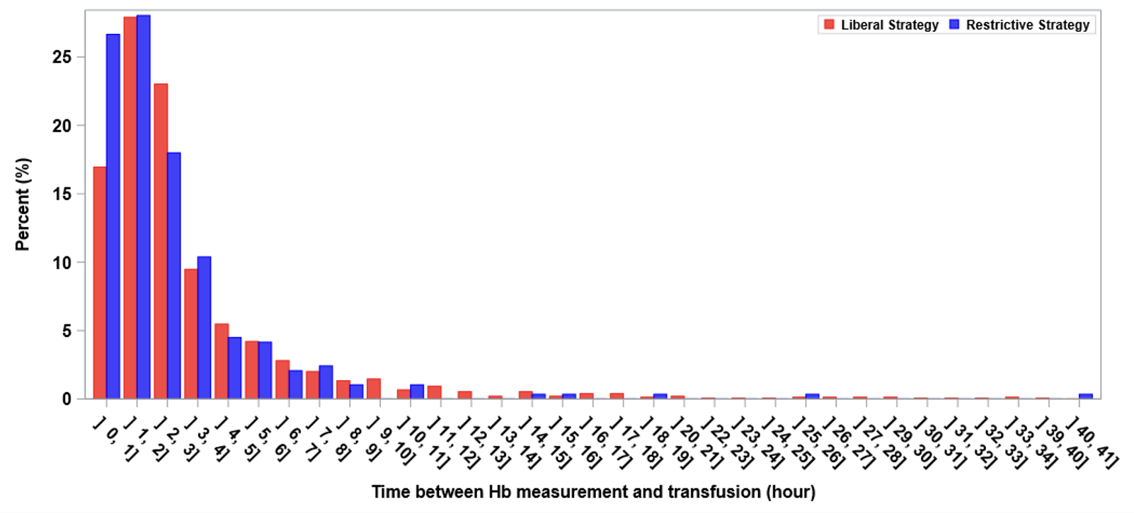
Time to Transfuse

Slide 27
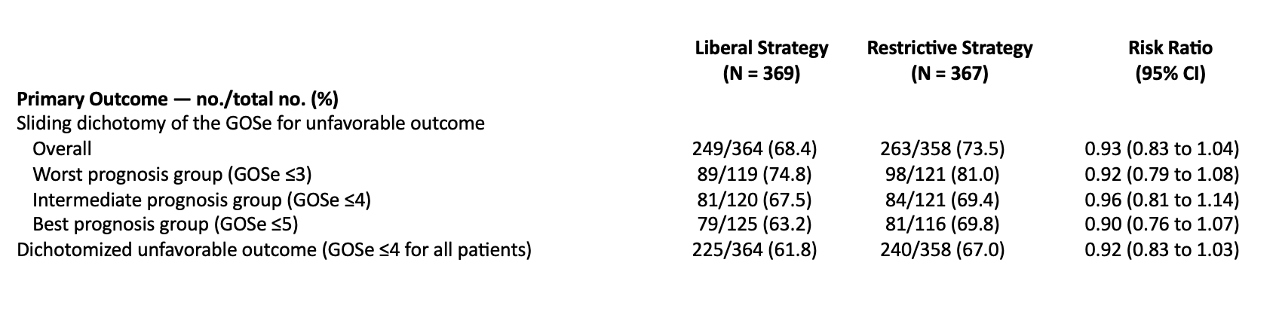
Primary outcome
Absolute risk reduction by 5.4% (95%CI −2.9 to 13.7%)

Slide 28
Primary outcome

Slide 29
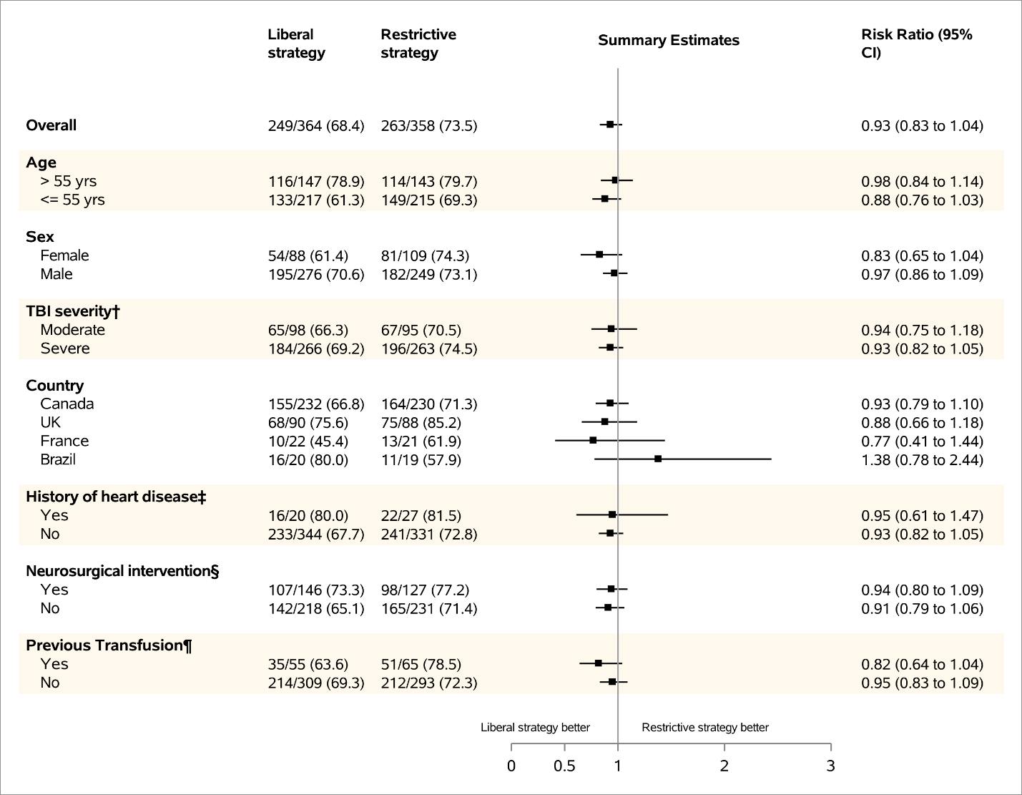


Subgroup analyses

Slide 30
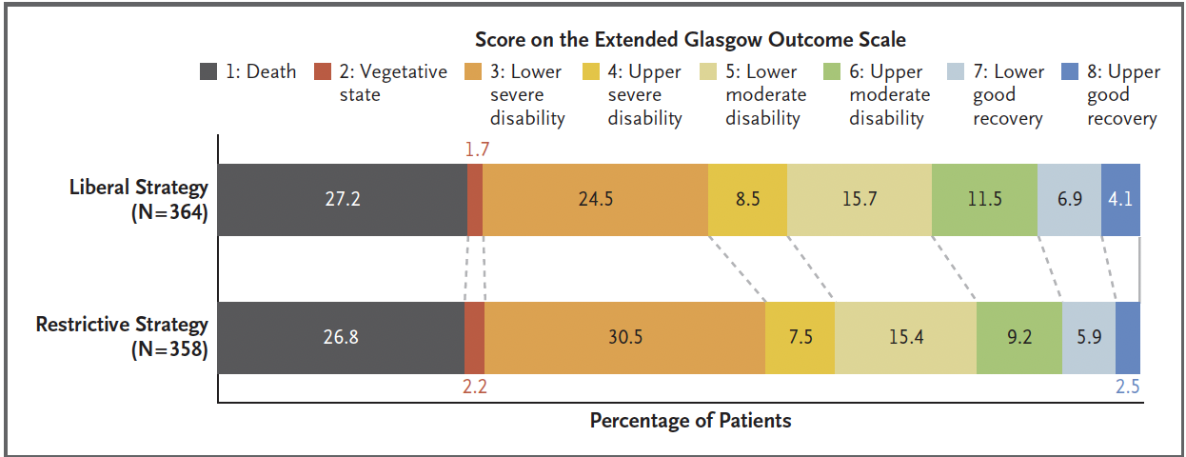
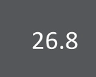

GOSe distribution
26.3

Slide 31
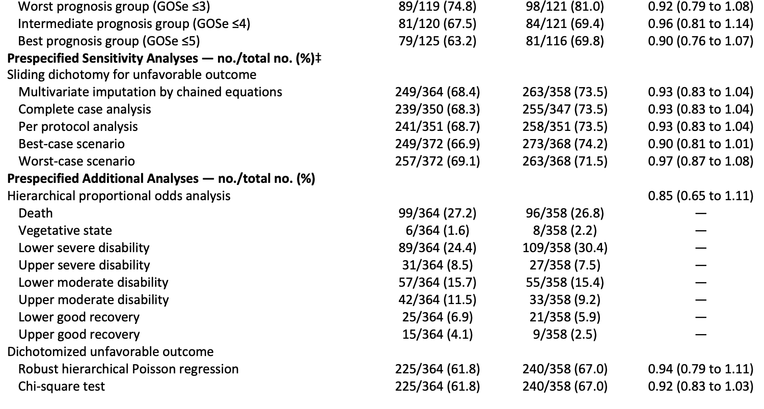
Sensitivity analyses

Slide 32
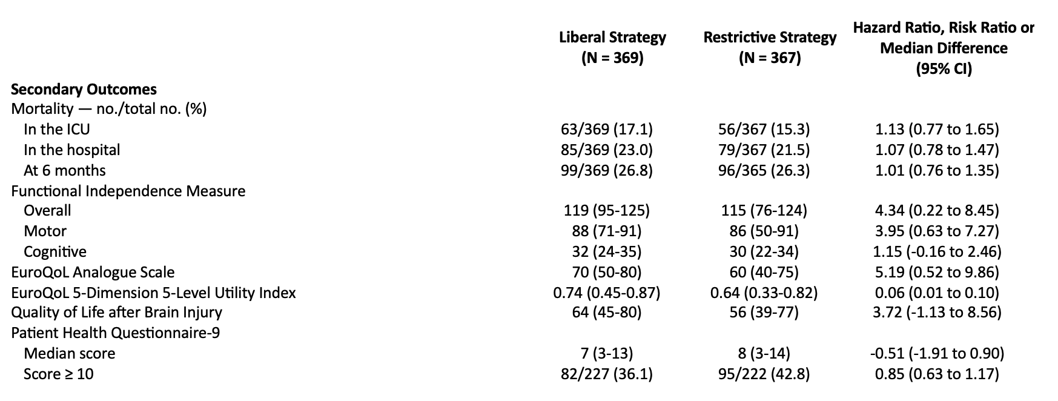
Secondary outcomes

Slide 33
Secondary outcomes

Slide 34
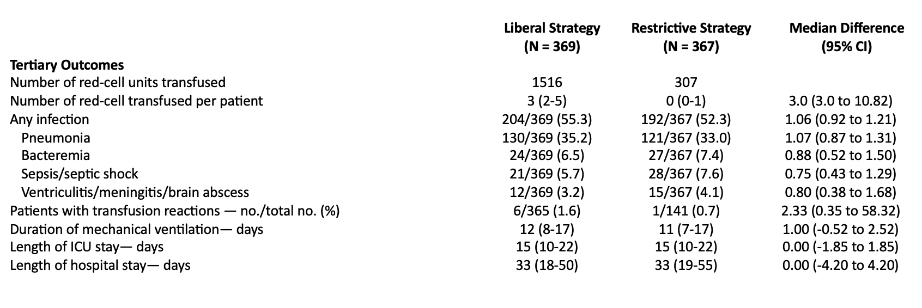
Tertiary outcomes

Slide 35
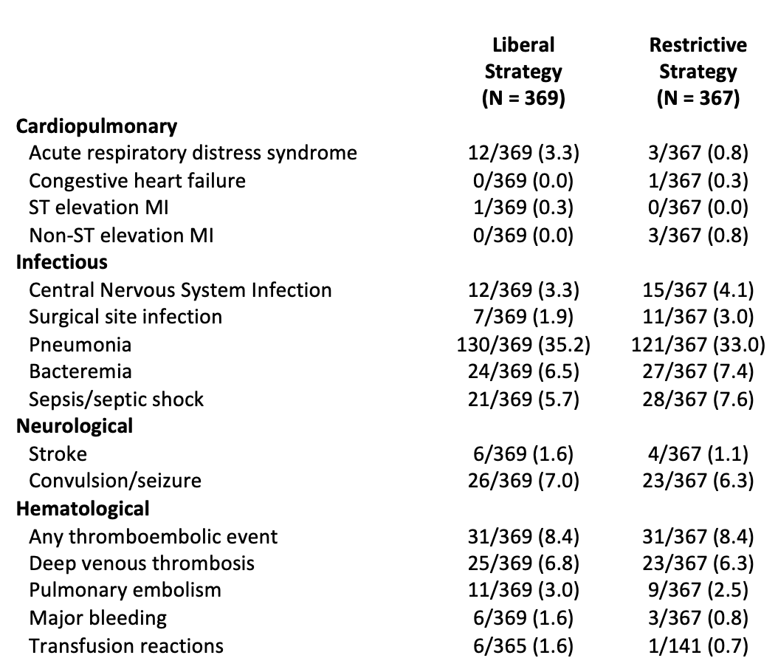
Post-randomization events

Slide 36
In summary
We did not observe a statistically significant decrease on the risk of an unfavourable neurological outcome at 6 months in critically ill adult patients with traumatic brain injury, based on the GOSe
  We cannot exclude the possibility of up to a 13.7% absolute reduction (or up to a 2.9% increase) in risk of an unfavourable outcome with a liberal transfusion strategy
A potential beneficial effect was observed with the functional independence measure and quality of life

Slide 37
Conclusion
Considering the overall findings, a liberal transfusion strategy is likely the best approach to use in critically ill adult patients with acute TBI

Slide 38
