Slide 1




The 2024 Guideline on use of Intravenous Albumin
from the International Collaboration for Transfusion Medicine Guidelines
Link to Guidelines
Raza S.
Transfusion Medicine Fellow
Canadian Blood Services | University of Toronto | No relevant COI
Title
Background
●●● Statements ●●●
Conclusions
Questions

Slide 2

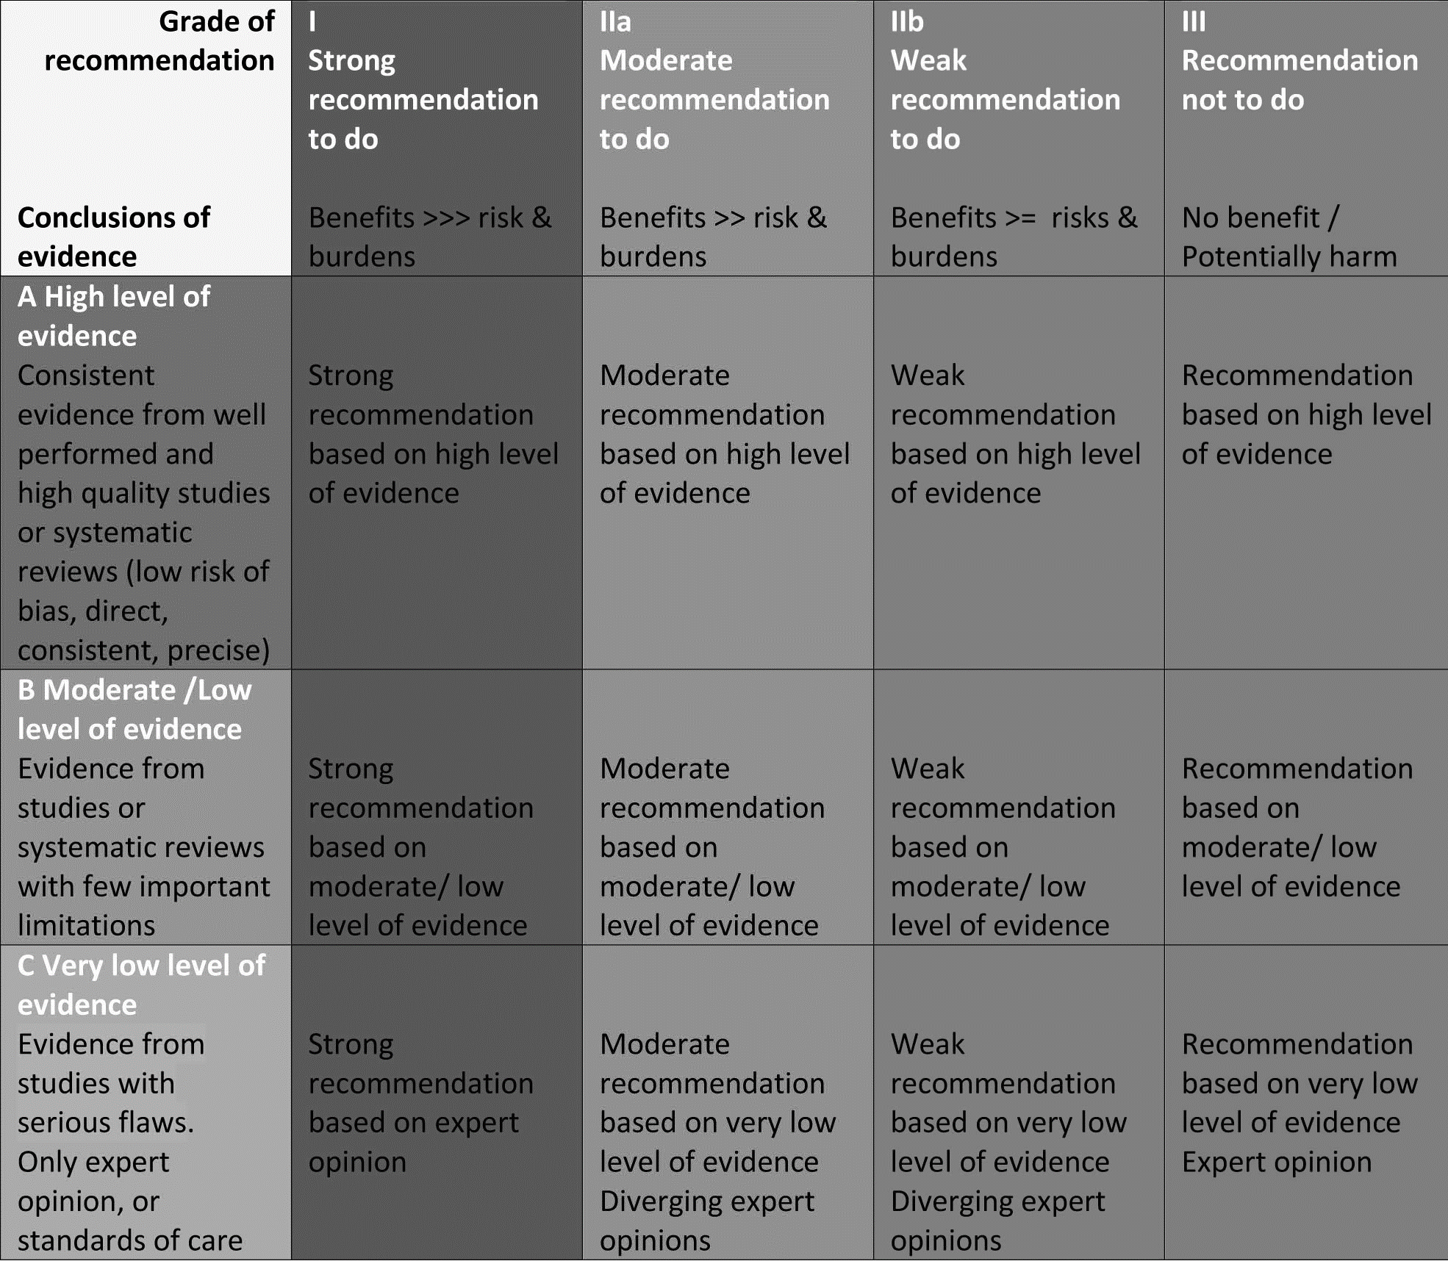

Objectives
To review appraisal of existing evidence used to derive the 2024 ICTMG intravenous albumin guidelines.
To review ICTMG recommendations for the use of intravenous albumin.
To setup discussion with the Breakthroughs in blood expert panel following the presentation
Title
Background
●●● Statements ●●●
Conclusions
Questions

Slide 3

Background
Sarah, 51-year old ♀, alcohol-related liver disease
Admitted hepato-pulmonary syndrome
The admitting physician is struggling because the patient is both hypotensive (low pressure) and anasarcous (diffusely swollen)
She wants to switch the patient from 0.9% saline infusion to a 5% albumin for hypotension and peritonitis
Title
Background
●●● Statements ●●●
Conclusions
Questions

Slide 4
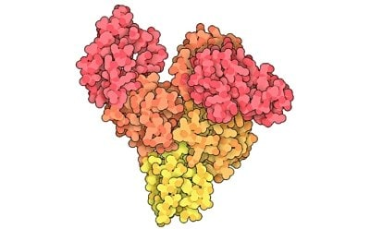
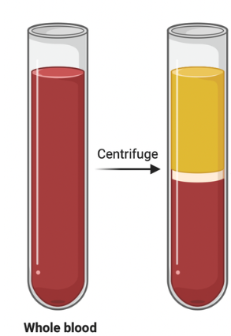
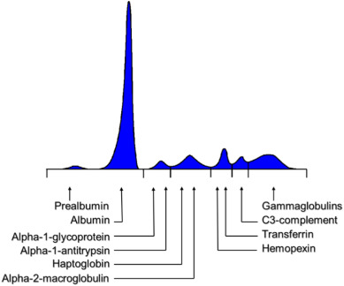
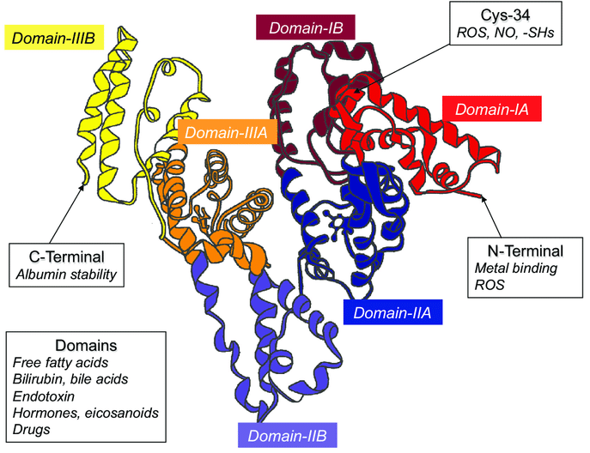
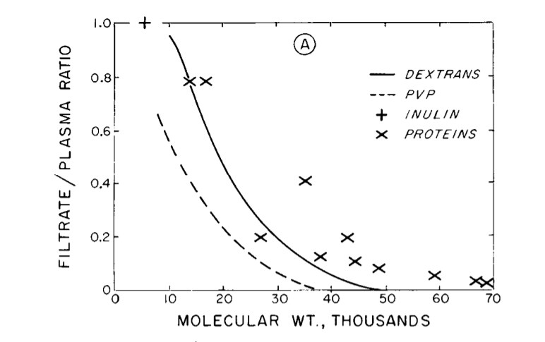
Albumin
The most abundant plasma protein
Albumin binds
Water
Electrolytes (Na/K/Ca)
Hormones
Fatty acids, fatty vitamins
Bilirubin
Thyroxine
Drugs
Albumin is a 67 kilo dalton protein
Albumin buffers pH
Negligible clearance due to (-) and wt
Some antioxidant effect
Albumin confers oncotic pressure
NEJM. 1974 Apr 4;290(14):785-92
Title
Background
●●● Statements ●●●
Conclusions
Questions
Notes:
Albumins 3.5–5.0 g/dl 60%

Slide 5
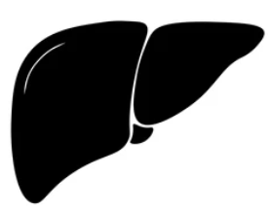

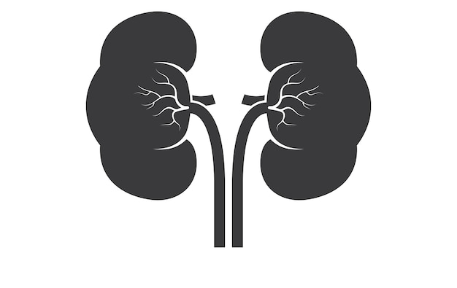


Physiology
Kwashiorkor (malnourishment)
Celiac disease (malabsorption)
Food (Amino Acids)
Synthesized in liver at 16 g / day
e.g. 70 kg person, 5L blood
Makes ~ 3 g/L daily
Synthetic liver dysfunction
Link to Guidelines
Increased transfer
Redistribution
60% extravascular
40% intravascular
Typical plasma albumin concentration
35 to 50 g/L (3.5 to 5.0 g/dL)
(about 200 g in a 5L blood volume)
endothelium
Under healthy conditions
Exchange rate is 5% per hour
10% metabolized per day
30 mg Renal filtration
1% Gastrointestinal loss
Hypermetabolism
Nephrotic Syndrome
Protein-Losing Enteropathy
Title
Background
●●● Statements ●●●
Conclusions
Questions

Slide 6
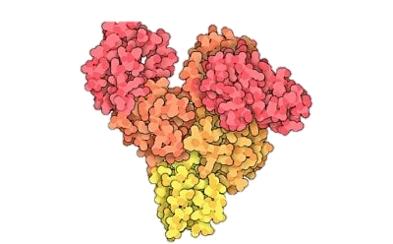
Oncotic Pressure
extravascular
endothelium
intravascular
Interstitium
Interstitial Pressure
Oncotic Pressure
Blood Vessel
Blood Pressure
Oncotic Pressure
Albumin confers 80% of blood oncotic pressure
(partly direct, partly via ion binding)
Title
Background
●●● Statements ●●●
Conclusions
Questions

Slide 7
Oncotic Pressure in Deranged Physiology
extravascular
endothelium
intravascular
Interstitium
Oncotic Pressure
Blood Vessel
Oncotic Pressure
Net Result:
Low intravascular blood pressure (hypotension)
High extravascular fluid (swelling)
Title
Background
●●● Statements ●●●
Conclusions
Questions

Slide 8
Deranged Physiology
Food (Amino Acids)
Negative Acute Phase Reactant
↑↑ extravascular
↓↓ intravascular
endothelium
Under critical illness
Exchange rate ↑↑
↑↑↑ metabolized per day
--/↑↑ Renal filtration
↑↑ Skin
↑↑↑ Gastrointestinal loss
Title
Background
●●● Statements ●●●
Conclusions
Questions

Slide 9
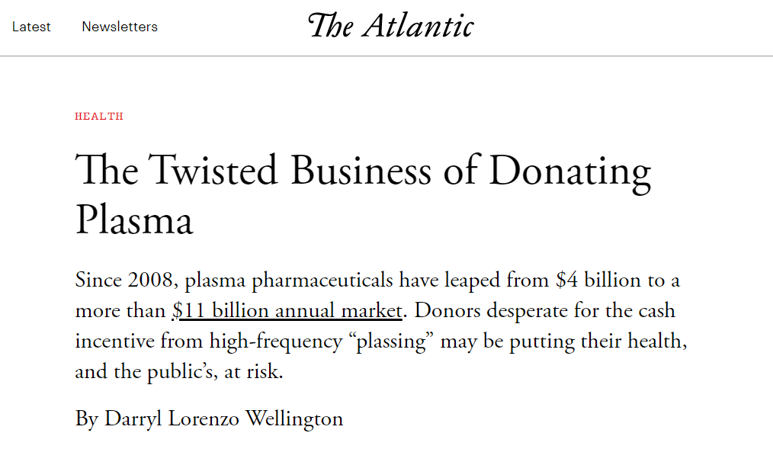
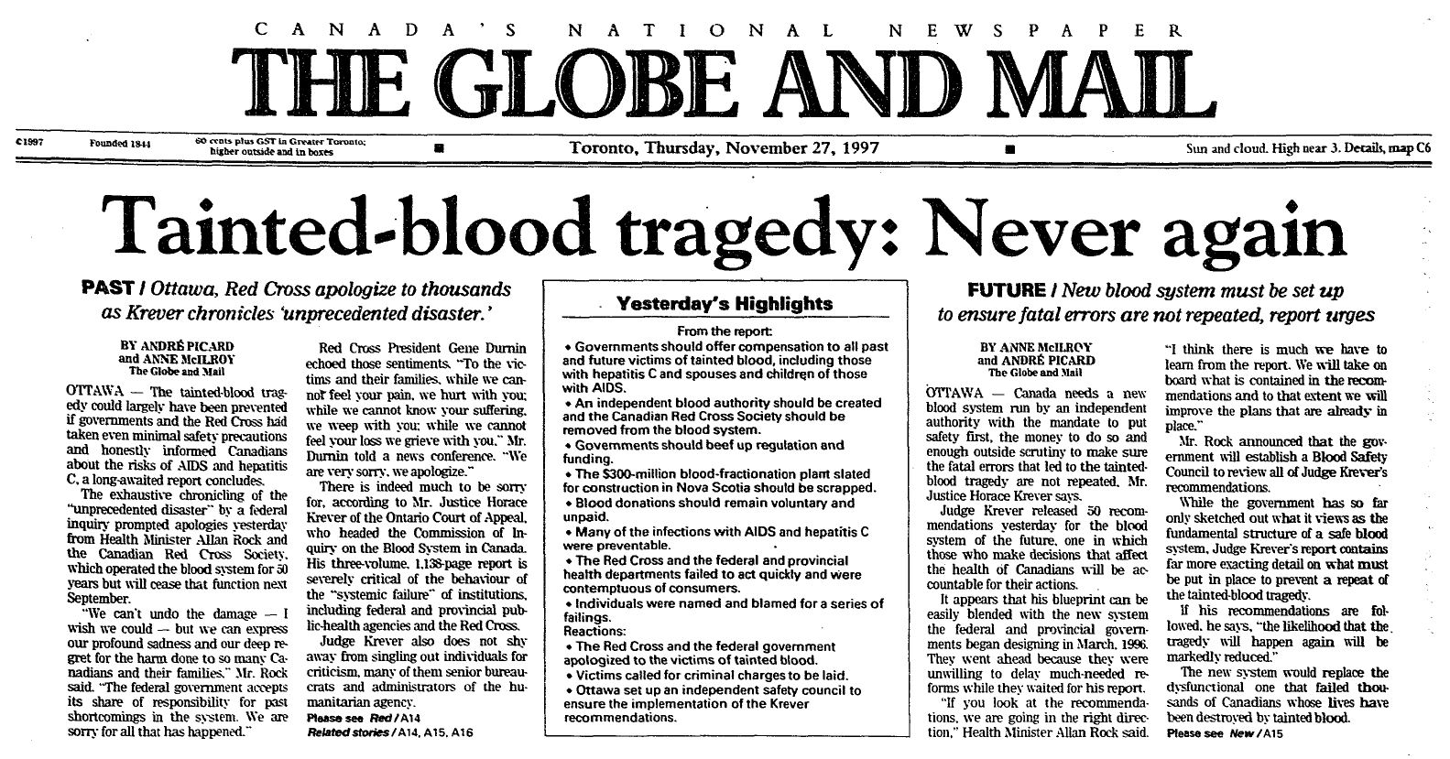
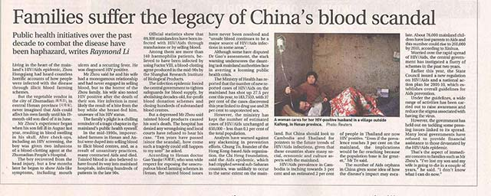
Albumin Transfusion
Albumin formulations
5% (or 5 g / 100 ml, or 50 g / L**)
20-25% (or 25 g / 100 ml) -- Hyperosmotic
Interstitium
5% given up to 5 ml/min
25% given up to 2 ml/min
Rationale
Oncotic Pressure
Vial sizes
50 ml, 100 ml, 250 ml, 500 ml
Risks
Transfusion Associated Circulatory Overload, Hypotension, Anaphylaxis, More RBC Transfusions, Peripheral gangrene
Costs 5% is $40 USD per 100 ml
25% is $60 USD per 100 ml
48h infusion of 5% alb at 1 ml/kg/hr is about $3,000
NS would be $50-100
The 5 billion + “plasma economy” is rife with scandals worldwide
Donors are often marginalized
Donors can be injured by adverse reactions
Donors often misreport on donor questionnaires
Ethics
Title
Background
●●● Statements ●●●
Conclusions
Questions

Slide 10
Prevailing Albumin Practice
Highly variable
1 | 2 | 3 | 4 | 5 | 6 | 7 | 8 | 9 | 10 | 11 | 12
Title
Background
●●● Statements ●●●
Conclusions
Questions

Slide 11

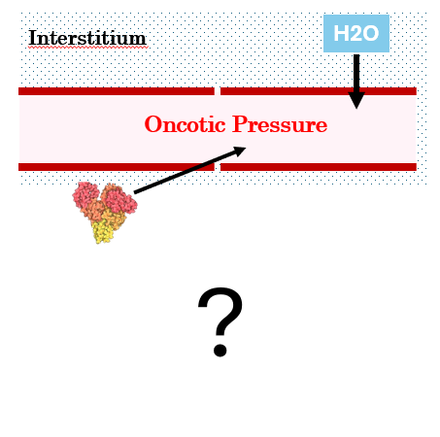

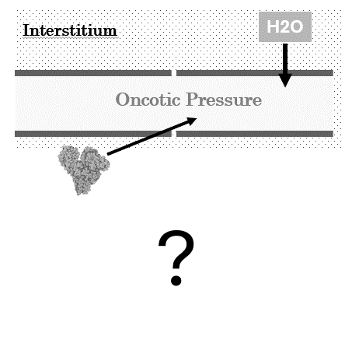
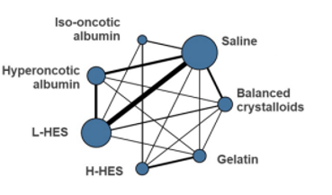
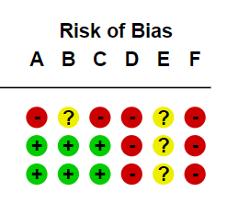
Methodology Preamble
Interstitium
H2O
Oncotic Pressure
?
Title
Background
●●● Statements ●●●
Conclusions
Questions

Slide 12
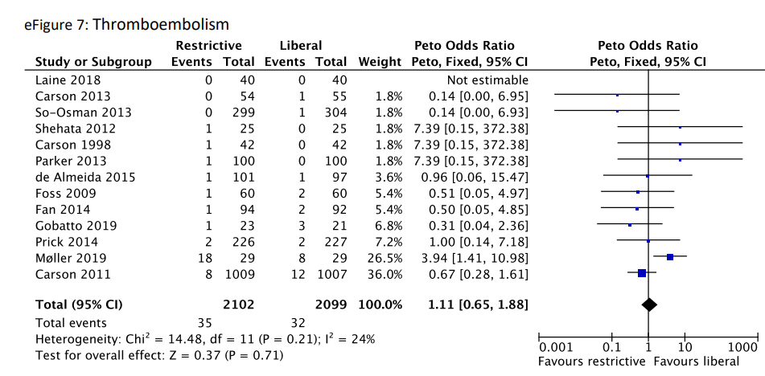
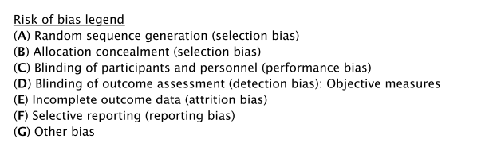
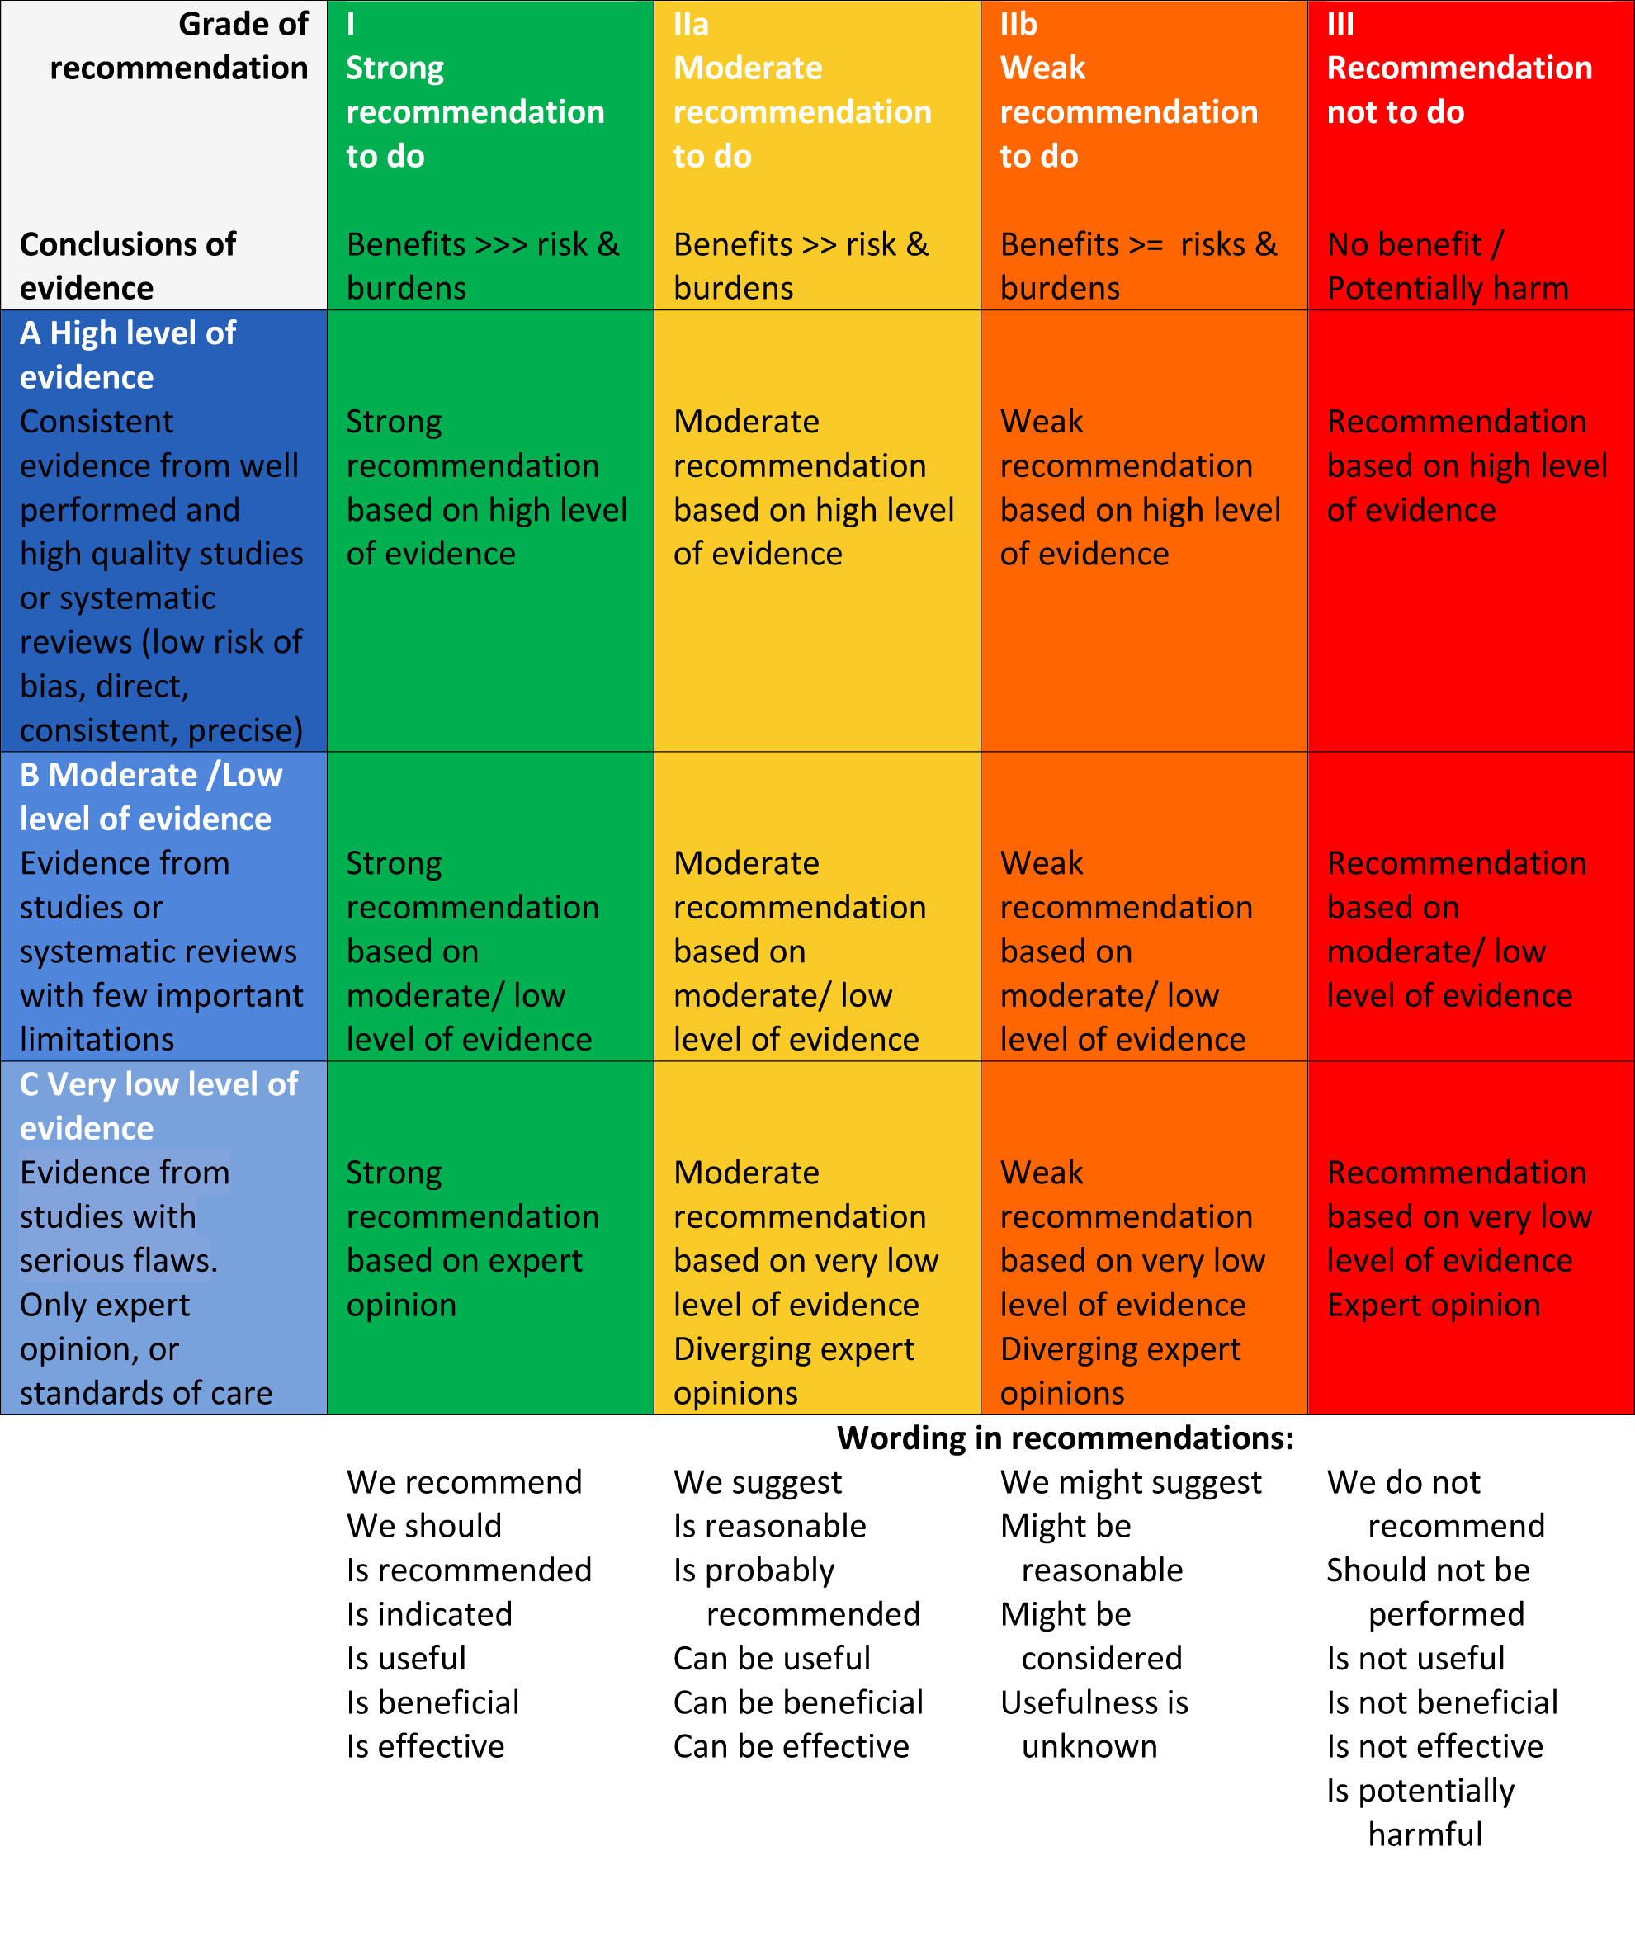
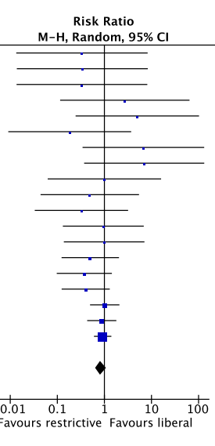
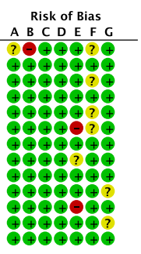
Methodology Preamble
Methods
1. Systematic Review
2. Risk of Bias Assessment
3. GRADE Methodology
Title
Background
●●● Statements ●●●
Conclusions
Questions

Slide 13


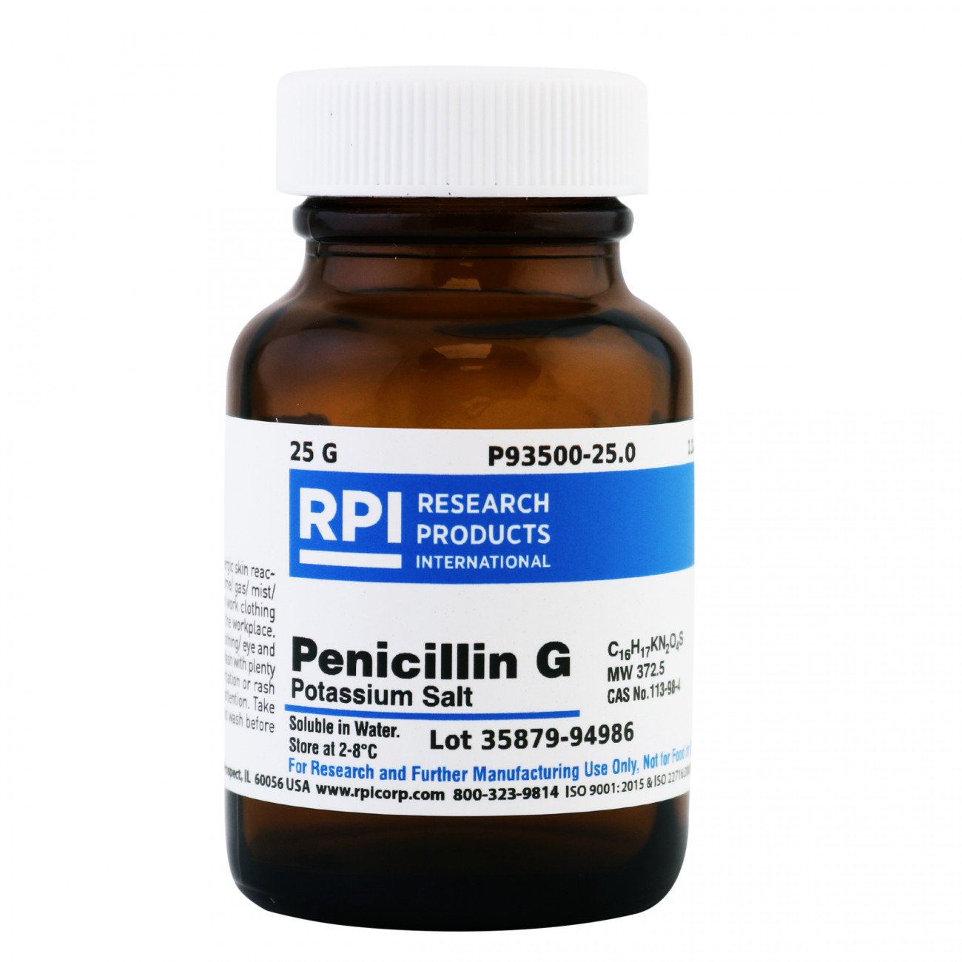

Methodology Preamble
Strength of evidence
Benefit Harm
Title
Background
●●● Statements ●●●
Conclusions
Questions

Slide 14
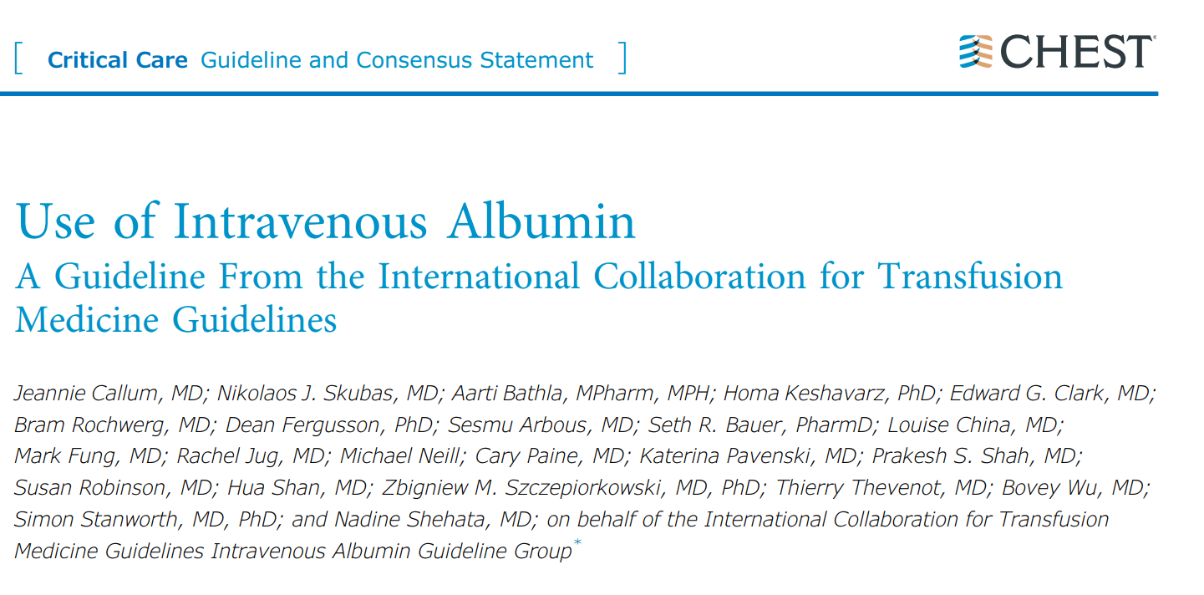

Guideline
Title
Background
●●● Statements ●●●
Conclusions
Questions

Slide 15
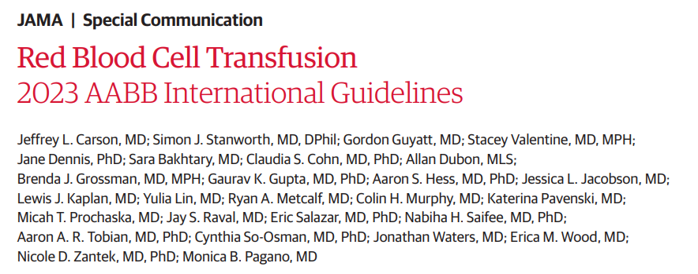
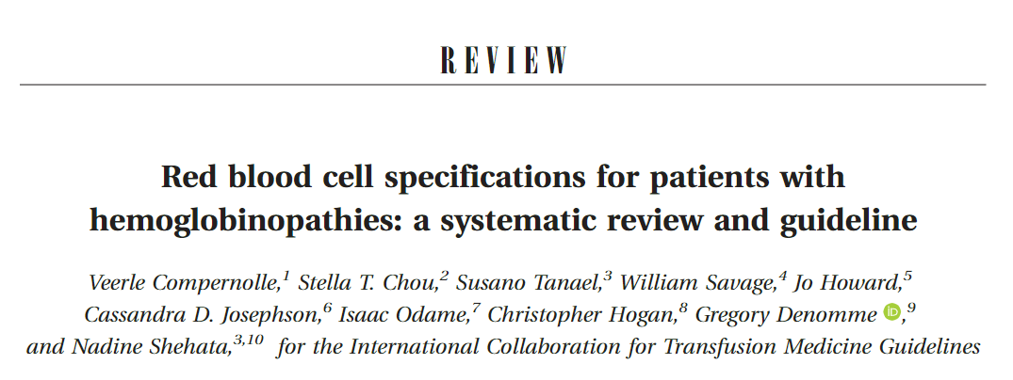
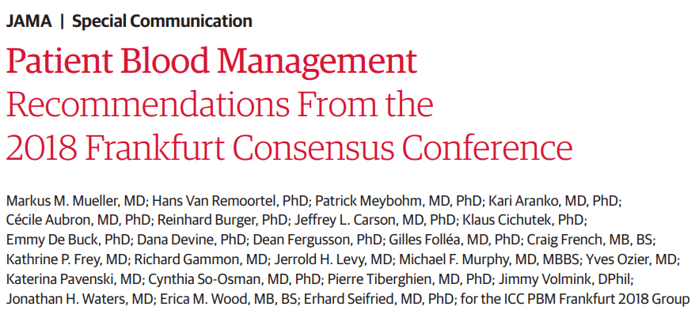
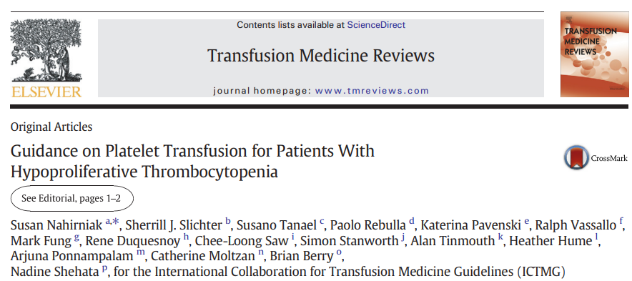
ICTMG
Collaborative of volunteers (full and project members) with a focus on rigorous guideline development methodology and implementation, engaging representatives from relevant disciplines, societies, and patient groups.
The ICTMG secretariat is hosted by Canadian Blood Services, the primary funder for ICTMG
Title
Background
●●● Statements ●●●
Conclusions
Questions
Notes:
Inception in 2011

Slide 16

ICTMG
Albumin Guideline Development Group
The international panel of expert volunteers for this guideline included:
* denotes ICTMG full membership at the time of guideline development
** indicates patient representation
Visit www.ICTMG.org
Title
Background
●●● Statements ●●●
Conclusions
Questions
Notes:
Inception in 2011

Slide 17
Scope
Appropriate use of albumin in
Intended primarily to inform
Liver disease
Critical Care
Nephrologists
Anesthesiologists
Lab Technologists
Hematologists
CV Surgeons
Pharmacists
Intensivist
Pathologists
Researchers
Renal replacement
Pediatric and Neonatal
Hospitalists
TM Physicians
Patients/Families
General Internists
Hepatologists
CV Surgery
Gastroenterologists
Not assessed: Plasma Exchange
Link to Guidelines
Title
Background
●●● Statements ●●●
Conclusions
Questions
Notes:
Inception in 2011

Slide 18
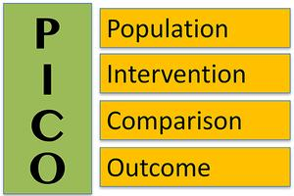


Methods
Co-chairs (2)
Guideline Panel
Methodologists
Clinicians
Researchers
Patient Representative
Systematic Review and Meta-Analyses were screened or
conducted (PROSPERO + PRISMA)
Quality of studies assessed using Cochrane Risk of Bias tool for RCTs and AMSTAR for Systematic Reviews.
Search terms determined by guideline panel based on PICO
Recommendations were developed using GRADE Methodology
References were screened and relevant data extracted and analysed using Distiller SR
The guideline recommendations were developed and reported in accordance with AGREE checklist
Title
Background
●●● Statements ●●●
Conclusions
Questions
Notes:
Inception in 2011
Search strategy developed by a librarian, and the search was conducted in multiple databases from inception to November 23, 2022

Slide 19
PICO
In patients with select clinical indications*, does intravenous albumin improve pre-specified outcomes when compared to comparator therapies?
P*
Hypovolemia
Sepsis
Hypoalbuminemia
Thermal injuries
Acute respiratory distress syndrome
Cirrhosis
Intradialytic hypotension
Cardiovascular surgery
I
Intravenous albumin
C
Synthetic colloids
Crystalloids
O
Mortality
Kernicterus
Acute neurological impairment
Chronic neurological impairment
Need for exchange transfusion
Need for top-up transfusion
Bilirubin level
Anemia
Length of hospital stay
Title
Background
●●● Statements ●●●
Conclusions
Questions
Notes:
Outcomes rankings were determined based on the means obtained from GDG voting

Slide 20
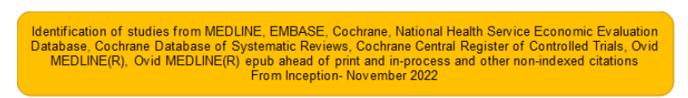
Literature Review
6783
total records identified
6186
records excluded after screening
Limitation of the search to the English language
597
full-text articles
Studies often did not report adverse reactions
Lack of comparative dosing strategies leaves uncertainty in choice between 4-5% and 20-25% albumin formulations
The guideline is limited to common uses of albumin and cannot address every possible patient scenario
54
studies
Quality Assessment
Title
Background
●●● Statements ●●●
Conclusions
Questions

Slide 21
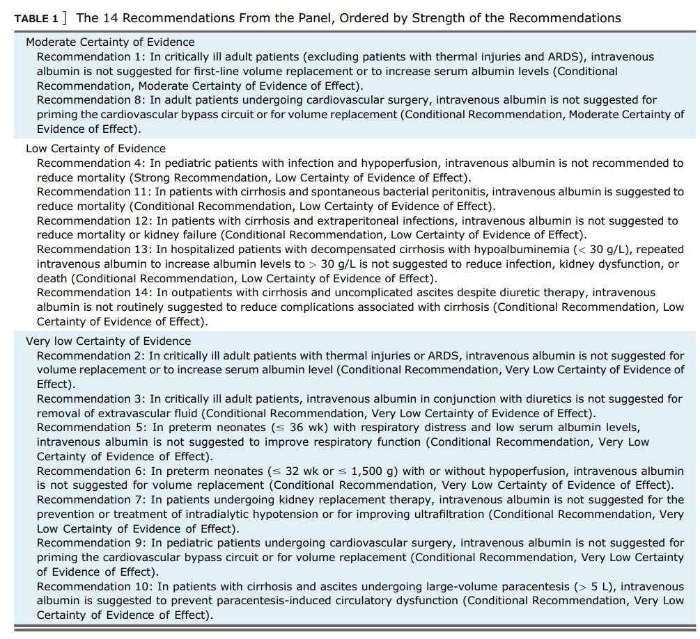
Statements
Link to Guidelines
Title
Background
●●● Statements ●●●
Conclusions
Questions

Slide 22
Cirrhosis
N=5
Critical Care
N=3
Pediatric & Neonatal
N=3
CV Surgery
N=2
Renal
N=1
Title
Background
●●● Statements ●●●
Conclusions
Questions

Slide 23
Cirrhosis
N=5
Critical Care
N=3
Pediatric & Neonatal
N=3
CV Surgery
N=2
Renal
N=1
Title
Background
●●● Statements ●●●
Conclusions
Questions

Slide 24
Cirrhosis
N=5
In patients with cirrhosis and ascites undergoing large-volume paracentesis (> 5 L), intravenous albumin is suggested to prevent paracentesis-induced circulatory dysfunction
In patients with cirrhosis and spontaneous bacterial peritonitis, intravenous albumin is suggested to reduce mortality
In patients with cirrhosis and extraperitoneal infections, intravenous albumin is not suggested to reduce mortality or kidney failure
In hospitalized patients with decompensated cirrhosis with hypoalbuminemia (< 30 g/L), repeated intravenous albumin to increase albumin levels to > 30 g/L is not suggested to reduce infection, kidney dysfunction, or death
In outpatients with cirrhosis and uncomplicated ascites despite diuretic therapy, intravenous albumin is not routinely suggested to reduce complications associated with cirrhosis
Moderate
Low
1
3
4
5
CERTAINTY OF EVIDENCE
2
Very low
For Against
●●●●●
Title
Background
●●● Statements ●●●
Conclusions
Questions

Slide 25

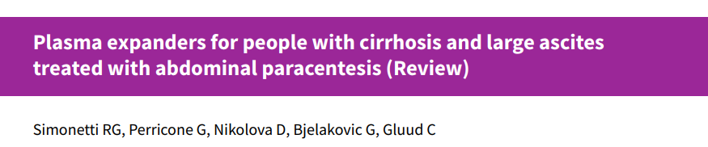
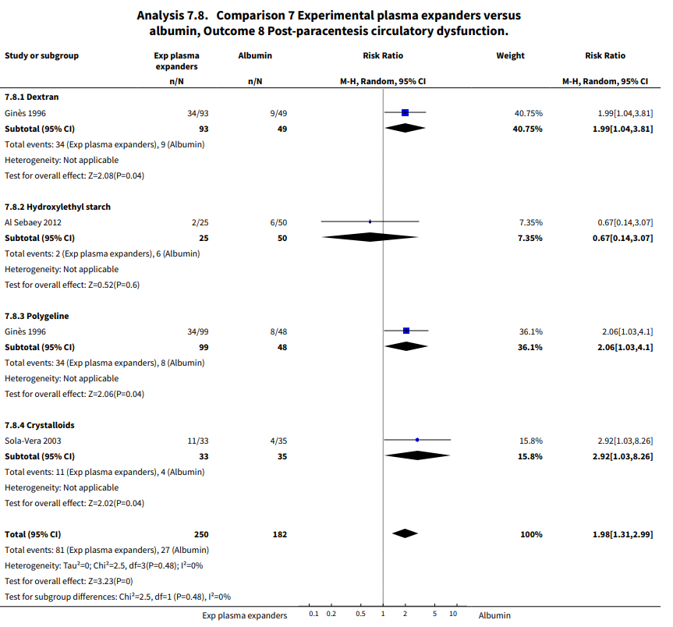
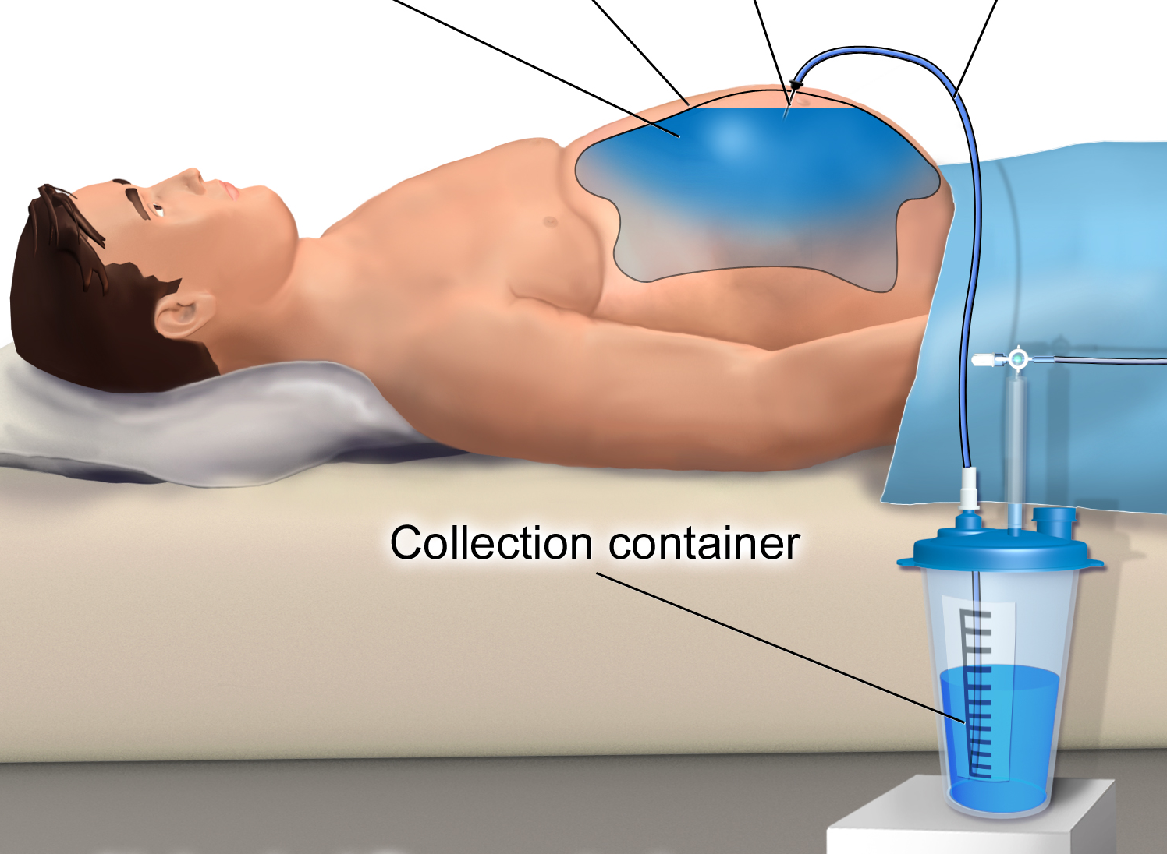
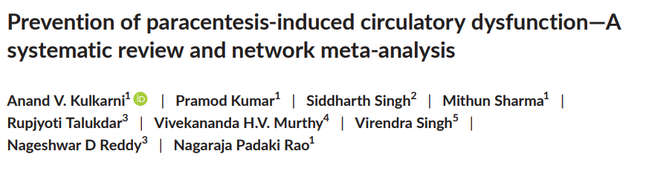
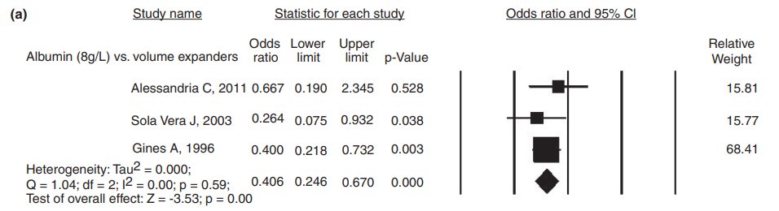
1. In patients with cirrhosis and ascites undergoing large-volume paracentesis (> 5 L), intravenous albumin is suggested to prevent paracentesis-induced circulatory dysfunction
Cochrane Database Syst Rev. 2019 Jun 28;6(6):CD004039.
27 RCTs (N = 1,592) examining plasma volume expanders cirrhosis + paracentesis
Included patients having large-volume paracentesis (> 5 L)
Compared with no plasma expander, hyperoncotic albumin (20-25%) showed
No effect of using hyperoncotic (20%-25%) albumin on
  Mortality (RR, 0.52; 95% CI, 0.06-4.83)
  Kidney impairment (RR, 0.32; 95% CI, 0.02-5.88),
  Recurrence of ascites (RR, 1.3; 95% CI, 0.49-3.42)
Benefit for paracentesis-induced circulatory dysfunction (RR, 1.98; 95% CI, 1.31-2.99)
Recommended dose:
Alb 20-25%, 6-8 g/L of fluid removed
Moderate
Found albumin at a dose of 8 g/L was found to be superior to other volume expanders for preventing post-paracentesis circulatory dysfunction
1
3
4
5
CERTAINTY OF EVIDENCE
Low
2
A 2020 systematic review focused on the impact of different therapies (albumin, other fluids, vasoactive drugs) on the rate of postparacentesis circulatory dysfunction
Included (n=9 RCTs, 620 patients)
Very low
For Against
Title
Background
●●● Statements ●●●
Conclusions
Questions

Slide 26
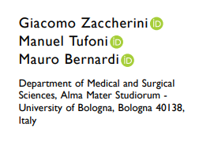
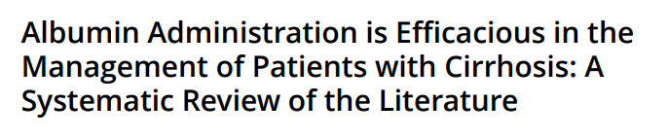
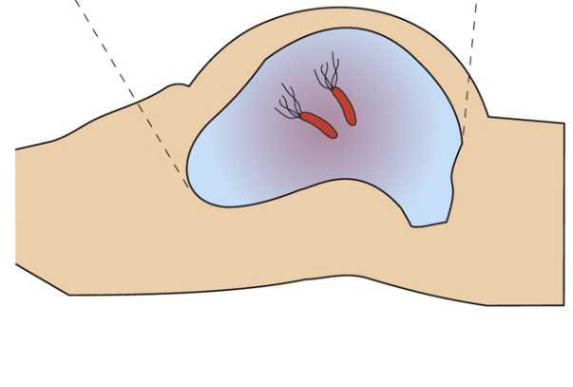
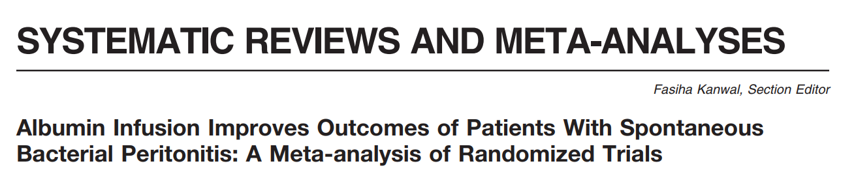
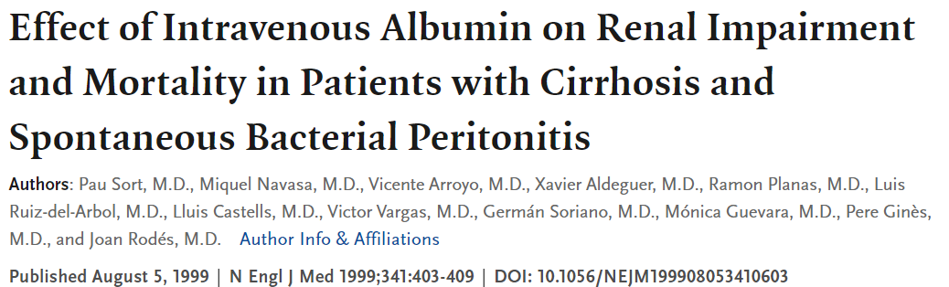
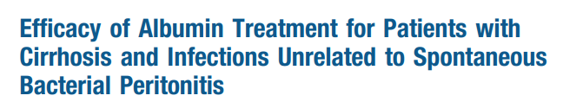
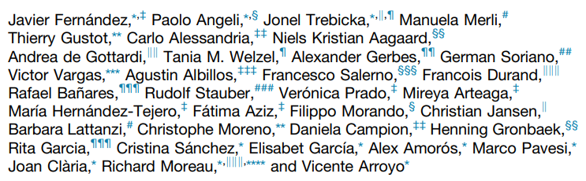
2. In patients with cirrhosis and spontaneous bacterial peritonitis, intravenous albumin is suggested to reduce mortality
Two SRs identified 5 unblinded RCTs
Trials used variable doses and duration of hyperoncotic albumin
Albumin reduced:
Rate of kidney impairment (OR, 0.21; 95% CI, 0.11-0.42)
Mortality (OR, 0.34; 95% CI, 0.19-0.60)
Recommended dose:
Alb 20-25%, Day 1: 1.5 g/kg, Day 3: 1.0 g/kg*
Largest RCT, randomized 126 patients to albumin + abx, or abx alone
Moderate
Patients treated with albumin showed
Lower kidney impairment (10% vs 33%; P = .002)
Lower in-hospital mortality (10% vs 29%; P = .01)
1
3
4
5
CERTAINTY OF EVIDENCE
Low
Second largest RCT, randomized 118 patients to albumin (plus antibiotics) or antibiotics alone
No effect on in-hospital mortality (13% vs 11%; P = .66)
Benefit seen for acute-on-chronic liver failure and new infections
Very low
2
For Against
Clinical Gastroenterology and Hepatology 2020;18:963–973
Title
Background
●●● Statements ●●●
Conclusions
Questions
Notes:
Mucosal-Associated Invariant T Cells Redistribute to the Peritoneal Cavity During Spontaneous Bacterial Peritonitis and Contribute to Peritoneal Inflammation - ScienceDirect

Slide 27
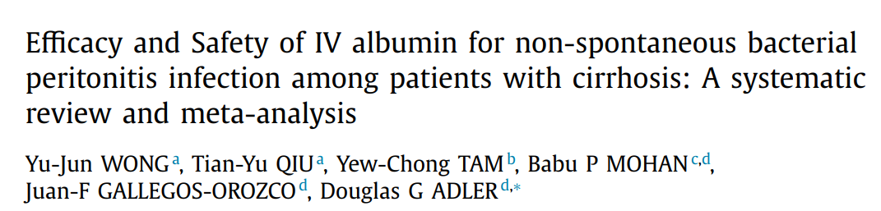
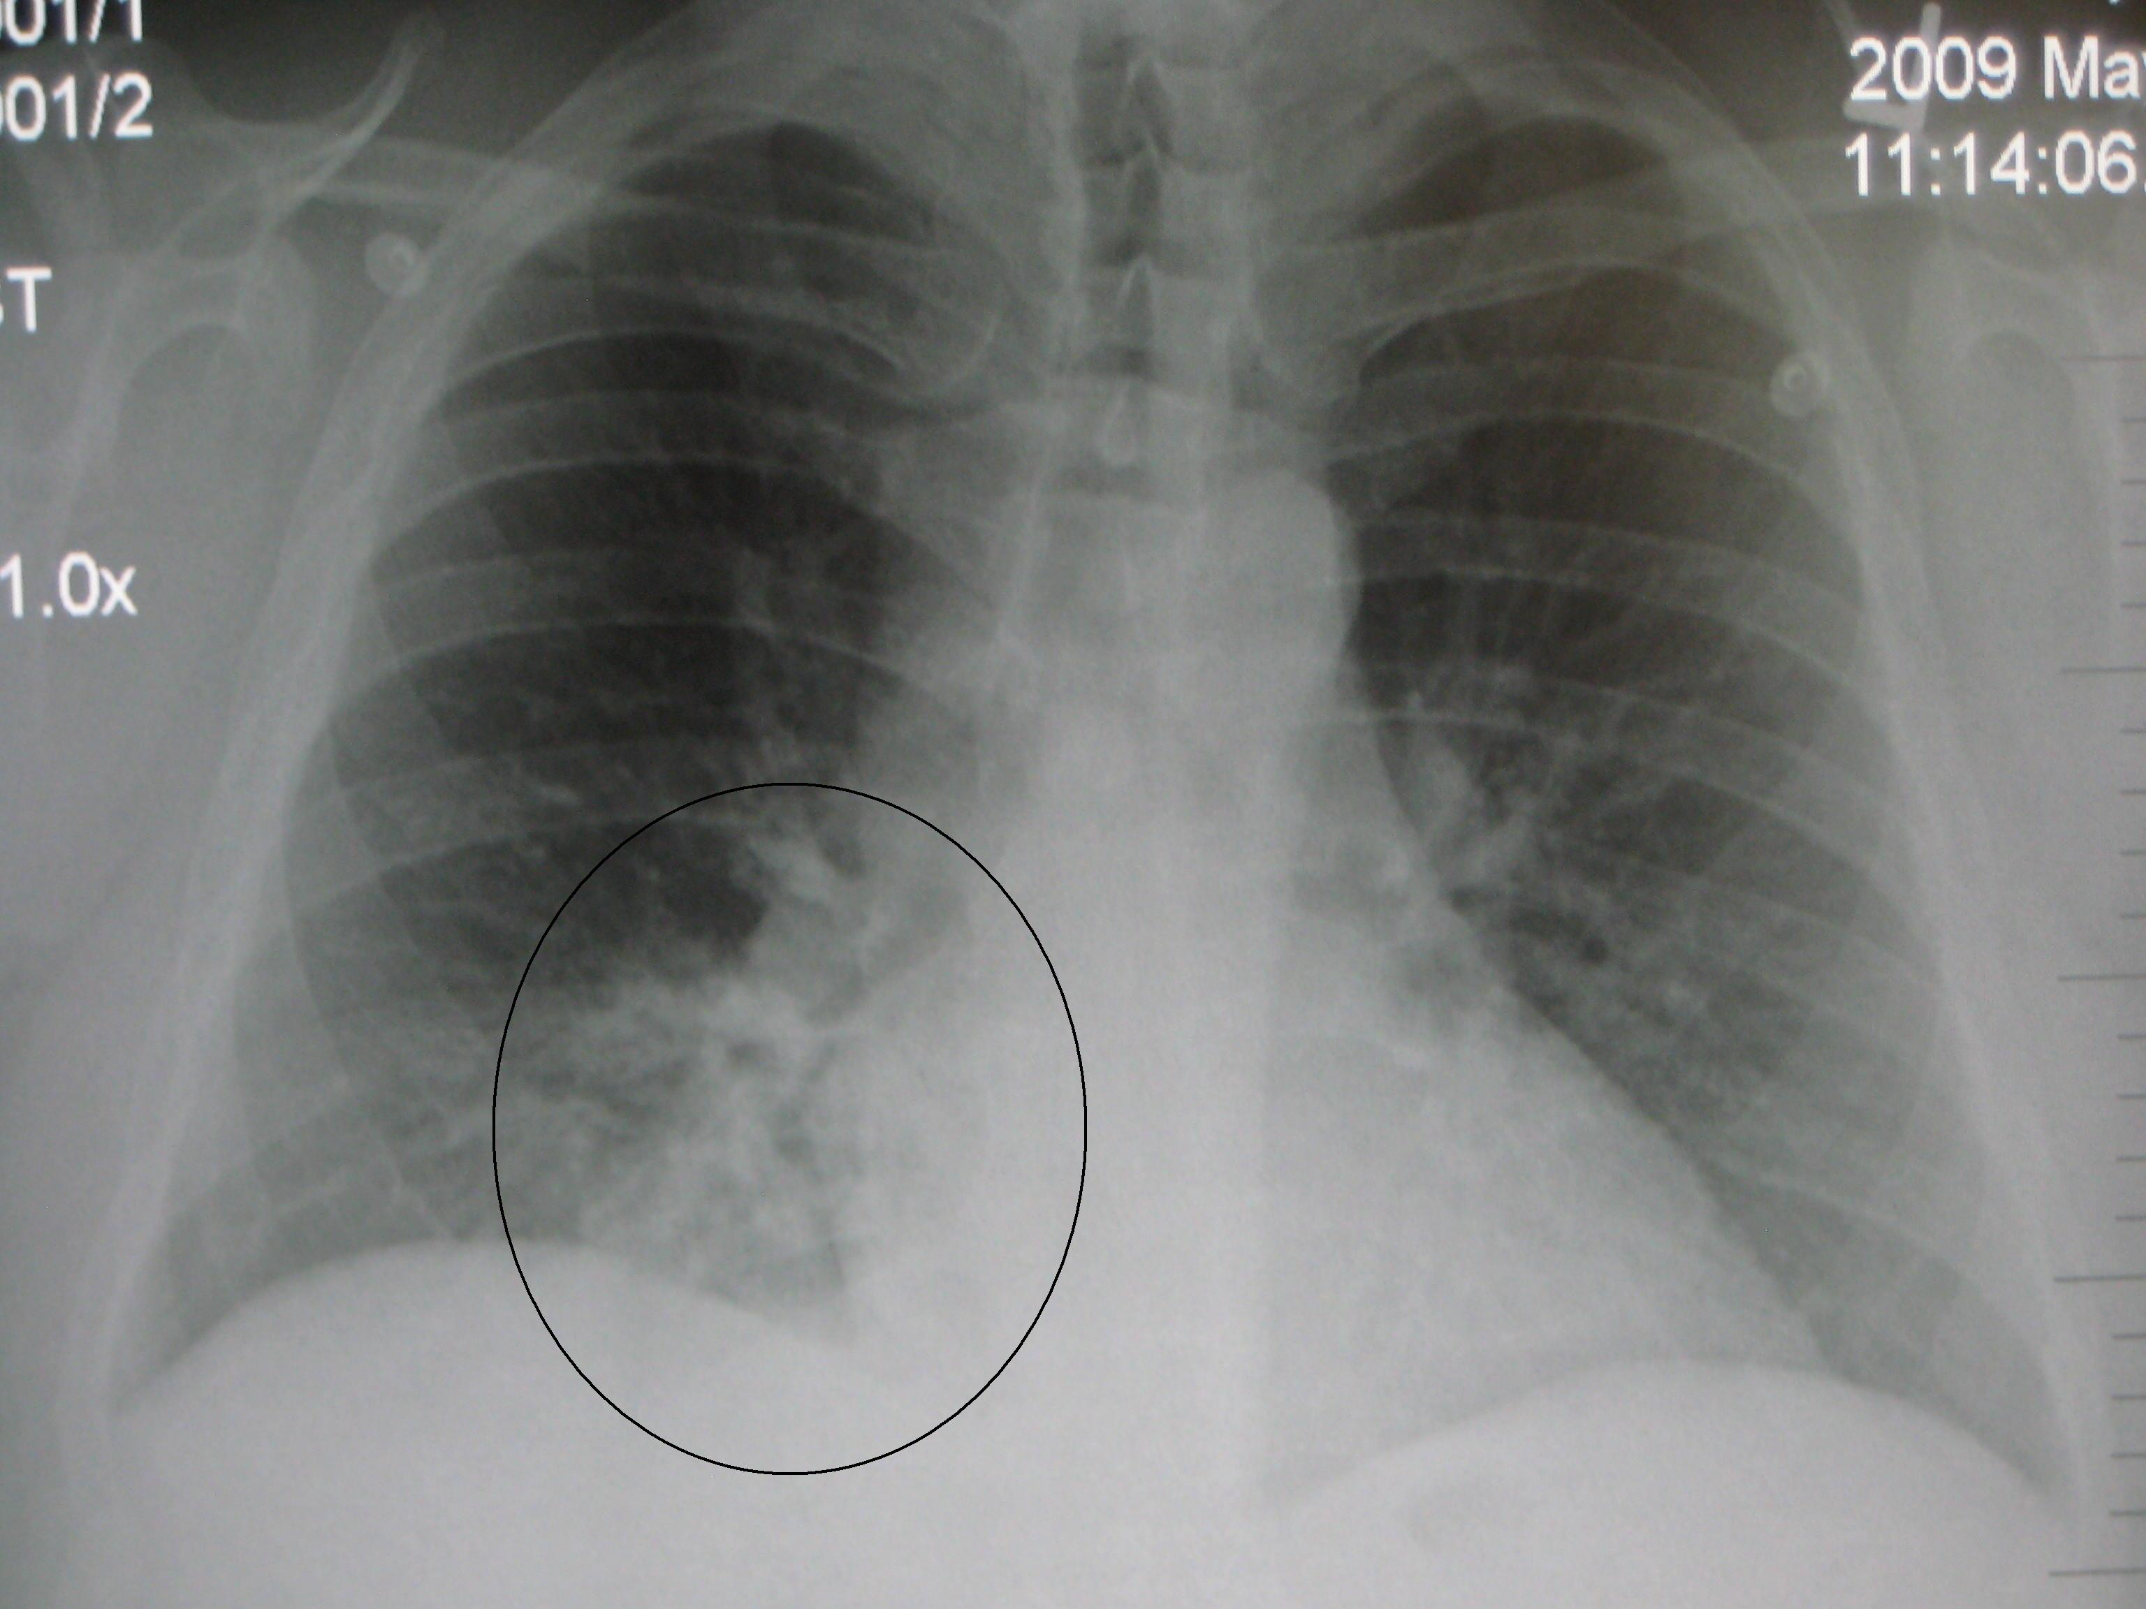
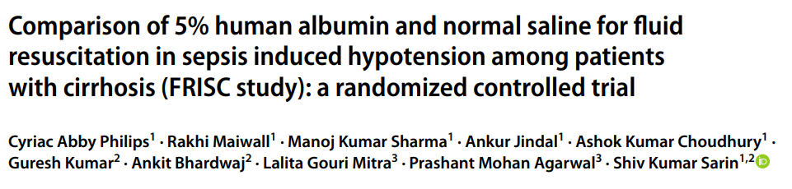
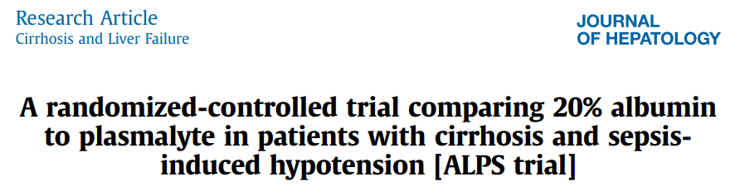
3. In patients with cirrhosis and extraperitoneal infections, intravenous albumin is not suggested to reduce mortality or kidney failure
2020 systematic review and meta-analysis of RCTs (3 RCTs, n=406)
No effect on mortality or kidney impairment
Higher rates of pulmonary edema with albumin (three studies [N = 406]; OR, 5.17; 95% CI, 1.62-16.47)
Higher resolution of acute on chronic liver failure (OR=0.11, 95%CI: 0.02-0.69, p=0.02)
Moderate
n = 308
n = 100
1
3
4
5
CERTAINTY OF EVIDENCE
Low
Similar survival at 7 days in the albumin-treated patients (saline, 39.0% vs albumin, 43.5%; P = .42, Fisher exact test)
Higher reversal of hypotension in patients receiving 5% albumin at 1 hr and 3 hr transfusion
No effect on initiation of dialysis, length of stay, or mortality at 28 days
Superior to crystalloid for reversal of hypotension without initiation of vasopressors at 3 h (22% vs 62%; P < .001)
Very low
2
For Against
Title
Background
●●● Statements ●●●
Conclusions
Questions
Notes:
Mucosal-Associated Invariant T Cells Redistribute to the Peritoneal Cavity During Spontaneous Bacterial Peritonitis and Contribute to Peritoneal Inflammation - ScienceDirect

Slide 28
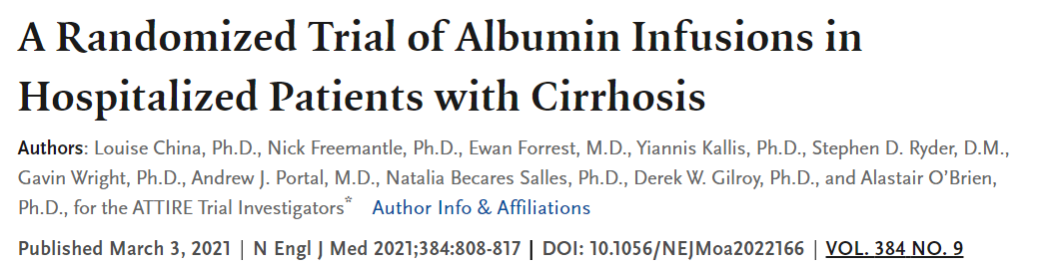
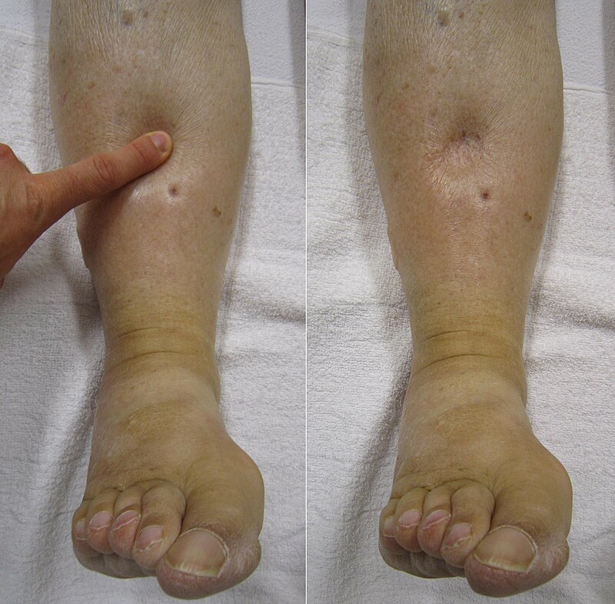
4. In hospitalized patients with decompensated cirrhosis with hypoalbuminemia (< 30 g/L), repeated intravenous albumin to increase albumin levels to > 30 g/L is not suggested to reduce infection, kidney dysfunction, or death
ATTIRE Study
Patients with hypoalbuminemia included (n=777)
Randomly received either targeted 20% human albumin solution for up to 14 days or until discharge, whichever came first, or standard care
Median Albumin given: 200 g
No difference was found in the primary end point (composite of new infections, kidney dysfunction, or death between days 3 and 15) (OR, 0.98; 95% CI, 0.71-1.33)
More severe or life-threatening serious adverse events were reported in the albumin-treated patients, primarily a numerical increase in pulmonary edema.
Moderate
Low
1
3
4
5
CERTAINTY OF EVIDENCE
Very low
2
For Against
Title
Background
●●● Statements ●●●
Conclusions
Questions
Notes:
Edema - Wikipedia

Slide 29
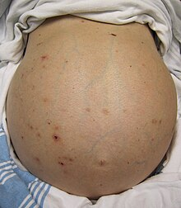
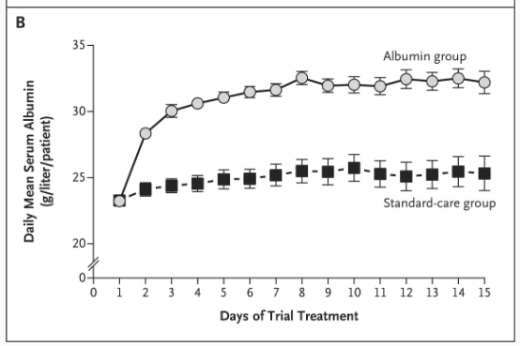

5. In outpatients with cirrhosis and uncomplicated ascites despite diuretic therapy, intravenous albumin is not routinely suggested to reduce complications associated with cirrhosis
Midodrine and albumin for prevention of complications in patients with cirrhosis awaiting liver transplantation. A randomized placebo-controlled trial
J Hepatol.
2018;69(6):1250-1259.
Randomized 440 patients with cirrhosis and uncomplicated, persistent ascites despite diuretic therapy
Albumin (40 g twice weekly for 2 weeks and then 40 g weekly for up to 18 months) or no albumin.
Patients randomized to albumin experienced
  Longer time to first paracentesis; required fewer paracenteses
  Lower hepatic encephalopathy, hepatorenal syndrome, spontaneous bacterial peritonitis, nonperitonitis infections, hyponatremia, or kidney dysfunction; experienced fewer days in hospital; lower all-cause mortality
Limitation—Performance Bias: albumin-treated patients underwent weekly health care interactions and the control group did not (!!)
Moderate
A Randomized Trial of Albumin Infusions in Hospitalized Patients with Cirrhosis
Low
1
3
4
5
CERTAINTY OF EVIDENCE
N = 196 outpatients, ascites awaiting liver transplantation
RCT: Oral midodrine and albumin or saline placebo
Very low
2
No difference in patient outcomes (end point was new infection, kidney dysfunction, or death, days 3-15)
For Against
The dose of albumin given as part of the intervention was lower (40 g every 15 days).
Title
Background
●●● Statements ●●●
Conclusions
Questions
Notes:
Ascites – Wikipedia
Solà E, Solé C, Simón-Talero M, Martín-Llahí M, Castellote J, Garcia-Martínez R, Moreira R, Torrens M, Márquez F, Fabrellas N, de Prada G. Midodrine and albumin for prevention of complications in patients with cirrhosis awaiting liver transplantation. A randomized placebo-controlled trial. Journal of hepatology. 2018 Dec 1;69(6):1250-9.
China L, Freemantle N, Forrest E, Kallis Y, Ryder SD, Wright G, Portal AJ, Becares Salles N, Gilroy DW, O’Brien A. A randomized trial of albumin infusions in hospitalized patients with cirrhosis. New England Journal of Medicine. 2021 Mar 4;384(9):808-17.

Slide 30
Cirrhosis
N=5
Critical Care
N=3
Pediatric & Neonatal
N=3
CV Surgery
N=2
Renal
N=1
Title
Background
●●● Statements ●●●
Conclusions
Questions

Slide 31


Critical Care
N=3
1. In critically ill adult patients (excluding patients with thermal injuries and ARDS), intravenous albumin is not suggested for first-line volume replacement or to increase serum albumin levels
2. In critically ill adult patients with thermal injuries or ARDS, intravenous albumin is not suggested for volume replacement or to increase serum albumin level
3. In critically ill adult patients, intravenous albumin in conjunction with diuretics is not suggested for removal of extravascular fluid
Moderate
1
Low
CERTAINTY OF EVIDENCE
Very low
2
3
For Against
Title
Background
●●● Statements ●●●
Conclusions
Questions

Slide 32





1 In critically ill adult patients (excluding patients with thermal injuries and ARDS), intravenous albumin is not suggested for first-line volume replacement or to increase serum albumin levels
Mortality
A systematic review from 2019 identified 55 RCTs comparing crystalloid with colloids in critical care. Data on mortality were available for 26,329 patients from 46 studies.
Better peak mean arterial pressure with albumin
No mortality benefit was found when crystalloid was compared with albumin (relative risk [RR] 1.02; 95% CI, 0.96-1.10)
Moderate
1
6,997 patients receiving critical care (including a mix of medical and surgical patients)
Compared 4% albumin with 0.9% normal saline.
No differences were found in outcomes, including 28-day mortality (RR, 0.99; 95% CI, 0.91-1.09)
Subgroup analysis found that patients with traumatic brain injury showed a higher mortality rate (RR, 1.62; 95% CI, 1.12- 2.34)
Low
CERTAINTY OF EVIDENCE
Very low
2
3
For Against
Title
Background
●●● Statements ●●●
Conclusions
Questions

Slide 33




2. In critically ill adult patients with thermal injuries or ARDS, intravenous albumin is not suggested for volume replacement or to increase serum albumin level
Included 4 RCTs and 4 observational studies
Overall, albumin infusion during the first 24 hours showed no significant overall effect on mortality
After those exclusions, albumin infusion was associated with reduced mortality. The pooled odds ratio was 0.34 with a 95% confidence interval of 0.19 to 0.58 (P < .001).
Moderate
1
Low
CERTAINTY OF EVIDENCE
Very low
2
3
For Against
Title
Background
●●● Statements ●●●
Conclusions
Questions
Notes:
Schulze SM, Weeks D, Choo J, Cooney D, Moore AL, Sebens M, Neumeister MW, Wilhelmi BJ. Amputation following hand escharotomy in patients with burn injury. Eplasty. 2016;16.

Slide 34





3. In critically ill adult patients, intravenous albumin in conjunction with diuretics is not suggested for removal of extravascular fluid
2022 SR/MA identified 3 RCTs (n=129)
Trials of albumin + diuretics vs. placebo + diuretics
Albumin reduced hypotensive episodes
No effect on mortality, days of mechanical ventilation
Moderate
1
Low
Included 10 RCTs of albumin with furosemide, compared with furosemide alone (N = 343).
Urine output was higher at 6h in the patients receiving albumin-furosemide, no difference was found in urine output at 24h.
CERTAINTY OF EVIDENCE
Very low
2
3
For Against
Title
Background
●●● Statements ●●●
Conclusions
Questions
Notes:
Schulze SM, Weeks D, Choo J, Cooney D, Moore AL, Sebens M, Neumeister MW, Wilhelmi BJ. Amputation following hand escharotomy in patients with burn injury. Eplasty. 2016;16.

Slide 35
Cirrhosis
N=5
Critical Care
N=3
Pediatric & Neonatal
N=3
CV Surgery
N=2
Renal
N=1
Title
Background
●●● Statements ●●●
Conclusions
Questions

Slide 36



Pediatric & Neonatal
N=3
1. In pediatric patients with infection and hypoperfusion, intravenous albumin is not recommended to reduce mortality
(Strong Recommendation, Low Certainty of Evidence of Effect).
2. In preterm neonates (≤ 36 weeks) with low serum albumin levels and respiratory distress, intravenous albumin is not suggested to improve respiratory function
3. In preterm neonates (≤ 32 weeks or ≤ 1,500 g) with or without hypoperfusion, intravenous albumin is not suggested for volume replacement
Low
1
CERTAINTY OF EVIDENCE
Very low
2
3
For Against
Title
Background
●●● Statements ●●●
Conclusions
Questions

Slide 37




1 . In pediatric patients with infection and hypoperfusion, intravenous albumin is not recommended to reduce mortality (Strong Recommendation, Low Certainty of Evidence of Effect).
Included n = 13 studies
Better mortality outcomes in no bolus (albumin or saline) arms at 48 hours for children with general septic shock (RR 0.69; 95%CI 0.54–0.89), and children with malaria (RR 0.64; 95%CI 0.45–0.91) when compared to giving any bolus.
Moderate
1
Children (n= 3141) with febrile illnesses randomly assigned to receive boluses of 5% albumin or 0.9% saline (20-40 ml/kg) or nothing
Low
CERTAINTY OF EVIDENCE
Very low
2
3
The 4-week mortality was 12.2%, 12.0%, and 8.7% in the three groups, respectively (P=0.004 for the comparison of bolus with control). Trial stopped prematurely
For Against
Title
Background
●●● Statements ●●●
Conclusions
Questions
Notes:
Schulze SM, Weeks D, Choo J, Cooney D, Moore AL, Sebens M, Neumeister MW, Wilhelmi BJ. Amputation following hand escharotomy in patients with burn injury. Eplasty. 2016;16.

Slide 38





2 . In preterm neonates (≤ 36 weeks) with low serum albumin levels and respiratory distress, intravenous albumin is not suggested to improve respiratory function
Study | Participants | Intervention | Comparator | Outcome (Effect Measure)
Cochrane SR 1 (2004) | 64 preterm neonates (≤ 36 weeks' gestation) | Albumin | No treatment | Mortality (RR not significant)
Cochrane SR 2 (2004) | Variable preterm neonates (≤ 32 weeks or ≤ 1,500 g) | Various fluids (including albumin) | Normal saline, plasma, no treatment | Mortality (RR)
Results
No difference in mortality or other outcomes observed.
- Albumin vs normal saline (N = 102): RR 1.02 (95% CI 0.50-2.06), no difference. - Albumin vs no treatment (N = 25): RR 0.92 (95% CI 0.23-3.72), no difference. - Albumin vs plasma (N = 20): No difference in duration of ventilation (mortality not reported).
3 . In preterm neonates (≤ 32 weeks or ≤ 1,500 g) with or without hypoperfusion, intravenous albumin is not suggested for volume replacement
Moderate
Low
1
CERTAINTY OF EVIDENCE
Very low
2
3
Single RCT | 33 term infants with dehydration, metabolic acidosis, diarrhea | 5% albumin (10 mL/kg) | Normal saline (10 mL/kg) | Various outcomes | No differences in outcomes observed.
For Against
Title
Background
●●● Statements ●●●
Conclusions
Questions
Notes:
Schulze SM, Weeks D, Choo J, Cooney D, Moore AL, Sebens M, Neumeister MW, Wilhelmi BJ. Amputation following hand escharotomy in patients with burn injury. Eplasty. 2016;16.

Slide 39
Cirrhosis
N=5
Critical Care
N=3
Pediatric & Neonatal
N=3
CV Surgery
N=2
Renal
N=1
Title
Background
●●● Statements ●●●
Conclusions
Questions

Slide 40


CV Surgery
N=2
1. In adult patients undergoing cardiovascular surgery, intravenous albumin is not suggested for priming the cardiovascular bypass circuit or volume replacement
2. In pediatric patients undergoing cardiovascular surgery, intravenous albumin is not suggested for priming the cardiovascular bypass circuit or volume replacement
Low
1
CERTAINTY OF EVIDENCE
Very low
2
For Against
Title
Background
●●● Statements ●●●
Conclusions
Questions

Slide 41


1 . In adult patients undergoing cardiovascular surgery, intravenous albumin is not suggested for priming the cardiovascular bypass circuit or volume replacement
2 . In pediatric patients undergoing cardiovascular surgery, intravenous albumin is not suggested for priming the cardiovascular bypass circuit or volume replacement
42 randomized controlled trials comparing intravenous albumin with synthetic colloids and crystalloids in cardiovascular surgery.
Primary outcome: all-cause mortality.
Secondary outcomes included renal failure, blood loss, duration of hospital or ICU stay, cardiac index, and blood component use.
Subgroups of age, comparator fluid, and intended use (priming, volume replacement, or both).
Results
  No significant difference in mortality between albumin and comparator fluids.
  No difference in rates of kidney failure, blood loss, hospital length of stay, cardiac index
  Albumin resulted in smaller fluid balance and higher albumin concentrations compared to other fluids.
Moderate
Low
1
CERTAINTY OF EVIDENCE
Very low
2
For Against
Title
Background
●●● Statements ●●●
Conclusions
Questions
Notes:
Schulze SM, Weeks D, Choo J, Cooney D, Moore AL, Sebens M, Neumeister MW, Wilhelmi BJ. Amputation following hand escharotomy in patients with burn injury. Eplasty. 2016;16.

Slide 42

Cirrhosis
N=5
Critical Care
N=3
Pediatric & Neonatal
N=3
CV Surgery
N=2
Renal
N=1
Title
Background
●●● Statements ●●●
Conclusions
Questions

Slide 43

Renal
N=1
1. In patients undergoing kidney replacement therapy, intravenous albumin is not suggested for prevention or treatment of intradialytic hypotension or for improving ultrafiltration
Moderate
Low
CERTAINTY OF EVIDENCE
Very low
1
For Against
Title
Background
●●● Statements ●●●
Conclusions
Questions

Slide 44




1 In patients undergoing kidney replacement therapy, intravenous albumin is not suggested for prevention or treatment of intradialytic hypotension or for improving ultrafiltration
1 single (N = 45) randomized crossover trial of 5% albumin compared with normal saline
No difference in the primary outcome (percentage target ultrafiltration achieved) or other clinical outcomes.
There were no significant differences in the nursing time required to treat IDH and the time to restore BP
Moderate
2021 RCT comparing patients receiving 0.9% saline or 25% albumin at the initiation of dialysis
65 hospitalized patients requiring hemodialysis with serum albumin levels of < 30 g/L
Improvement in hypotension, lowest intradialytic systolic BP, and ultrafiltration rate
Low
CERTAINTY OF EVIDENCE
Very low
1
For Against
Title
Background
●●● Statements ●●●
Conclusions
Questions
Notes:
Schulze SM, Weeks D, Choo J, Cooney D, Moore AL, Sebens M, Neumeister MW, Wilhelmi BJ. Amputation following hand escharotomy in patients with burn injury. Eplasty. 2016;16.

Slide 45
Cirrhosis
N=5
Critical Care
N=3
Pediatric & Neonatal
N=3
CV Surgery
N=2
Renal
N=1
Title
Background
●●● Statements ●●●
Conclusions
Questions

Slide 46
Takeaway 1
Group | Population | Indication | Stance | Strength | Evidence
Cirrhosis | Patients with cirrhosis and spontaneous bacterial peritonitis Recommended dose: Alb 20-25%, Day 1: 1.5 g/kg, Day 3: 1.0 g/kg | Reduce mortality | For | Conditional | Low
Cirrhosis | Patients with cirrhosis and ascites undergoing large volume paracentesis (>5 liters) Recommended dose: Albumin 20-25%, 6-8 g/L of fluid removed | Prevent paracentesis-induced circulatory dysfunction | For | Conditional | Very low
Cirrhosis | Outpatients with cirrhosis and uncomplicated ascites despite diuretic therapy | Reduce complications associated with cirrhosis | Against | Conditional | Low
Cirrhosis | Hospitalized patients with decompensated cirrhosis with hypoalbuminemia (<30 g/L) | Reduce infection, kidney dysfunction or death | Against | Conditional | Low
Cirrhosis | Patients with cirrhosis and extraperitoneal infections | Reduce mortality or kidney failure | Against | Conditional | Low
CV Surg | Adult patients undergoing cardiovascular surgery | Priming the cardiovascular bypass circuit or volume replacement | Against | Conditional | Moderate
CV Surg | Pediatric patients undergoing cardiovascular surgery | Priming the cardiovascular bypass circuit or volume replacement | Against | Conditional | Very low
ICU | Critically ill adults (excluding thermal injuries and ARDS) | First-line volume replacement or increase serum albumin levels | Against | Conditional | Moderate
ICU | Critically ill adults | Removal of extravascular fluid with diuretics | Against | Conditional | Very low
ICU | Critically ill adults with thermal injuries or ARDS | Volume replacement or increase serum albumin level | Against | Conditional | Very low
Neonate | Preterm neonates (<36 weeks) with low serum albumin levels and respiratory distress | Improve respiratory function | Against | Conditional | Very low
Neonate | Preterm neonates (<32 weeks or <1,500 g) with or without hypoperfusion | Volume replacement | Against | Conditional | Very low
Peds | Pediatric patients with infection and hypoperfusion | Reduce mortality | Against | Strong | Low
Renal | Patients undergoing renal replacement therapy | Prevention or treatment of intradialytic hypotension or improving ultrafiltration | Against | Conditional | Very low
Group | Population | Indication | Stance | Strength | Evidence
Cirrhosis | Patients with cirrhosis and spontaneous bacterial peritonitis Recommended dose: Alb 20-25%, Day 1: 1.5 g/kg, Day 3: 1.0 g/kg* | Reduce mortality | For | Conditional | Low
Cirrhosis | Patients with cirrhosis and ascites undergoing large volume paracentesis (>5 liters) Recommended dose: Albumin 20-25%, 6-8 g/L of fluid removed | Prevent paracentesis-induced circulatory dysfunction | For | Conditional | Very low
Cirrhosis | Outpatients with cirrhosis and uncomplicated ascites despite diuretic therapy | Reduce complications associated with cirrhosis | Against | Conditional | Low
Cirrhosis | Hospitalized patients with decompensated cirrhosis with hypoalbuminemia (<30 g/L) | Reduce infection, kidney dysfunction or death | Against | Conditional | Low
Cirrhosis | Patients with cirrhosis and extraperitoneal infections | Reduce mortality or kidney failure | Against | Conditional | Low
CV Surg | Adult patients undergoing cardiovascular surgery | Priming the cardiovascular bypass circuit or volume replacement | Against | Conditional | Moderate
CV Surg | Pediatric patients undergoing cardiovascular surgery | Priming the cardiovascular bypass circuit or volume replacement | Against | Conditional | Very low
ICU | Critically ill adults (excluding thermal injuries and ARDS) | First-line volume replacement or increase serum albumin levels | Against | Conditional | Moderate
ICU | Critically ill adults | Removal of extravascular fluid with diuretics | Against | Conditional | Very low
ICU | Critically ill adults with thermal injuries or ARDS | Volume replacement or increase serum albumin level | Against | Conditional | Very low
Neonate | Preterm neonates (<36 weeks) with low serum albumin levels and respiratory distress | Improve respiratory function | Against | Conditional | Very low
Neonate | Preterm neonates (<32 weeks or <1,500 g) with or without hypoperfusion | Volume replacement | Against | Conditional | Very low
Peds | Pediatric patients with infection and hypoperfusion | Reduce mortality | Against | Strong | Low
Renal | Patients undergoing renal replacement therapy | Prevention or treatment of intradialytic hypotension or improving ultrafiltration | Against | Conditional | Very low
Title
Background
●●● Statements ●●●
Conclusions
Questions

Slide 47
Takeaway 2
Cirrhosis
N=5
High
Critical Care
N=3
Moderate
1
CERTAINTY OF EVIDENCE
Pediatric & Neonatal
N=3
1
Low
1
3
4
5
1
CV Surgery
N=2
Very low
2
1
2
3
2
2
3
Renal
N=1
For Against
Title
Background
●●● Statements ●●●
Conclusions
Questions
Notes:
Schulze SM, Weeks D, Choo J, Cooney D, Moore AL, Sebens M, Neumeister MW, Wilhelmi BJ. Amputation following hand escharotomy in patients with burn injury. Eplasty. 2016;16.

Slide 48
Takeaway 3
Ongoing implementation research project
Team:
Objective:
Using a behavioural science approach to support the implementation of recommendations in ICTMG’s clinical guideline on albumin use.
Next steps:
Survey healthcare providers in Canada about barriers and enablers to using specific recommendations in the new ICTMG albumin clinical guideline.
Justin Presseau
Jacob Crawshaw
Fabiana Lorencatto
Sophie Chargé
Abby Wolfe
Jeannie Callum
Simon Stanworth
Sheharyar Raza
Interested in supporting and participating in such projects?
Reach out info@ictmg.org
Title
Background
●●● Statements ●●●
Conclusions
Questions

Slide 49




Kimberly Figures
Abby Wolfe
Casey Kapitany
Thank you
Guideline Authors
Jeannie Callum
Simon Stanworth
Questions
Title
Background
●●● Statements ●●●
Conclusions
Questions

