Slide 1
Octaplasma:
Information for laboratory technologists
January 2023
This document may be found on: Canadian Blood Services’ professional education website, profedu.ca
Information is current to January 12, 2023. Always refer to the Product Monograph for up-to-date information. Our product portfolio (octapharma.ca)
Notes:
Octaplasma: Information for laboratory technologists

Slide 2

Overview
Project background
Octaplasma:
  product description
  labelling and tracking
  packaging
  ordering
  receiving and laboratory information system (LIS)
  storage
  thawing
Contact
This document may be found on: Canadian Blood Services’ professional education website, profedu.ca
Information is current to January 12, 2023. Always refer to the Product Monograph for up-to-date information. Our product portfolio (octapharma.ca)
Notes:
This presentation provides a brief background on pathogen-reduced products and components at Canadian Blood Services, as well as the following information specific to Octaplasma, the solvent detergent treated plasma manufactured by Octapharma:
Product description
Labelling and tracking
Packaging
Ordering
Receiving and Laboratory Information System (LIS)
Storage
Thawing
Contact information

Slide 3
Project background
Part of our broader long-term commitment to introduce pathogen inactivation technology (PIT).
Multiple phases planned, including the gradual migration to pathogen inactivated plasma from our current untreated plasma inventory.
Octaplasma is already listed on the Canadian Blood Services formulary and already in (limited) use by some customers.
This document may be found on: Canadian Blood Services’ professional education website, profedu.ca
Information is current to January 12, 2023. Always refer to the Product Monograph for up-to-date information. Our product portfolio (octapharma.ca)
Notes:
As an additional layer of patient safety, Canadian Blood Services aims to introduce pathogen-reduced components and products wherever possible. This project is part of Canadian Blood Services broader long-term commitment to introduce pathogen inactivation technology (PIT). There are many benefits of pathogen inactivation. It reduces the residual risk of transfusion transmitted infections that remain after donor screening and donation testing. It reduces the risk of emerging or unknown pathogens that can be transmitted during transfusion to a patient. And finally, it reduces the risk of a fatal adverse transfusion reaction, transfusion associated graft-vs-host disease, by rendering white cells inactive.
All of these contribute to improved patient safety.
There are multiple phases planned for this project, including the gradual migration to pathogen inactivated plasma from Canadian Blood Services' current untreated plasma inventory.
Octaplasma, the S/D plasma manufactured by Octapharma, is already listed on the Canadian Blood Services formulary and already in limited use by some customers so it’s a natural transition to make this product available to all hospital customers.

Slide 4
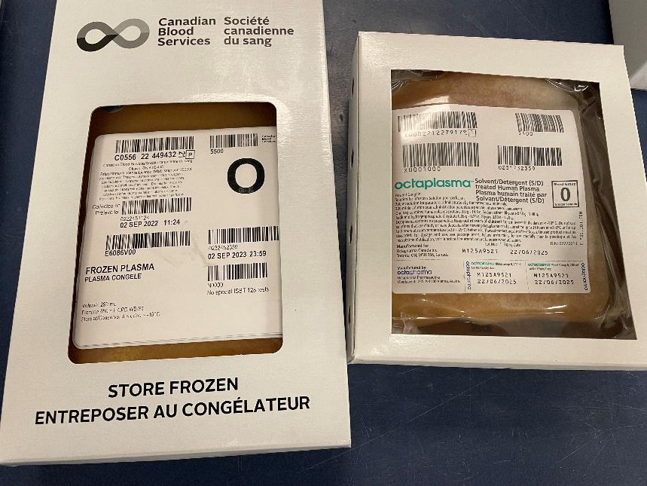
Octaplasma: product description
See the Octaplasma product monograph
Key points:
  Manufactured from pools of human plasma treated with solvent detergent.
  Standardized unit volume of 200ml.
  Blood group O, A, B and AB are available.
Frozen Plasma
Octaplasma
This document may be found on: Canadian Blood Services’ professional education website, profedu.ca
Information is current to January 12, 2023. Always refer to the Product Monograph for up-to-date information. Our product portfolio (octapharma.ca)
Notes:
For a full product description for Octaplasma, please refer to the Octaplasma product monograph.
A few key points to note are that:
Octaplasma is manufactured from pools of human plasma that is treated with solvent detergent.
The standardized unit volume for this product is 200ml.
Blood groups O, A, B and AB are available.

Slide 5
Octaplasma: labelling and tracking
See the Octaplasma product monograph.
As with all human blood-derived components and products, tracking is required for potential quarantine and retrieval purposes.
Each unit is labelled with a unique ISBT 128 tracking number and a lot number.
This document may be found on: Canadian Blood Services’ professional education website, profedu.ca
Information is current to January 12, 2023. Always refer to the Product Monograph for up-to-date information. Our product portfolio (octapharma.ca)
Notes:
For complete details regarding labelling, refer to the Octaplasma product monograph.
As with all human blood-derived components and products, tracking is required for potential quarantine and retrieval purposes.
Each Octaplasma unit is labelled with a unique ISBT 128 tracking number and a lot number.

Slide 6
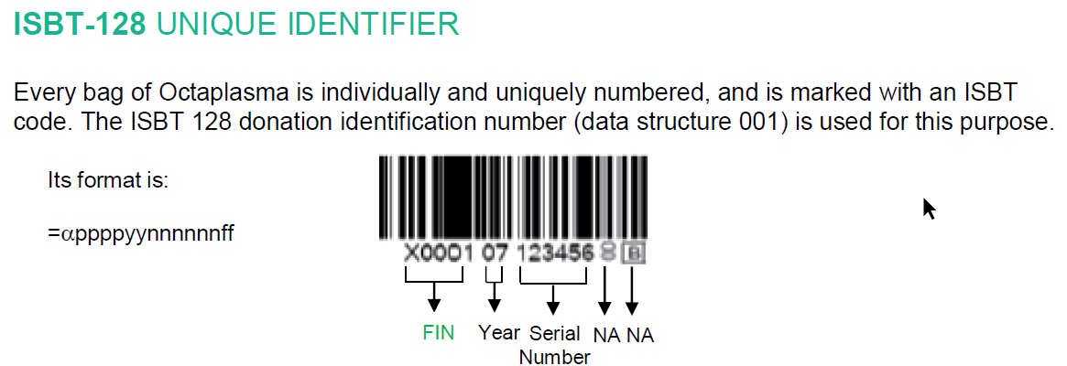
Octaplasma: labelling and tracking
For detailed product information, please refer to Octaplasma's product monograph.
For more about the unique identifier, see the Octapharma Blood Bank Communication attached to Customer Letter 2022-28.
Source: Octapharma. Octaplasma: Blood Bank Communication. June 2015. Attached to Canadian Blood Services Customer Letter 2022-28
Notes:
This slide shows an example of what the ISBT 128 unique identifier looks like and the format structure.
For more information about the unique identifier, please refer to the Octapharma Blood Bank Communication that is attached to Canadian Blood Services’ Customer Letter 2022-28.

Slide 7
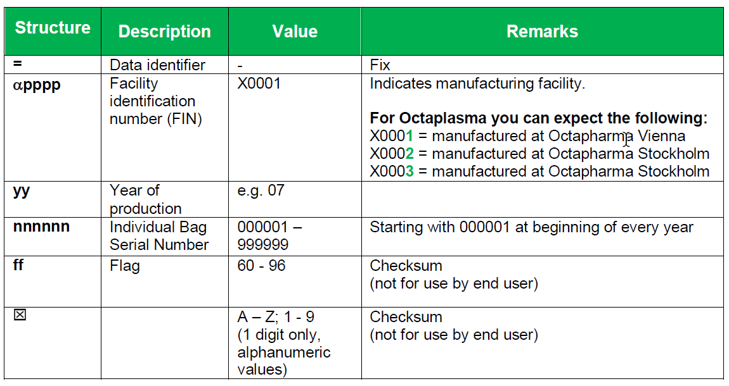
Octaplasma: labelling and tracking
Source: Octapharma. Octaplasma: Blood Bank Communication. June 2015. Attached to Canadian Blood Services Customer Letter 2022-28
Notes:
This is an excerpt from the Octapharma Blood Bank Communication attached to Customer Letter 2022- 28 regarding the unique identifier found on each Octaplasma unit.

Slide 8
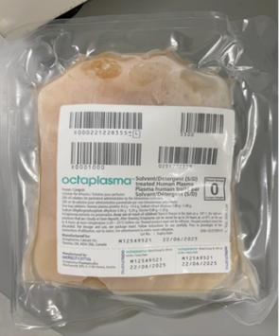
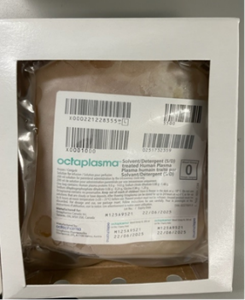
Octaplasma: packaging
See the Octaplasma product monograph
Packaged in cases of 10 units.
Each unit has an over-wrap of polyamide/ polyethylene.
Each individual unit is packaged in a cardboard carton.
This document may be found on: Canadian Blood Services’ professional education website, profedu.ca
Information is current to January 12, 2023. Always refer to the Product Monograph for up-to-date information. Our product portfolio (octapharma.ca)
Notes:
Please refer to the Octaplasma product monograph for complete information regarding packaging.
A couple items of note regarding packaging:
It is packaged in cases of 10 units
Each unit has an over-wrap of polyamide/polyethylene
Each individual unit is packaged in a cardboard carton

Slide 9
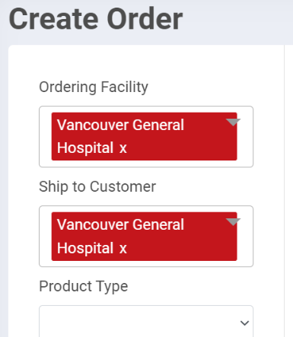
Octaplasma: ordering
Can be ordered from your local Canadian Blood Services distribution site using our Hospital Portal or contingency method.
Although this is a product manufactured by a pharmaceutical company and considered a plasma protein and related product, Octaplasma will be listed in its own Product Type section for ordering purposes.
This document may be found on: Canadian Blood Services’ professional education website, profedu.ca
Information is current to January 12, 2023. Always refer to the Product Monograph for up-to-date information. Our product portfolio (octapharma.ca)
Notes:
Octaplasma can be ordered from your local Canadian Blood Services distribution site using the CBS Hospital Portal or your hospital contingency method.
Although this is a product manufactured by a pharmaceutical company and considered a plasma protein and related product, Octaplasma will be listed in its own Product Type section for ordering purposes. This slide shows an example of what this will look like in the Hospital Portal.

Slide 10
Octaplasma: receiving and LIS
Upon receipt, inspect as per your transfusion service standard operating procedure.
We recommend that you set up this product in your laboratory information system using the unique identifier, as well as the product lot number.
This document may be found on: Canadian Blood Services’ professional education website, profedu.ca
Information is current to January 12, 2023. Always refer to the Product Monograph for up-to-date information. Our product portfolio (octapharma.ca)
Notes:
When receiving Octaplasma, inspect the product as per your transfusion service standard operating procedure.
Canadian Blood Services recommends that you set up the product in your laboratory information system using the unique identifier as well as the product lot number.

Slide 11
Octaplasma: storage
Follow the instructions in the Octaplasma product monograph.
Key points:
  Protect from exposure to light.
  Store at < -18 ⁰C.
  Follow the expiration date on the product.
This document may be found on: Canadian Blood Services’ professional education website, profedu.ca
Information is current to January 12, 2023. Always refer to the Product Monograph for up-to-date information. Our product portfolio (octapharma.ca)
Notes:
For complete instructions for storage of Octaplasma, please refer to the Octaplasma product monograph.
Some key points regarding storage are as follows:
Protect the product from exposure to light
Store the product at <-18°C
Follow the expiration date on the product

Slide 12
Octaplasma: thawing
Follow the thawing instructions in the Octaplasma product monograph.
Thawed Octaplasma should be stored at the temperature indicated in the product monograph and for the maximum time indicated.
Earlier reports of visible fibrin threads observed during thawing (see the CBS CL 2017-07 and Octapharma attachment) have been addressed in the updated Octaplasma product monograph.
This document may be found on: Canadian Blood Services’ professional education website, profedu.ca
Information is current to January 12, 2023. Always refer to the Product Monograph for up-to-date information. Our product portfolio (octapharma.ca)
Notes:
For thawing Octaplasma, follow the thawing instructions in the Octaplasma product monograph.
Thawed Octaplasma should be stored at the temperature indicated in the product monograph and for the maximum time indicated.
Please note that earlier reports of visible fibrin threads observed during thawing have been addressed in the Octaplasma product monograph.

Slide 13

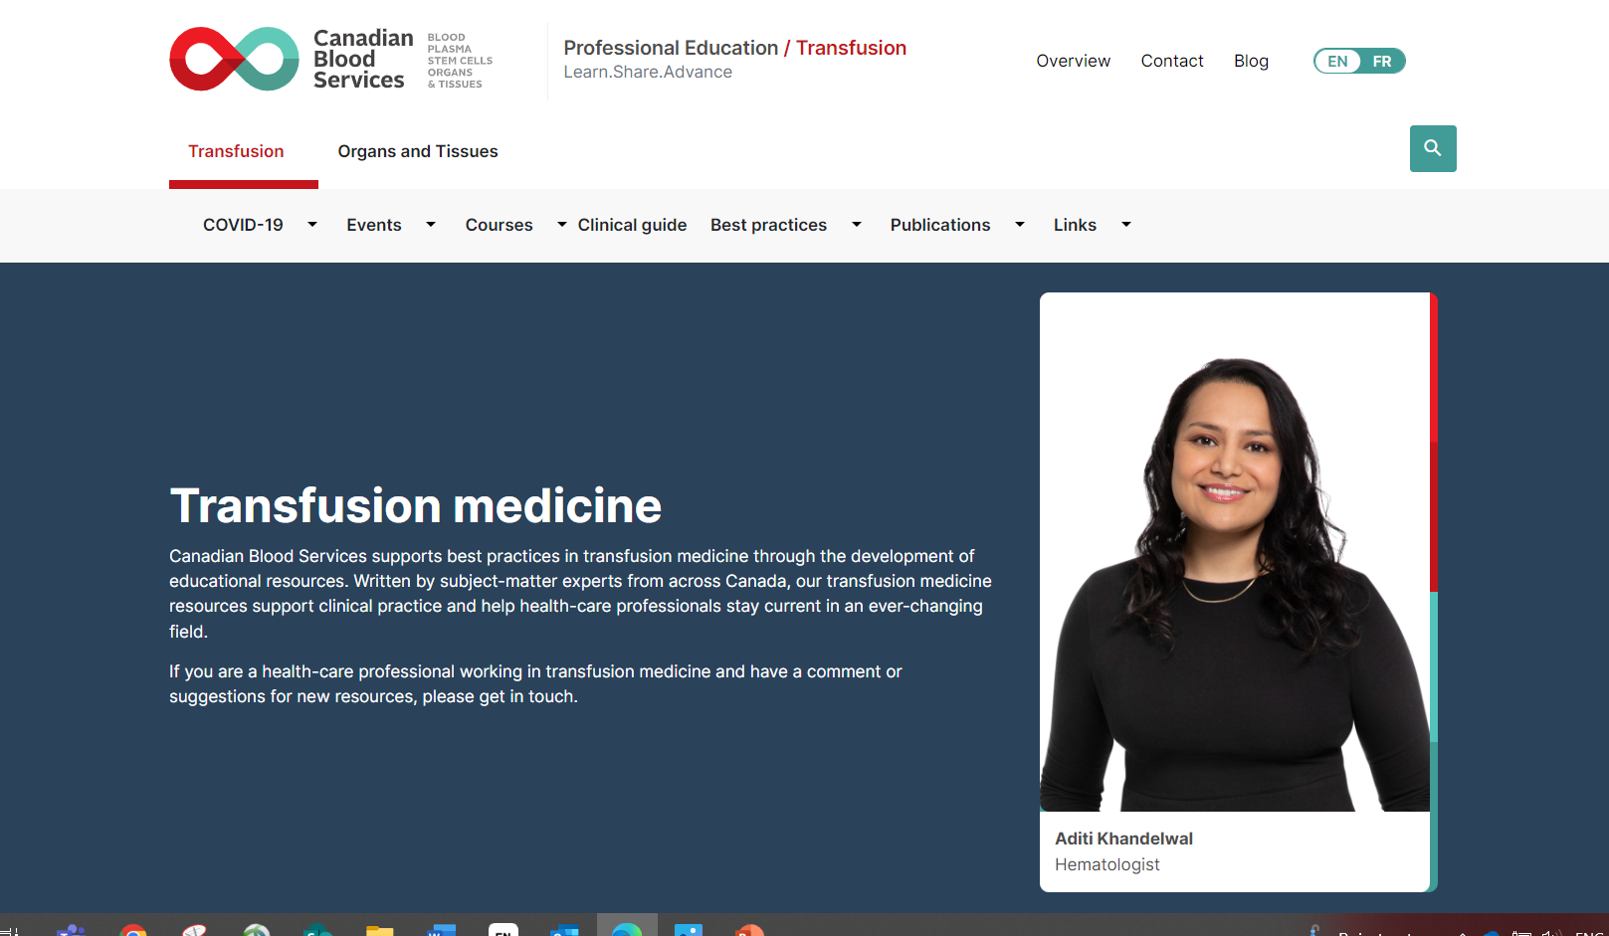
Additional resources
Notes:
Additional Resources

Slide 14
Resources
Octapharma Canada website (https://octapharma.ca)
Octaplasma product monograph
(https://octapharma.ca/en/therapies/product-overview)
FAQ: Solvent detergent (S/D) treated plasma (Octaplasma) (under publications on profedu.ca)
Including additional resources:
Octaplasma: Clinical overview slide deck (also available as narrated video)
Octaplasma: Information for laboratory technologists slide deck (also available as narrated video)
Octaplasma (S/D plasma): one-page clinical summary
This document may be found on: Canadian Blood Services’ professional education website, profedu.ca​
Information is current to January 12, 2023. Always refer to the Product Monograph for up-to-date information. Our product portfolio (octapharma.ca)​
Notes:
This slide is for your reference and lists many excellent resources that are available.
Octapharma has prepared many educational resources that are available on their website. As well, the product monograph should always be consulted.
At Canadian Blood Services, there are various educational resources about S/D plasma and many other topics on the Professional Education website.

Slide 15

Contact
Please contact Octapharma with any questions about Octaplasma.
Please contact your local Hospital Liaison Specialist with any questions about Canadian Blood Services and plasma.
This document may be found on: Canadian Blood Services’ professional education website, profedu.ca​
Information is current to January 12, 2023. Always refer to the Product Monograph for up-to-date information. Our product portfolio (octapharma.ca)​
Notes:
Please contact Octapharma with any questions about Octaplasma.
Please contact your local Hospital Liaison Specialist with any questions about Canadian Blood Services and plasma.

