Slide 1
Donor high titre isohemagglutinin (anti-A/anti-B) testing at Canadian Blood Services
November 2022
Slides prepared by Marc Bienz, Melanie Bodnar, Gwen Clarke
Source: Canadian Blood Services’ professional education website, profedu.ca

Slide 2
Background
What: To provide “Low Anti-A/B” labelled pooled and apheresis platelets and transfusable group A plasma confirmed by donor testing to have low isohemagglutinin titres
Why: To help support inventory management while mitigating the risk of acute hemolytic transfusion reaction (AHTR) when ABO incompatible components are required
How: Automated isohemagglutinin titre testing (anti-A1, anti-B) of all whole blood and apheresis donors
When: Starting November 7, 2022
Source: Canadian Blood Services’ professional education website, profedu.ca

Slide 3
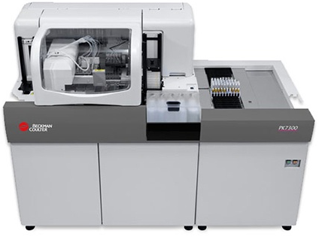
How will donor high titre isohemagglutinin testing be performed?
Example: high titre group A donor
A1
cells
B
cells
A1 cells
1:32
B cells
1:32
-A
-B
-AB
-D
CON
Performed with routine ABO and Rh typing
Inexpensive and uses existing infrastructure/reagents
Plasma of every donor tested on each donation
Ensures that no single donor with a very high isohemagglutinin titre
will impact the final pooled component
For donor to be considered low titre: plasma must test negative against both A1 cells and B cells
Testing is NOT performed on the final component
BECKMAN COULTER PK
Automated Microplate System
Source: Canadian Blood Services’ professional education website, profedu.ca
Notes:
All whole blood and apheresis donors will have automated anti-A1 and anti-B isohemagglutinin testing performed on each donation. Unlike at the hospital, this testing is performed on the donor and not on the final component. This is a very important distinction. High titre isohemagglutinin testing is done at the same time as the ABO and Rh typing of the donor on the Beckman Coulter PK analyzer.
The PK analyzer dilutes the donor plasma at a 1:32 dilution and tests the plasma separately against A1 and B cells.
This diagram illustrates testing on a group A donor with anti-B isohemagglutinins in their plasma (reacts against B cells in the reverse grouping). At a 1:32 dilution, the result is positive indicating that this is a high titre group A donor. Negative results are indicated by a small red dot. Positive results are indicated by a diffuse pattern of reaction. This donor would not be excluded from use in component manufacturing, but components manufactured from this donor cannot be labelled as low titre. For a group O donor, their plasma must test negative against both the A1 and B cells in order for the donor to be considered low titre.

Slide 4
What titre cut-off will be used for determining which donors are high titre?
≈
1:32
PK Analyser
1:128
Immediate spin (IS)
Source: Canadian Blood Services’ professional education website, profedu.ca
Notes:
The 1:32 titre cut-off on the PK analyser is roughly equivalent to a 1:128 cut-off by immediate spin manual tube testing.
Development work and validation studies included testing donor samples on the PK analyser, by saline tube testing read after immediate spin and at saline indirect antiglobulin phase (SIAT). These studies confirm that the PK analyser will reliably test positive at the 1:32 dilution for samples with a manual tube test immediate spin result greater than or equal to 1:128 IS. Negative results on the PK analyser were negative at 1:128 IS in all samples. The test has a high negative predictive value for this cut-off.

Slide 5
Why was a titre cut-off equivalent to 1:128 immediate spin selected for donor high titre testing?
Context
No agreed upon or standardized cut-off value
No recognized standard method for isohemagglutinin titre testing
Rationale
Most AHTR from surveillance systems occurred at titres above 1:128 (IS) or 1:256 by IAT
Cut-off must balance safety with availability of components
Experience
Canadian Blood Services is implementing the same donor high titre assay on the PK analyzer as that used by the NHSBT in Great Britain and the Australian Red Cross Blood Service
Source: Canadian Blood Services’ professional education website, profedu.ca
Notes:
Acute hemolytic transfusion reactions due to the passive transfer of antibodies to group A and B antigens in ABO incompatible platelet transfusions are rare. There is no universally agreed upon testing method or titre cut-off value. The 1:128 manual titre immediate spin cut-off was chosen based on the experiences of other blood suppliers and hemovigilance data, which appear to support its use as a safe cut-off value.
Antibody titration is a semi-quantitative assay. The optimal titre cut-off value must balance two considerations: the ability to identify donors with the highest isohemagglutinin titres while ensuring a reasonable proportion of components are labelled as low titre. If the titre cut-off is too stringent, very few low titre components will be available and this will not be useful for inventory management.
The goal of this testing is to determine which donors have relatively higher titres and thus may be at higher risk of causing AHTR when out of group plasma containing components are used.

Slide 6
What are the advantages of using an automated method for isohemagglutinin titre testing?
1. Better efficiency, consistency, sensitivity and reproducibility compared to manual methods
2. Equitable access: Large scale testing by Canadian Blood Services gives hospitals not equipped to perform titre testing access to low titre components
Source: Canadian Blood Services’ professional education website, profedu.ca

Slide 7
What are the advantages of using an automated method for isohemagglutinin titre testing?
3. PK7300 can detect some high IgG titre (albeit not as sensitive as IAT)
Patients with high titre IgM
Patients with high titre
IgM and IgG
Patients with high titre IgG
Manual IS
(22°C, no incubation)
PK analyser
(28°C, 60 min incubation)
Manual IAT
(37°C, 60 min incubation)
Source: Canadian Blood Services’ professional education website, profedu.ca
Notes:
Many hospital sites perform immediate spin (IS) manual tube testing on the final component using a titre cut-off of 1:50.
Although the donor titre cut-off used by Canadian Blood Services is higher, there are important differences in this testing approach: 1) platelet pools will have the additional dilutional effect of four or seven donors in a pool (for untreated and pathogen reduced platelets respectively); and, 2) the PK assay is performed using a 1 hour incubation at a higher temperature (28°C) than immediate spin room temperature assays (22°C) and appears to detect some high titre IgG isohemagglutinins albeit not with the same degree of sensitivity of an IAT (indirect antiglobulin test) method.
Validation studies showed that positive test results on the PK were often negative at 1:128 IS but positive at 1:128 IAT. In our preliminary development work, up to one third of donors who were positive by the PK were positive only by a 1:128 SIAT (saline indirect antiglobulin test) with a negative result by 1:128 immediate spin tube test.

Slide 8
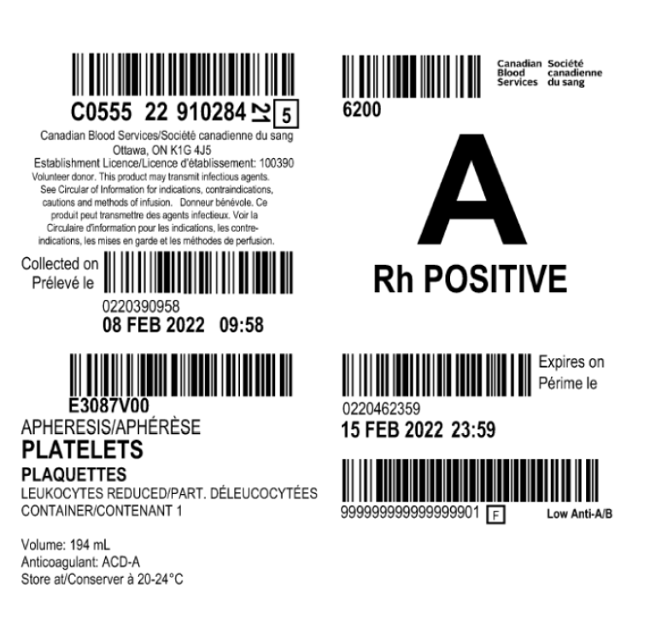
How will blood components be labelled to indicate that they are low titre?
Components will be labelled as “Low Anti-A/B” if all contributing donors test as low titre
Which components will be labelled?
Group A, B and O pooled untreated platelets
Group A, B and O pathogen-reduced platelets
Group A, B and O untreated apheresis platelets
Group A plasma
Source: Canadian Blood Services’ professional education website, profedu.ca
Notes:
The COI names for the labelled components are as follows:
Pooled untreated platelets = Pooled platelets LR CPD
Pathogen-reduced platelets = Pooled platelets psoralen-treated
Apheresis platelets = untreated apheresis platelets
Components that are considered low titre based on donor testing will be labelled as “Low Anti-A/B”. For platelet pools, all donors in the pool must individually test as low titre. For group O donors, both anti-A and anti-B must be below the pre-established cut-off for that donor to be considered low titre. “Low Anti-A/B” will be both an eye-readable and bar-code readable attribute. Only low titre components will be labelled. Components that are unlabelled may be derived from one or more donors who did not meet criteria for being considered low titre or, less commonly, may not have been tested. This same automated PK assay is being used for low titre group O whole blood that is being manufactured by Canadian Blood Services for military use (not available to hospitals for civilian use at this time).

Slide 9



Is low titre a consideration in the platelet pooling process?
No.
Each of the four randomly selected
donors in an untreated platelet pool must test as low titre for the final pooled component to be considered low titre.
LT
LT
HT
LT
LT
LT
LT
LT
Unit not labelled “Low anti-A/B”
Unit labelled “Low anti-A/B”
LT
Source: Canadian Blood Services’ professional education website, profedu.ca
Notes:
At the current time, low titre donors will NOT be deliberately selected for inclusion in a platelet pool during the manufacturing process.
All four donors (including the donor plasma used for reconstitution) are randomly selected with respect to donor titre status.

Slide 10
Using this high titre assay, what proportion of donors are estimated to test as low titre?
Donor type | Proportion (%)
Group O | 60–70
Group A | 80–90
Group B | 85–95
Source: Canadian Blood Services’ professional education website, profedu.ca
Notes:
The values provided are estimates based on results from the literature, preliminary validation data and other blood group suppliers. There are many factors that can influence a donor's isohemagglutinin levels: age, sex, recent vaccination status, even diet and consumption of probiotic foods.
We will provide updated data from Canadian donors as this testing proceeds on a larger scale. There may be fluctuations in the relative proportion of donors who test positive for high titre isohemagglutinins over time although data from other blood suppliers and the literature suggests that this is usually minimal.

Slide 11
If a pooled platelet concentrate is not labelled as “Low Anti-A/B”, is it still possible that the final component is low titre?
Yes
The dilution of a high titre donor by other donors in the pool may result in a final low titre platelet component even though it is not labelled as such.
Source: Canadian Blood Services’ professional education website, profedu.ca

Slide 12
Should hospitals that routinely perform high titre isohemagglutinin testing on platelet concentrates continue to do so?
Yes
This will depend on a hospital’s demand for ABO incompatible platelets.
For untreated platelet pools it is estimated 15-20% will be labelled
“Low anti-A/B”
LT
LT
HT
HT
Up to 80% may be low titre
Notes:
Larger hospitals that currently perform high titre testing on the final platelet component and require a steady, consistent supply of low titre platelets should continue to do so as Canadian Blood Services may not be able to meet their demands for low titre platelets. The development work for this high titre assay was primarily done in the context of untreated non-pathogen-reduced platelets.
As shown, when testing is performed by the hospital, up to 80% of platelet pools may test as low titre (estimate based on data provided through personal communication from select hospitals and proportion may vary depending on the cut-off and test method used). By contrast, when testing is performed on the donor, given the requirement for all 4 randomly selected donors in a platelet pool to test negative, only 20% of untreated platelet pools are expected to be labelled as low titre. This “discrepancy” is the rationale for why hospitals with a large demand for low titre platelets should continue their own in house testing.
Note that with the current testing and manufacturing strategy, this discrepancy will be even greater for pathogen-reduced platelets as addressed later in the presentation.

Slide 13
Why is Canadian Blood Services performing high titre isohemagglutinin testing on donors and not on the final blood component?
Testing of donors:
Uses existing cost-effective, automated infrastructure
Donor testing process effectively established by other large blood suppliers
Enables the labelling of multiple component types as low titre
Testing of final component rather than donors would:
Impact manufacturing efficiency
Delay the distribution of platelet and plasma components
Source: Canadian Blood Services’ professional education website, profedu.ca

Slide 14





How should low titre platelet inventory be distributed and used?
Each facility must determine how best to incorporate labelled low titre platelets into their inventory management strategy.
Preliminary modelling studies show that for hospitals who use a hub and spoke model of distribution, the diversion of labelled low titre platelets to smaller hospital sites with limited platelet inventory may reduce discard rates
HT/LT
LT
Source: Canadian Blood Services’ professional education website, profedu.ca
Notes:
This work was done by John Blake at Canadian Blood Services and was published in abstract form at the AABB 2022 conference.

Slide 15
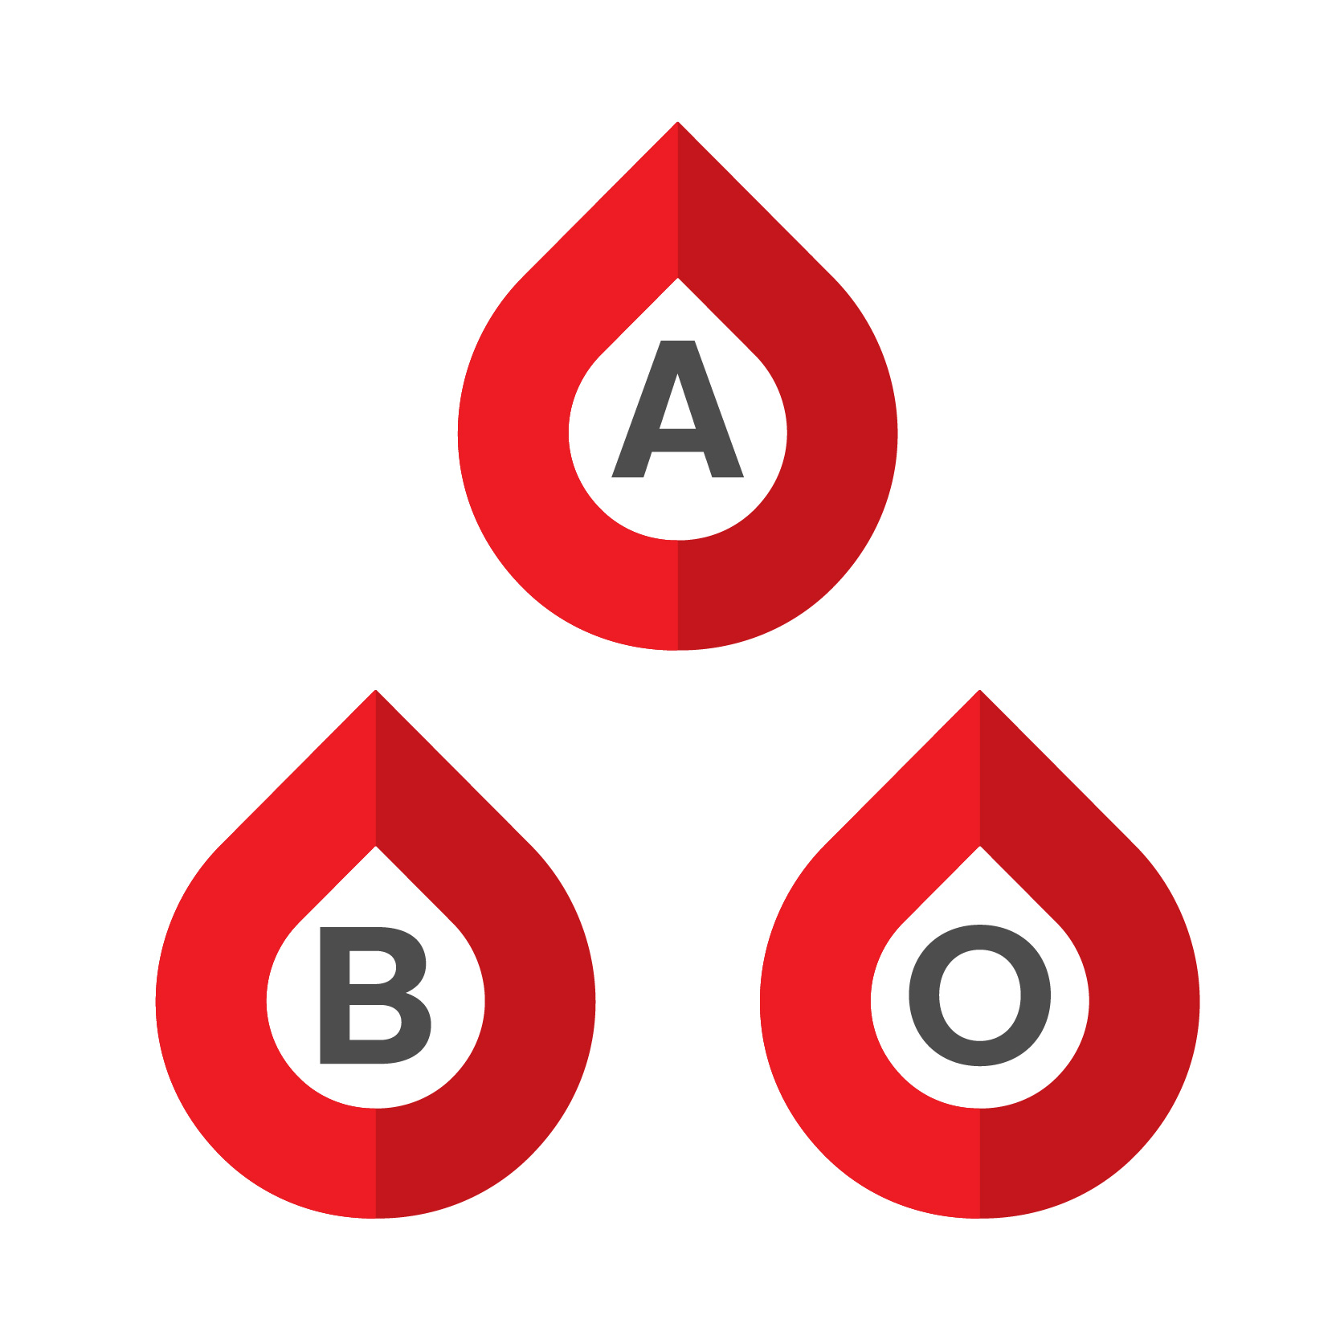
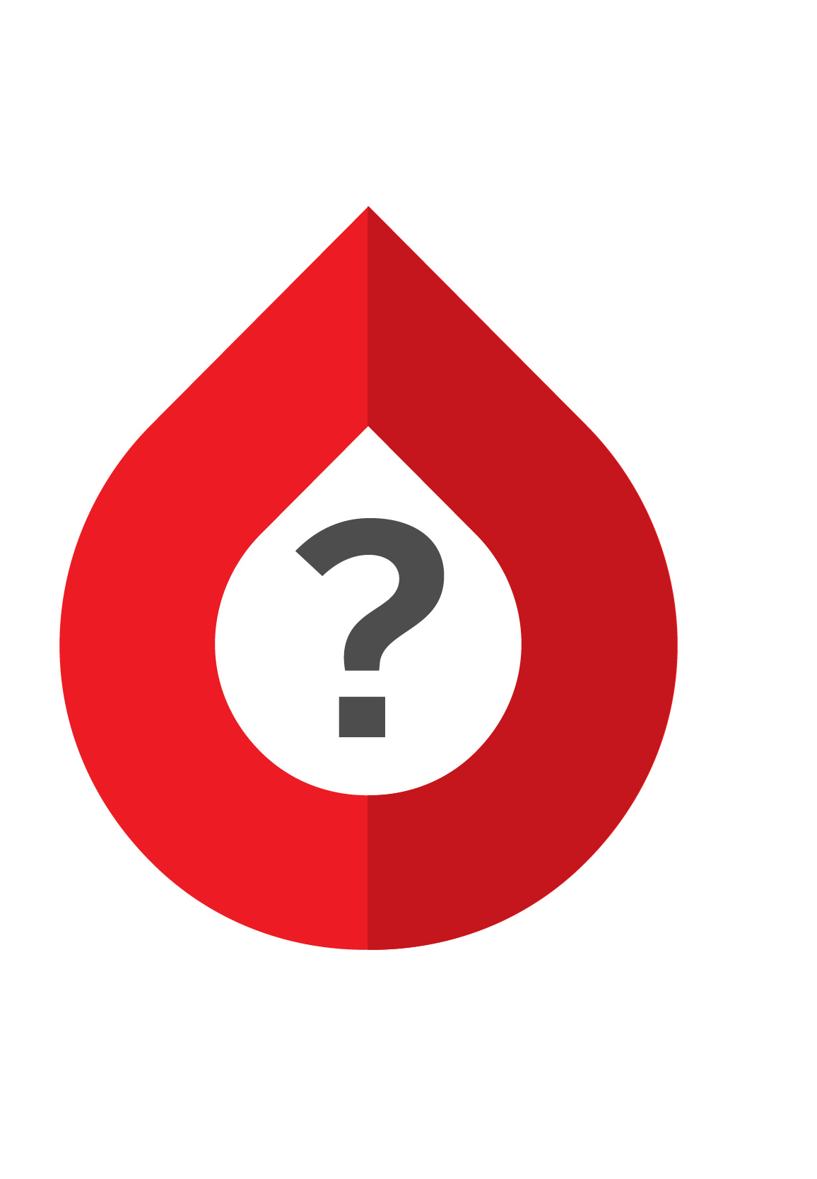
How should low titre group A plasma inventory be distributed and used?
80–90% of group A donors will test as low titre
Hospitals that use group A plasma for emergency use when a recipient’s ABO group is unknown may want to internally prioritize labelled low titre group A plasma for use in trauma patients and massive hemorrhage protocols.
Source: Canadian Blood Services’ professional education website, profedu.ca

Slide 16



Can low titre blood components be specifically requested or ordered?
No. Specific orders for low titre components is not possible at this time.
Distributed on a “first-in-first-out” basis to help maintain national inventory and avoid component wastage.
ORDER
​PICK-UP
LT
LT
LT

Slide 17
Does donor high titre testing eliminate the risk of acute hemolytic transfusion reactions due to ABO incompatible platelet or plasma transfusions?
Low titre testing = mitigation strategy ≠ risk elimination strategy
Intrauterine transfusion
Recipient with small total blood volume
Neonates
↑ risk of AHTR if...
Pediatrics
Large transfused volume
The optimal platelet or plasma component for transfusion is one that is ABO identical
Source: Canadian Blood Services’ professional education website, profedu.ca
Notes:
Donor high titre isohemagglutinin testing is a risk mitigation strategy.
The optimal platelet or plasma component for transfusion is one that is ABO identical, but when ABO incompatible platelets or plasma components must be used, a component that is labelled as low titre is safer than one that is untested or not labelled.
Recipients with a small blood volume (recipients of intrauterine, neonatal or pediatric transfusion) and those receiving a large cumulative volume of incompatible plasma infused over time may be at increased risk for a hemolytic complication despite the use of components labelled as low titre. This risk may be further magnified when using apheresis platelet components where all of the plasma comes from one donor and is not subject to the additional dilutional effects of pooling (for example, HLA and HPA selected apheresis platelets that contain ABO incompatible plasma from a single donor).
Other recipient factors and biologic characteristics of antibodies (aside from relative titre strength) may also influence the risk of acute hemolytic adverse events.
If an AHTR due to the use of components labelled as “Low Anti-A/B” is suspected, this should be reported to Canadian Blood Services following local procedures for reporting an adverse transfusion event (see Guide to reporting adverse transfusion reactions).

Slide 18
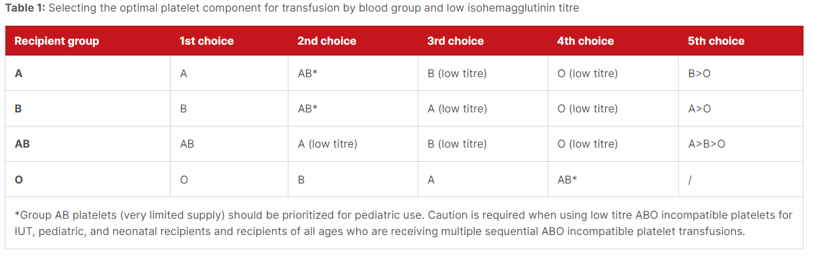
Given that platelet inventory will include a mix of components across ABO blood groups both with and without low isohemagglutinin titres, how should a platelet unit be selected for transfusion to an individual patient?
Source: Canadian Blood Services’ professional education website, profedu.ca
Notes:
The optimal platelet component is one that is ABO identical to the recipient, but due to inventory constraints and the short shelf-life of platelets, this may not be always be feasible.
The most important consideration with respect to ABO compatibility in platelet transfusion is the presence of passively transferred donor isohemagglutinins that may target the corresponding ABO antigens on the recipient’s red cells, potentially causing an AHTR.
While platelet recovery may be reduced in ABO incompatible platelet transfusions (i.e., recipient plasma contains isohemagglutinins against A and/or B antigens expressed on the platelet surface), this is usually not clinically significant.
Using group A platelets for group B patients (and vice versa) is preferred over group O if ABO identical components are not available. Group O individuals tend to have relatively higher overall levels of isohemagglutinins and a proportionately greater IgG component in addition to IgM isohemagglutinins. In practical terms, the selection of the optimal platelet component for any given patient will depend on the inventory at hand and the individual patient characteristics. This table may be used to support decision making.
Note that AB platelets are in very limited supply and should be prioritized for pediatric use (only 3% of Canadian blood donors are group AB). Only 9 % of Canadian donors are group B. Using the above table, in the case of a group A recipient, if there is no group A platelet available, the next choice will realistically be a low titre group O platelet as AB platelets and low titre group B platelets are unlikely to be available.

Slide 19
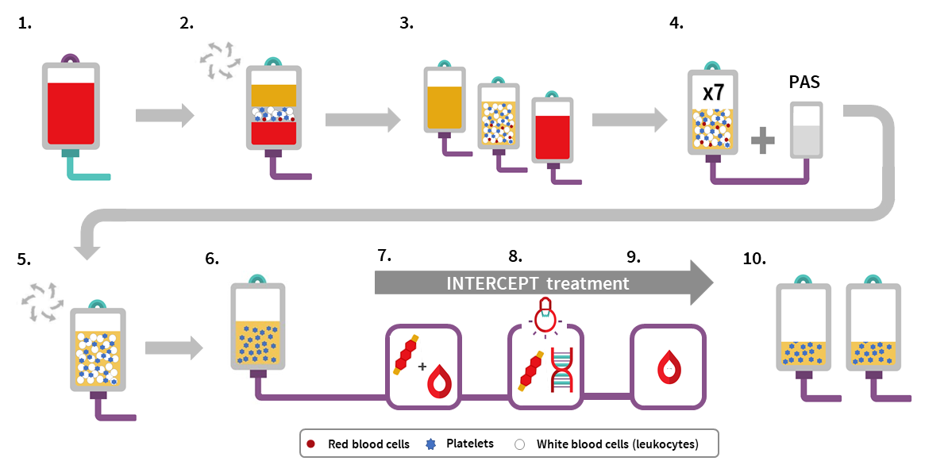
Pooled platelets psoralen-treated manufacturing
Source: Canadian Blood Services’ professional education website, profedu.ca​
Notes:
This figure is excerpted from Chapter 19 of Canadian Blood Services Clinical Guide to Transfusion and a description of each step is included in slide 12 of the additional resource Pathogen-reduced platelets – Clinical overview slide deck available here: Pathogen-reduced platelets | Professional Education (blood.ca).

Slide 20
How will the implementation of pathogen-reduced pooled platelets impact isohemagglutinin levels in the final component? Will isohemagglutinin testing still be necessary?
All 7 donors in a pathogen-reduced platelet pool must test as low titre for the final component to be labelled as such resulting in relatively fewer components being labelled as “Low Anti-A/B” with the current testing strategy
Platelet additive solution (PAS) will reduce the isohemagglutinin levels in the final component due to the removal of approximately 60% of the donor plasma
Preliminary data from other blood suppliers suggests that even with the use of PAS donor high titre testing is still warranted
Work is ongoing to determine the optimal isohemagglutinin testing strategy for pathogen-reduced platelets
Source: Canadian Blood Services’ professional education website, profedu.ca
Notes:
With regards to pathogen-reduced platelets, there are two important factors that will impact isohemagglutinin titres and the proportion of components that will be labelled as low titre. First, the use of platelet additive solution during the manufacturing process will result in a dilutional effect on the isohemagglutinin levels in the final component. The magnitude of this effect is uncertain, but a recently published study on apheresis platelets suggest that isohemagglutinin levels may be reduced by half (for example, a titre of 32 will be reduced to 16 after use of PAS). This is consistent with the fact that PAS replaces approximately 60% of the donor plasma.
Secondly, pathogen-reduced platelets manufactured at Canadian Blood Services have 7 donors in a pool rather than 4. Based on current criteria, all 7 randomly selected donors in the pool must test as low titre for the final component to be labelled as such. The probability of all 7 group O donors being low titre is estimated at 8-10%.
With the current testing and manufacturing strategy, an even smaller number of components will be labelled as low titre even though a proportionately larger number of components would be expected to be low titre due to the use of PAS.
Preliminary data from other blood suppliers and a limited number of published studies suggest that isohemagglutinin titre testing is still warranted in the era of pathogen-reduced platelets and platelet additive solution. However, the optimal testing strategy remains to be determined and is actively being explored at Canadian Blood Services.

Slide 21
Together, we are Canada’s Lifeline

