Slide 1
Pathogen-reduced platelets: component overview
Published: October 2022
Updated: July 2023
Source: Canadian Blood Services’ professional education website, profedu.ca
Notes:
This presentation was originally published in October 2022. It was updated in April 2023 to reflect a change in PPPT shelf-life from 5 to 7 days and July 2023 following Health Canada's approval of APPT and untreated apheresis platelet in PAS-E.

Slide 2

Overview
Brief overview of pathogen inactivation technology (PIT)
Component characteristics
Implementation
  Hospital implementation considerations
  Labels
Resources
Contact
Source: Canadian Blood Services’ professional education website, profedu.ca
Notes:
This presentation will provide you with a brief overview of pathogen inactivation technology, the component characteristics of psoralen-treated, pathogen-reduced platelets compared to untreated platelets, and some implementation considerations. It will also provide links to additional resources.

Slide 3
Acronyms
Acronym(s) | Name
PPPT | Pooled platelet psoralen-treated
APPT | Apheresis platelet psoralen-treated
PIT | Pathogen inactivation technology
PAS | Platelet additive solution PAS-E is the formulation of PAS used at Canadian Blood Services
AP in PAS | Apheresis platelet in PAS-E, not pathogen-reduced
Source: Canadian Blood Services’ professional education website, profedu.ca
Notes:
Psoralen treatment is the method we use to pathogen-reduce the platelets. Components referred to as psoralen-treated are pathogen-reduced. Acronyms used in this presentation are: (read slide)

Slide 4

Pathogen inactivation technology (PIT)

Slide 5
Platelet components
Existing components, in plasma
  Untreated pooled platelet (Pooled platelets LR CPD)
  Untreated apheresis platelet (Apheresis platelet)
New platelet components, in platelet additive solution (PAS-E)
  Pooled platelet psoralen-treated (PPPT)
  Apheresis platelet psoralen-treated (APPT)
  Untreated apheresis platelet in PAS-E
Source: Canadian Blood Services’ professional education website, profedu.ca
Notes:
Currently, two untreated or non-pathogen reduced platelet components are manufactured by Canadian Blood Services – untreated pooled platelets in plasma and untreated apheresis platelets in plasma. In December 2021, Health Canada approved the use of Cerus’ INTERCEPT Pathogen Inactivation Technology for manufacturing pooled platelets psoralen-treated (PPPT) at Canadian Blood Services. PPPT was introduced by Canadian Blood Services at select hospitals in January 2022, and manufacturing will roll out across production centres in 2023.
Canadian Blood Services received Health Canada approval for the manufacturing of 2 new platelet components beginning in June 2023 - apheresis platelet psoralen-treated (APPT) and untreated apheresis platelet in PAS-E. Implementation of these two platelet components will also roll out across production centres in 2023.

Slide 6



Pathogen inactivation technology
Canadian Blood Services has introduced Cerus' INTERCEPT pathogen inactivation technology (psoralen treatment) to manufacture PPPT as an additional layer of safety against:
      Bacterial contaminants (gram-positive and gram-negative)
      Viruses (enveloped and non-enveloped)
      Protozoa parasites
      White blood cells (leukocytes), which can no longer replicate rendering irradiation unnecessary
Source: Canadian Blood Services’ professional education website, profedu.ca
Notes:
It should be noted that our untreated platelet components are very safe. The pathogen inactivation technology adds an additional layer of safety against bacterial contaminants, viruses, protozoa parasites and white blood cells. The white blood cells can no longer replicate, rendering irradiation of psoralen-treated components unnecessary.

Slide 7
Pathogen inactivation technology
Psoralen-treated platelets
      Do not require irradiation as leukocytes can no longer replicate
      Contraindicated for neonatal patients treated with phototherapy devices that emit a peak energy wavelength less than 425 nm, OR have a lower bound of the emission bandwidth <375 nm
      Are resuspended in a PAS/plasma solution
      Please see our clinical presentation for more details on manufacturing, PAS, benefits, indications and contraindications
Source: Canadian Blood Services’ professional education website, profedu.ca
Notes:
(Read out slide)

Slide 8

Component characteristics: psoralen-treated vs. untreated

Slide 9
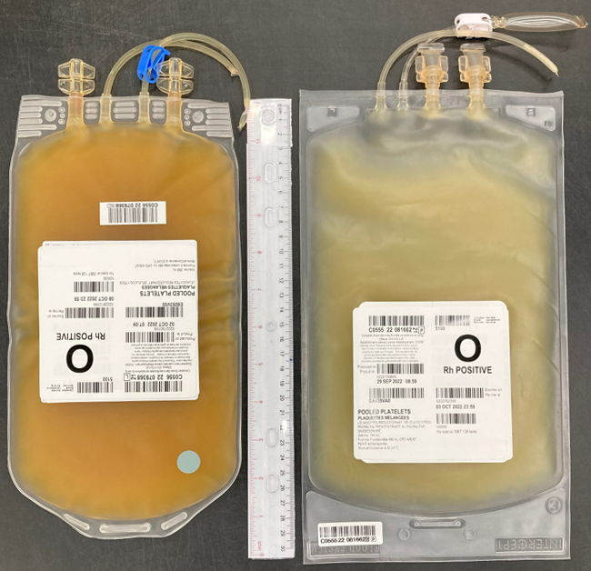
Untreated pooled platelet in plasma
Pooled platelet psoralen-treated (PPPT)
Tubing
Pouch & clip
Ports
Port
Port
Source: Canadian Blood Services’ professional education website, profedu.ca
Notes:
This slide illustrates the difference in appearance of both components. On the right, the bag of the new psoralen-treated pooled-platelet is slightly longer and wider than the untreated pooled platelet bag on the left. The treated component is lighter in color due to the addition of the Platelet Additive Solution.

Slide 10
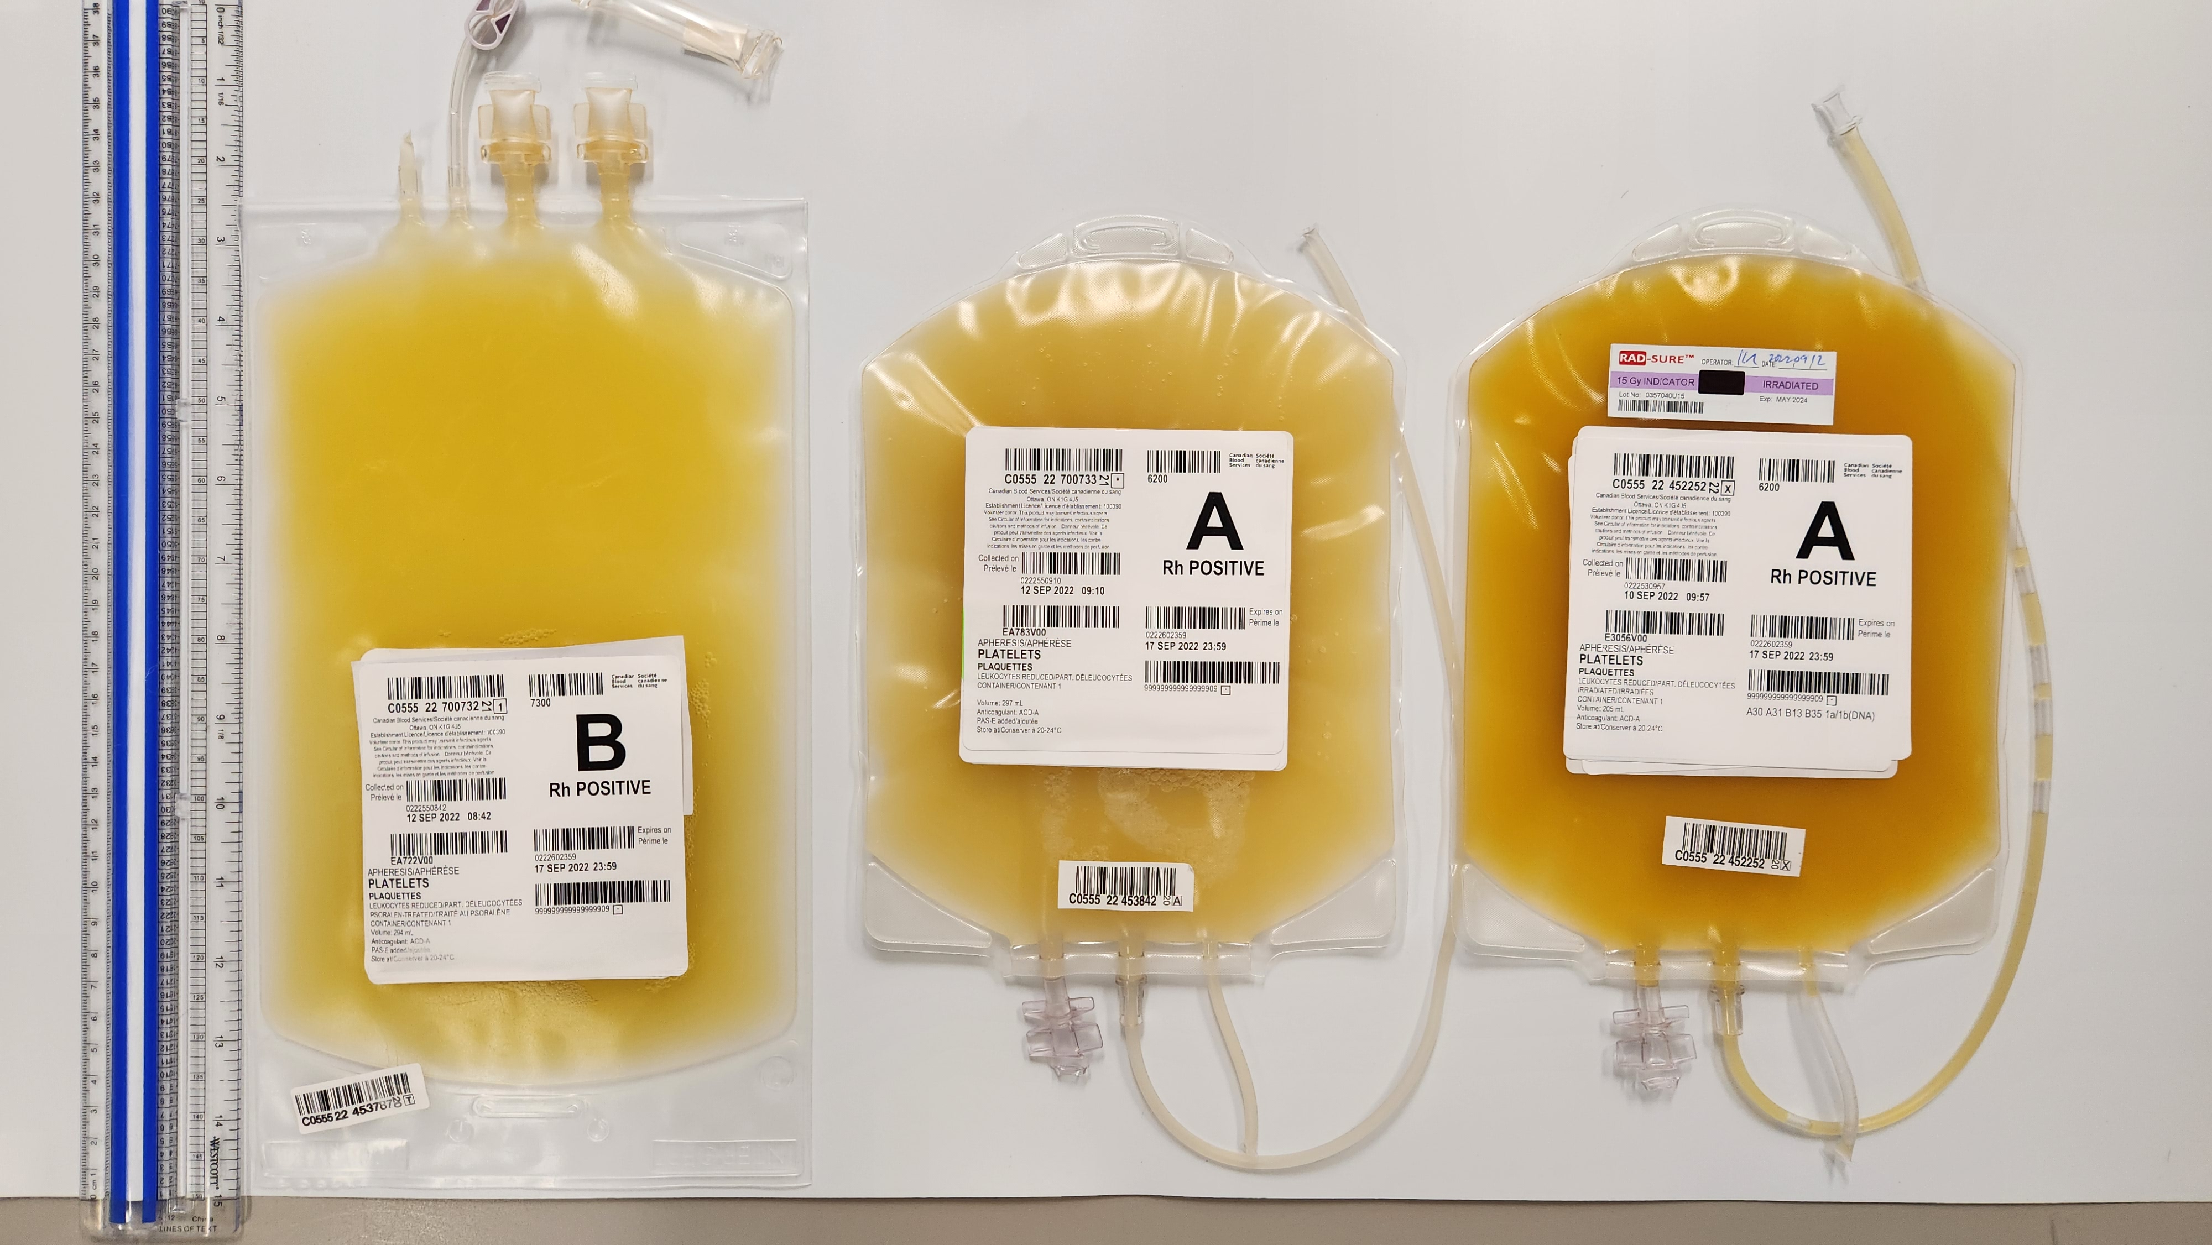
Apheresis platelet psoralen-treated (APPT)
Untreated apheresis platelet in PAS-E
Untreated apheresis platelet in plasma
Pooled platelets psoralen-treated (PPPT)
Untreated pooled platelets in plasma
Notes:
This slide illustrates the difference in appearance of the apheresis components. On the left, the bag of the new psoralen treated apheresis platelet, the middle is the untreated platelet in PAS-E and the right is the untreated apheresis platelet that you are familiar with.

Slide 11
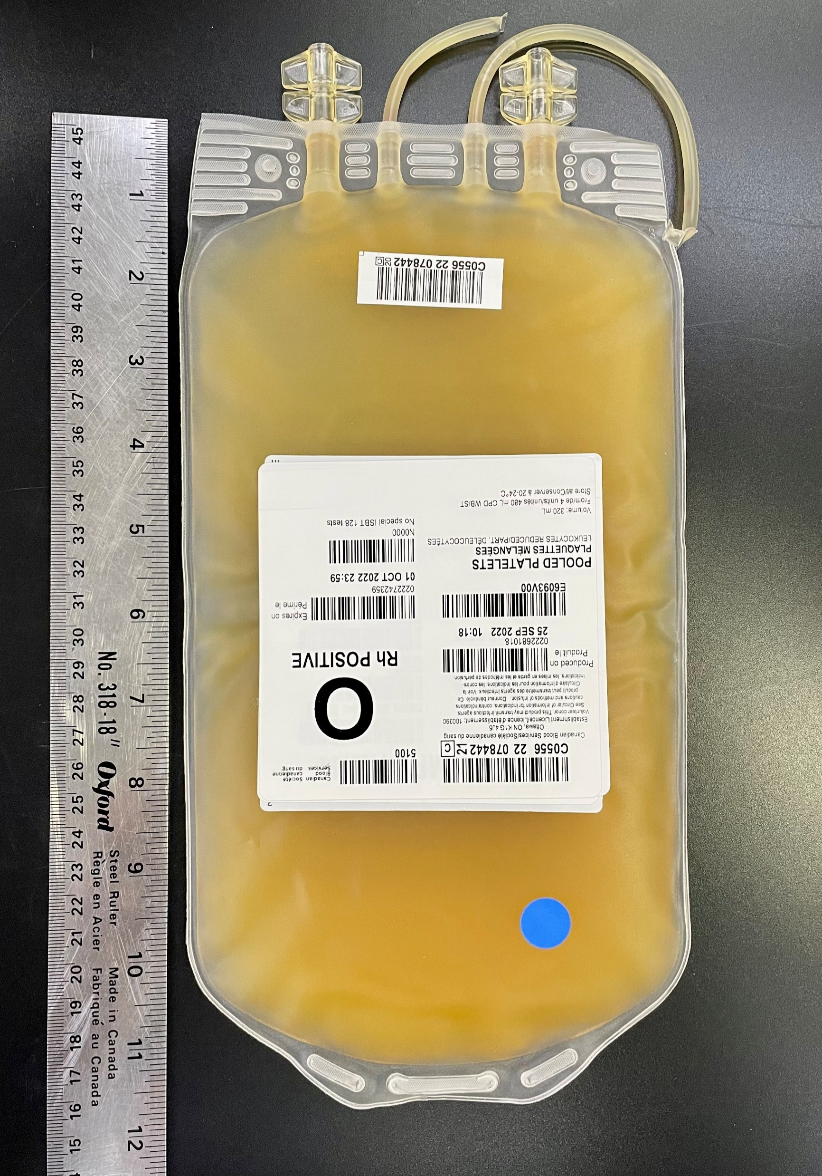
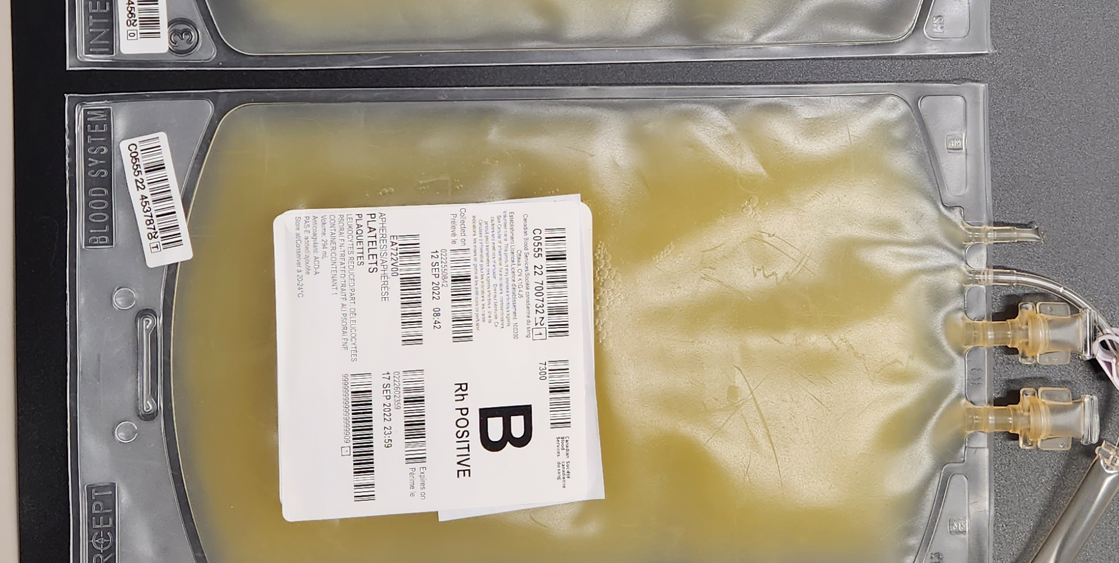
Psoralen-treated vs. untreated pooled platelet
 | Untreated pooled platelets | Psoralen-treated
Size | 30 cm x 15 cm | 31 cm x 18 cm
Ports | 2/ bag | 2/ bag
Sampling lines | 1 x ~12 cm attached tubing segment | 1 x sampling pouch
Bag material | PVC-BTHC (tubing contains DEHP) | Ethylene-vinyl acetate (EVA) (tubing contains DEHP)
Source: Canadian Blood Services’ professional education website, profedu.ca
Notes:
The bag of the treated pooled component is 1 cm longer and 3 cm wider.
They both have two ports.
The PPPT bag has a sampling pouch, instead of extra tubing, that can be used for testing, which will be further demonstrated later in this presentation.
Like the current material, the EVA bags do not contain any DEHP plasticizer, however, the attached transfusion ports and tubing may be made of plastics that contain DEHP. Platelet units may also come into contact with DEHP plasticizer during collection and component manufacturing.

Slide 12
Psoralen-treated vs. untreated pooled platelet
 | Untreated pooled platelets | Psoralen-treated
Volume | 317 mL (±16)* | 184 mL (±9)**
Platelet Yield (x10⁹ platelets per unit) | 339 (±44)* | 251 (±32)**
Composition | From 4 units of WB | From 7 units of WB then split in 2
Suspended in | 100% plasma | ~40% plasma / ~60% PAS-E
*Pooled Platelets LR CPD, Apheresis Platelets Circular of Information, January 2022
**Pooled Platelets Psoralen-treated Circular of Information,
January 2022
Average plasma volume in pooled platelets psoralen-treated is expected to be ~75 mL (184 mL x 40% = ~75 mL) compared to current pools with an average of 317 mL (100% plasma)
Please refer to our Circulars of information on blood.ca for more details
Source: Canadian Blood Services’ professional education website, profedu.ca
Notes:
Treated platelets are a much lower volume than untreated pooled platelets, on average about 130 ml less, and contain much less plasma.
The platelet yield is lower in the treated component, but there is evidence that there is no significant difference in bleeding risk between treated and untreated platelets. Please refer to the clinical presentation for more information.
The untreated pooled platelet component is made from the buffy coat pools of 4 donors and suspended in 100% plasma from a male donor. Treated platelets are made from pools split from 7 donors and are suspended in an approximately 60/40 PAS-E/plasma solution.
(Read bottom bullets)

Slide 13
Psoralen-treated vs. untreated pooled platelet
 | Untreated pooled platelet | Psoralen-treated
Total Shelf life | 7 days* | 7 days**
Available Shelf life | 5 days (max) | 6 days (max)
Release into inventory limited by | Completion of hold period for BacT culture | Completion of Intercept treatment (no BacT culture)
Maximum typical shelf-life | ~4 days | ~4-5 days
 | Note: Due to First In First Out (FIFO) practices and operational requirements, platelets are not always released on first day available
*Pooled Platelets LR CPD, Apheresis Platelets Circular of Information, January 2022
**Pooled Platelets psoralen-treated Circular of Information, April 2023
Source: Canadian Blood Services’ professional education website, profedu.ca
Notes:
The 7-day shelf life of PPPT was approved by Health Canada effective April 24, 2023.
Since the manufacturing process with psoralen does not require bacterial testing prior to release into inventory, the treated platelets are available for end labelling to the hospitals approximately one day sooner than the untreated pooled platelets. Typically, the maximum shelf life for the hospital of an untreated pooled platelet is ~4 days whereas for the treated pool is ~4-5 days.
Freshest platelets are not always released on the day they become available as they are released based on First In First Out practices and maximized operations at Canadian Blood Services to minimize outdates.

Slide 14
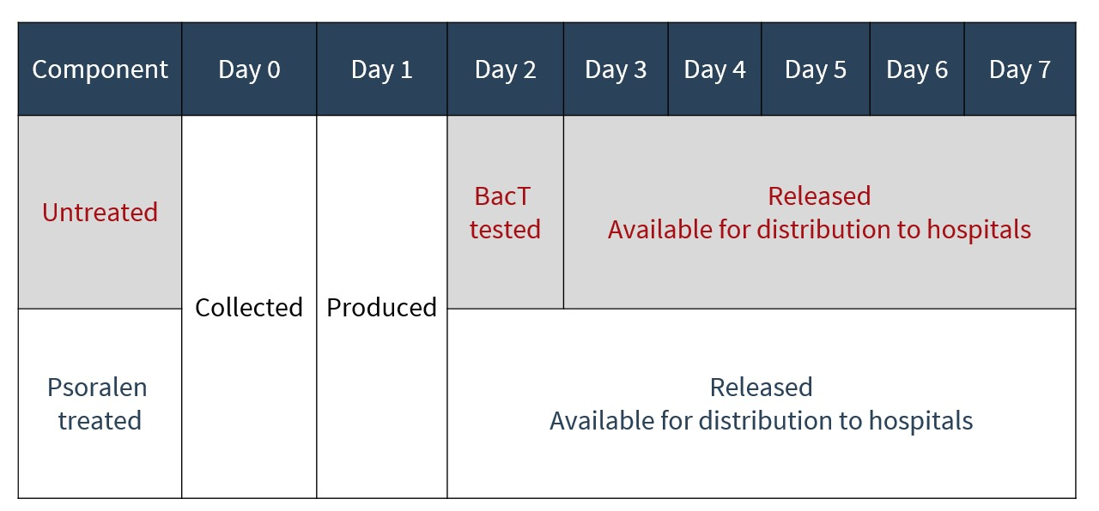
Manufacturing timelines – shelf life
Shelf life: untreated platelets vs. psoralen-treated
Note: Due to First In First Out (FIFO) practices and operational requirements, platelets are not always released on first day available
Notes:
This slide shows another visualization comparing the shelf-life of treated and untreated components.

Slide 15


Hospital considerations
Timelines
IT systems
Transfusion policies
Staff training
New Circular of Information

Slide 16

Anticipated implementation timeline for pathogen- reduced platelets
Implementation of PPPT, APPT and AP in PAS is rolling out across the country.
Please consult our most recent customer letter on national implementation of pathogen-reduced platelets or reach out to your local Hospital Liaison Specialist for details and timelines.
Notes:
Read slide. Customer letters are being released on a regular basis to update hospitals on implementation roll out progress.

Slide 17

Hospital implementation considerations
Hospital IT:
  ISBT Component Code (more on next slides)
  Incorporate into CPOE (Computerized Physician Order Entry)
    Indicate psoralen-treated component is equivalent to irradiated
Administration of component:
  Assess/revise transfusion policies
  Inform staff that irradiation is not required/indicated
  Patient and nurse education
  Example materials (bag & label) can be provided upon request (contact your CBS Hospital Liaison Specialist)
Please refer to the most recent Circular of Information on blood.ca
Source: Canadian Blood Services’ professional education website, profedu.ca
Notes:
For Hospital IT, please ensure to add the ISBT component codes to the LIS.
The new components need to be incorporated into the CPOE and indicate that the Psoralen-treated component is equivalent to irradiated
For component administration, please assess and revise transfusion policies
Inform staff that irradiation is not required or indicated for the treated components.
Education will be required for nurses and patients
Example bags and labels can be provided upon request (contact your HLS)
Please refer to the most recent circular of information on blood.ca

Slide 18
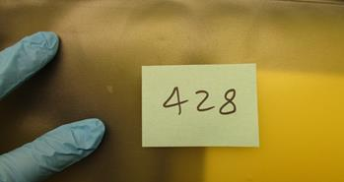
Hospital implementation considerations
Blood bank/perfusionists/nurses:
Smaller unit volume (mass) and EVA plastic causes bags to slide on the agitator trays
  Inexpensive magnetic clips are recommended to secure bags to the agitator shelf
Microaggregates have been reported in some units.
  Platelets containing visible particles are not inferior to particle-free concentrates*
  Aggregates should dissipate following agitation
  Placing units in landscape orientation on agitator may help reduce aggregate formation
* Feys B, Devloo R, De Pourcq K, et al.: Apheresis platelet concentrates containing visible particles are not inferior to particle-free concentrates, in vitro. Vox Sanguinis 2013; 105(Suppl. 1):11
Notes:
(Read slide) It is important to note that the microaggregates have been observed in other countries using this technology.

Slide 19
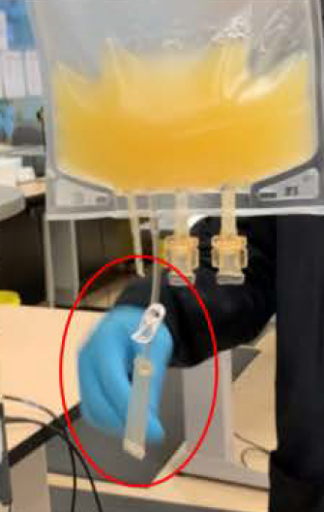
Hospital implementation considerations
Blood bank/perfusionists/nurses:
  Sampling line – the usual sampling line will be replaced by a single line with an integral sampling chamber which can be used to take a sample from the unit. This new configuration is compatible with the use of Hematype Segment Sampling Device.
  Ports – the ports on the new container are ISO compliant. No change to spiking technique is required.
Source: Canadian Blood Services’ professional education website, profedu.ca
Notes:
This picture provides you with a closer look at the sampling line and pouch which can be used to take a sample from the unit. This configuration allows for the use of a Hematype Segment Sampling Device.
The sampling line can also be used for sterile docking.
The ports are ISO compliant, therefore no change to current spiking technique is needed. There have been no reports to date of any issues with spiking of the new bags.

Slide 20
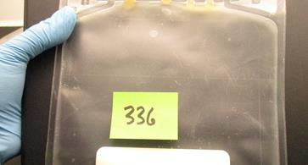
Hospital implementation considerations
Blood bank/perfusionists/nurses
  The new bag is made of EVA plastic (ethylene-vinyl acetate) which is more prone to show scratches and wrinkles. Strictly cosmetic, no impacts on platelet quality.
As with any blood component, it is good practice to confirm acceptability by visual inspection.
New Visual Inspection Tool is being finalized and will be posted to our Professional education website
Source: Canadian Blood Services’ professional education website, profedu.ca
Notes:
The bags of the new pathogen-reduced pooled platelets are made of EVA plastic. This type of plastic is more prone to show scratches or wrinkles. These are strictly cosmetic in nature and won’t impact the quality of the platelets.
Since the plastic of the new bag is more brittle, it is always a good practice to confirm acceptability by visual inspection, including absence of leaks, when handling the component. Canadian Blood Services is working on a new Visual Inspection Tool which will be posted on our Professional Education website soon.

Slide 21
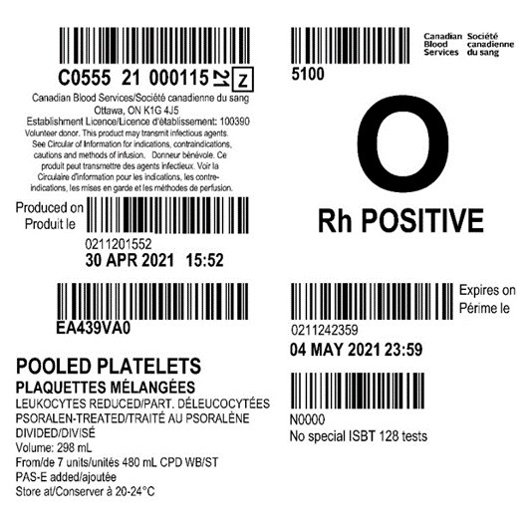
New label (new code, new name, 7-day shelf life*)
ISBT label, final component
New component codes:
EA439VA0: part 1 of 2 of the divided double dose platelet after treatment has been completed
EA439VB0: part 2 of 2 of the divided double dose platelet after treatment has been completed
Refer to CL 2022-18 Attachment 2
*7-day shelf-life was approved by Health Canada effective April 24, 2023.
Notes:
The next two slides will review the ISBT128 labels of the new components
As mentioned, two new codes will need to be entered into the hospital system. Two codes because we started with a double dose component.
In the new component codes, the letters A and B identify the split units.
Therefore, part 1 of 2 will be identified as EA439VA0 and part 2 of 2 as EA439VB0.
Customer Letter # 2022-18 contains information on labelling and ISBT128 codes
Labels and codes for the apheresis platelet psoralen-treated and Apheresis Platelet in PAS components will be released in Customer Letter #2022-34 on blood.ca.

Slide 22
New label (new code, new name, 7-day shelf life*)
ISBT Label, final component
Produced on: Date X
Expires on: Date Y (7 days from collection Date)
Name: Pooled Platelets, Leukocytes reduced, Psoralen-Treated, Divided
Volume: XX mL
From 7 units 480mL CPD WB
PAS-E added
Store at 20-24°C
*7-day shelf-life was approved by Health Canada effective April 24, 2023.
Notes:
This slide illustrates the placement of the component description: - click
the name – Pooled Platelets, Leukocyte Reduced, Psoralen Treated (meaning pathogen-reduced), Divided – click
The volume - click
From 7 units of 480mL CPD WB - click
That PAS-E was added - click
And finally, the storage temperature - click
The ‘Produced on’ date just above the component description
And the ‘Expiry date’ on the right

Slide 23
Hospital implementation considerations
To be routinely distributed upon implementation at most sites:
  Pooled platelet psoralen-treated (7-day shelf life*)
  Apheresis platelet in plasma (7-day shelf life) until apheresis platelet psoralen-treated components become available
Canadian Blood Services may need to import and distribute:
  Untreated pooled platelets in plasma (7-day shelf life) to support local hospital demand.
Untreated components may be offered only as irradiated to avoid any confusion and decrease risk of errors at bed side (TBD by each region based on hospital need).
*7-day shelf-life was approved by Health Canada effective April 24, 2023.
Notes:
Read slide
Ensure that you are prepared for a dual inventory of treated and untreated platelet components, both initially with untreated apheresis components and treated pooled components, but also for the rare possibility of untreated pooled components imported to support regional demand.

Slide 24

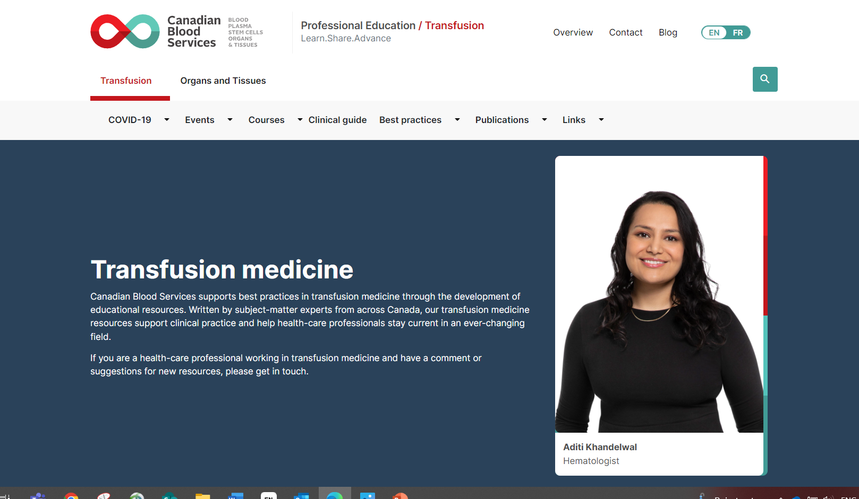
Additional resources

Slide 25
Resources
Canadian Blood Services professional education website (profedu.ca)
  Clinical Guide to Transfusion, Chapter 19, Pathogen-reduced platelets
  Clinical slide deck (also available as narrated video)
  Component slide deck (also available as narrated video)
  Clinical highlights slide deck (also available as narrated video)
  FAQ: Information for health professionals on pathogen-reduced platelets (PPPT)
  FAQ: Information for health professionals on apheresis platelet psoralen-treated (APPT) and untreated apheresis platelet in PAS-E
Canadian Blood Services website (blood.ca)
  Circular of Information
INTERCEPT package insert: intercept-canada.com
Ontario Regional Blood Coordinating Network (ORBCoN) information on pathogen-reduced pooled platelets: Information on Pathogen Reduced Pooled Platelets – Transfusion Ontario
Source: Canadian Blood Services’ professional education website, profedu.ca
Notes:
To point out:
If surfing on Web, beware of different regulatory requirements applicable depending on jurisdictions.

Slide 26

Contact
Notes:
For any questions or comments

Slide 27

Contact
Please contact your local Hospital Liaison Specialist with any questions
Notes:
For any questions or comments

Slide 28
Together, we are Canada’s Lifeline
Notes:
Thank you again joining Canadian Blood Services to learn more about our new Pathogen-Reduced Platelet components.

