Slide 1
Pathogen-reduced platelets: clinical overview
October 2022
Source: Canadian Blood Services’ professional education website, profedu.ca

Slide 3

Overview
Pathogen inactivation technology
  Mechanism of action
  Safety
Production
Platelet additive solution
Indications and contraindications
Benefits and drawbacks
Source: Canadian Blood Services’ professional education website, profedu.ca
Notes:
(Read out overview)

Slide 4
Acronyms
Acronym | Name
PPPT | Pooled platelet psoralen-treated
APPT | Apheresis platelet psoralen-treated
PIT | Pathogen inactivation technology
PRT | Pathogen reduction technology
PAS | Platelet additive solution PAS-E is the formulation of PAS used at Canadian Blood Services
Source: Canadian Blood Services’ professional education website, profedu.ca
Notes:
PPPT and APPT are types of pathogen-reduced platelets
PIT and PRT are interchangeable terms

Slide 5

Pathogen inactivation technology (PIT)

Slide 6



Pathogen inactivation technology
PIT reduces the risk of transfusion-transmitted pathogen infections and provides an additional layer of safety against:
      Viruses (enveloped and non-enveloped)
      Bacteria (gram-positive, gram-negative, spirochete)
      Protozoa parasites
      White blood cells (leukocytes), which can no longer replicate and produce cytokines, rendering irradiation unnecessary
Source: Canadian Blood Services’ professional education website, profedu.ca
Notes:
Bacterial contamination remains a risk following blood transfusion, particularly with platelet components as they are stored at room temperature. To improve blood safety, many countries have implemented pathogen inactivation technologies to reduce the risk of bacterial transmission. Pathogen inactivation technology reduces the risk of transfusion-transmitted pathogen infections and provides an additional layer of safety against (read out the slide).

Slide 7
Terminology
At Canadian Blood Services, Cerus’ INTERCEPT pathogen inactivation technology (PIT) will be used to manufacture pathogen-reduced platelet components.
Pathogen-reduced platelets are also known as:
INTERCEPT platelets
Pathogen reduction technology (PRT) platelets
Psoralen-treated platelets
Other terms:
Pooled platelets psoralen-treated (PPPT)
Apheresis platelets psoralen-treated (APPT)
Source: Canadian Blood Services’ professional education website, profedu.ca
Notes:
(Read slide)
Other terms of relevance include pooled platelets psoralen-treated (PPPT) and apheresis platelets psoralen-treated (APPT), which refer to specific types of pathogen-reduced platelets.

Slide 8
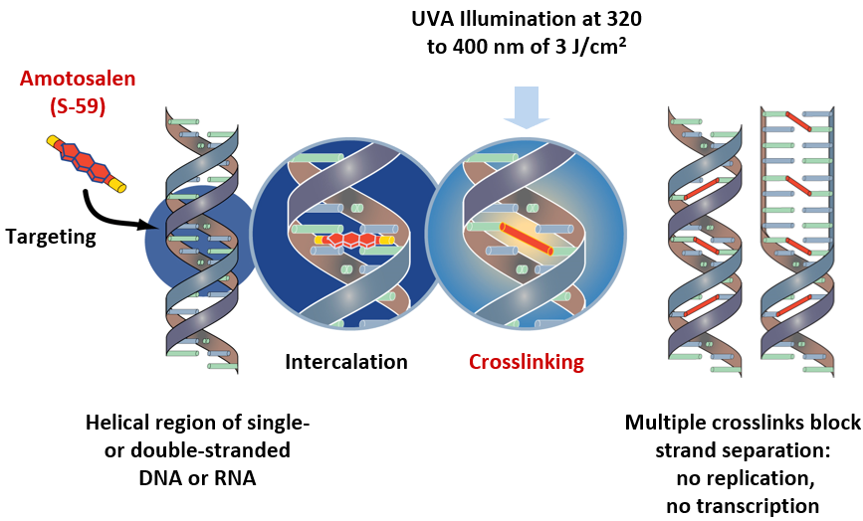
Mechanism of action (INTERCEPT)
Amotosalen (synthetic psoralen) is added to the platelet component
Intercalates within nucleic acids of DNA/RNA in cells, bacteria, viruses and parasites
When UVA illumination occurs (320-400 nm), crosslinking damages DNA/RNA
This inactivates cells and pathogens
Residual amotosalen is removed
Source: Cerus. Intercept® Blood System for Platelets - Package Insert – Dual Storage (DS) Processing Set. Concord, CA, Cerus Corporation, 2021.
Notes:
Amotosalen is the active photoreactive compound of the Cerus INTERCEPT pathogen inactivation system. Amotosalen is a synthetic psoralen. Amotosalen is added to the platelet component and intercalates within nucleic acids that compose the DNA and RNA of cells, bacteria, viruses and parasites. Amotosalen becomes activated when exposed to ultraviolet A illumination, causing permanent crosslinking between nucleic acid strands. This leads to DNA/RNA damage and inactivates cells and pathogens which may be present in a platelet unit. Any residual amotosalen is removed by a compound adsorption device.

Slide 9
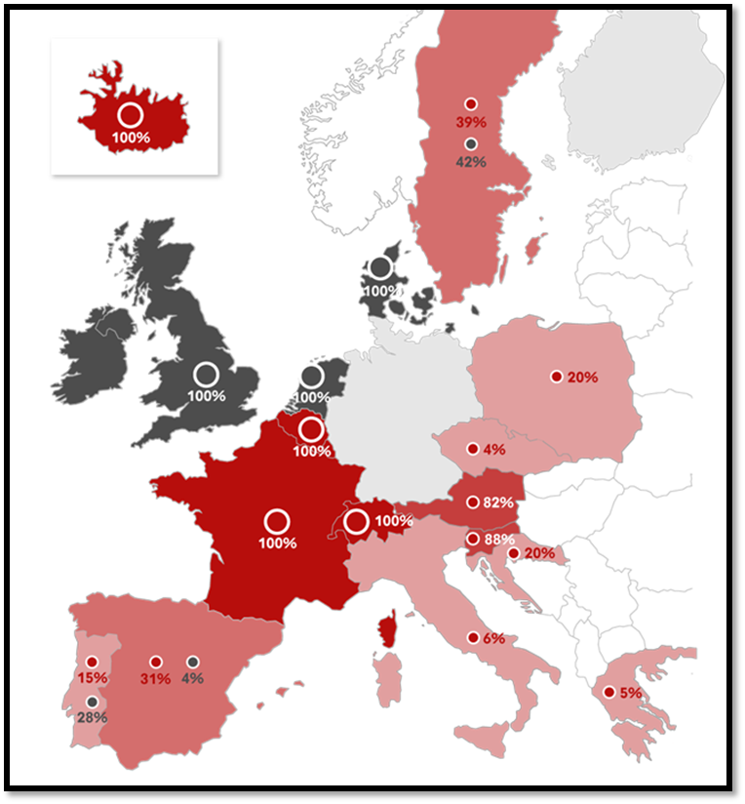
Safety
Amotosalen safety profile
Toxicity extensively studied
Minimal residual amotosalen
In vitro, animal model, and European hemovigilance data suggests safe
About INTERCEPT (provided by Cerus):
Commercialized for nearly 20 years
Adopted for the treatment of >50% of platelets produced in 10 Countries‡
Approx. 8.5 million INTERCEPT treated doses globally (plasma and platelets)*
Pathogen inactivated platelet concentrates
Platelet concentrates screened for bacteria
Platelet concentrates with neither bacterial screening nor pathogen inactivation
Source: Cerus 2018 data on file
‡Countries where INTERCEPT is standard of care, treating >50% of platelets
*Dose treated estimates for platelet and plasma based on the number of kits sold to date
Notes:
The toxicity of psoralen-based treatments has been extensively studied in in vitro, in animal studies, and in clinical trials. The residual amotosalen amount after platelet preparation is minimal and falls well below toxic thresholds. It is important to highlight that while pathogen reduced platelets are new to Canada, they have been routinely used in Europe since the mid-2000s. INTERCEPT has been commercialized for nearly 20 years, with approximately 8.5 million intercept treated components administered globally. Large multinational hemovigilance databases have confirmed the excellent safety profile seen in the preclinical studies.

Slide 10

Manufacturing

Slide 11
Platelet components
Existing components, in plasma
Untreated pooled platelet (Pooled platelets LR CPD)
Untreated apheresis platelet (Apheresis platelet)
New platelet components, in platelet additive solution (PAS-E)
Pooled platelet psoralen-treated (PPPT)
Apheresis platelet psoralen-treated (APPT)*
Untreated apheresis platelet, in PAS-E*
*APPT and untreated apheresis platelets in PAS-E require Health Canada approval and are not currently available in Canada.
Source: Canadian Blood Services’ professional education website, profedu.ca
Notes:
Currently, two untreated or non-pathogen reduced platelet components are manufactured by Canadian Blood Services – untreated pooled platelets in plasma and untreated apheresis platelets in plasma. In December 2021, Health Canada approved the use of Cerus’ INTERCEPT Pathogen Inactivation Technology for manufacturing pooled platelets psoralen-treated (PPPT) at Canadian Blood Services. PPPT was introduced by Canadian Blood Services at select hospitals in January 2022, and manufacturing will roll out across production centers in 2023.
Canadian blood services will also be submitting to Health Canada applications for the manufacturing of 2 new platelet components - apheresis platelet psoralen-treated (APPT) and untreated apheresis platelet in PAS-E. Implementation is pending Health Canada approval and these components are not currently available in Canada.
For details on component characteristics, please see the component focused slide deck and video available, circular of information, as well as the professional education chapter on pathogen reduced platelets.

Slide 12
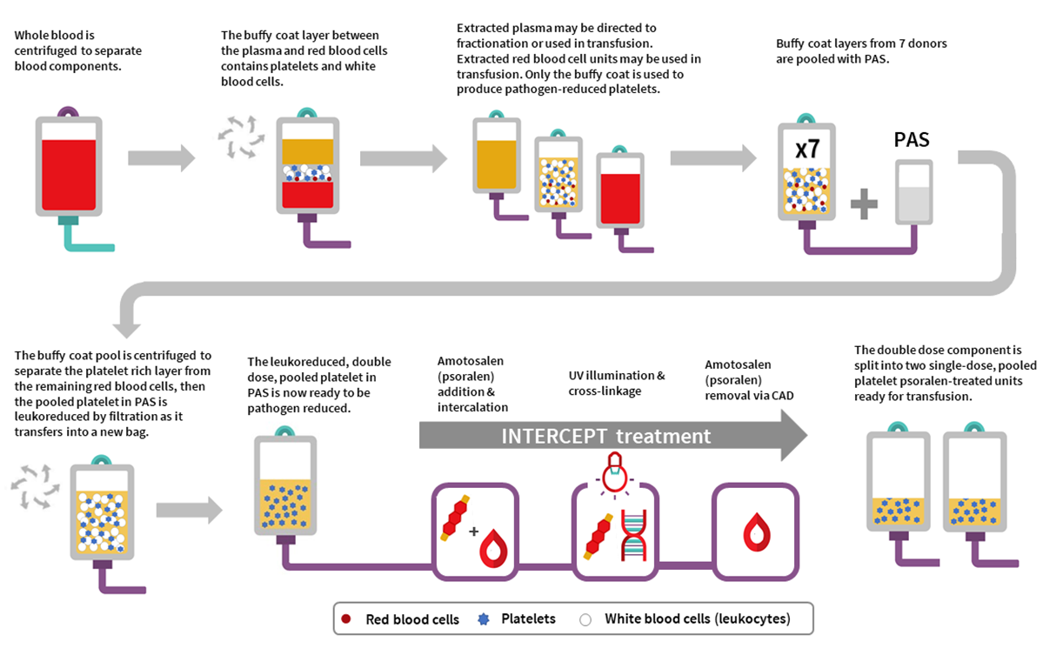
Manufacturing of PPPT
Source: Blais-Normandin I, Tordon B, Anani W, and Ning S. Pathogen-reduced platelets. In: Clarke G, Abe T, editors. Clinical Guide to Transfusion [Internet]. Ottawa: Canadian Blood Services, 2022. Chapter 19.
Notes:
The manufacturing of PPPT begins with the collection of whole blood from donors in a Canadian Blood Services donor centre. Whole blood units are centrifuged to separate out the buffy coat which contains platelets and leukocytes, from the plasma and red blood cells. Seven buffy coats—one from each donor unit— are then pooled together and platelet additive solution is added. The buffy coat pool is then centrifuged, and the platelet-rich supernatant is extracted from the remaining red blood cells retained in the buffy coat through a platelet-sparing leukoreduction filter, to produce a double dose pooled platelet.
This now leukoreduced, double dose pooled platelet component is ready to be pathogen inactivated. Pathogen inactivation occurs with the addition of amotosalen and exposure to UVA illumination to inactivate pathogens and leukocytes. Amotosalen is then removed via the compound adsorption device. The double-dose PPPT unit is then split into two single-dose PPPT units and ready for transfusion.

Slide 13
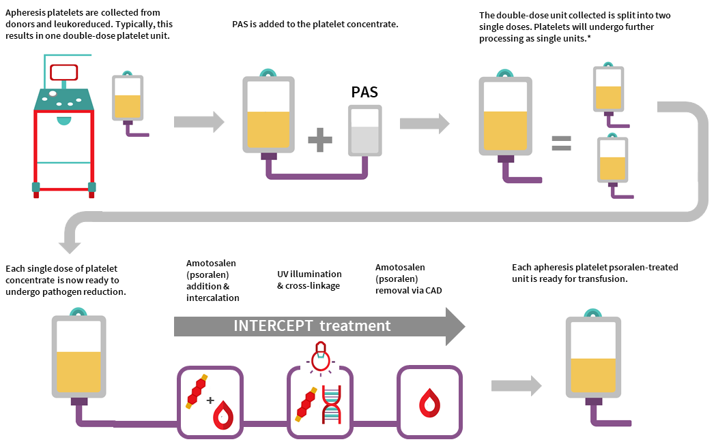
Manufacturing of APPT and untreated apheresis platelets in PAS-E*
*APPT and untreated apheresis platelets in PAS-E require Health Canada approval and are not currently available in Canada.
Source: Blais-Normandin I, Tordon B, Anani W, and Ning S. Pathogen-reduced platelets. In: Clarke G, Abe T, editors. Clinical Guide to Transfusion [Internet]. Ottawa: Canadian Blood Services, 2022. Chapter 19.
Notes:
Production begins with a single donor apheresis donation, which extracts platelets and plasma, performed in a Canadian Blood Services donor centre. Each collection yields one or two platelet components. Platelets are leukoreduced by the system during collection. Platelet additive solution is then added to the platelet concentrate. Double dose platelet components are split into single doses. *For untreated apheresis platelet in PAS-E, manufacturing is complete at this step and the component is sent for bacterial screening without undergoing pathogen inactivation. For the APPT component, these single dose platelets are now ready for pathogen inactivation. Pathogen inactivation occurs with the addition of amotosalen, exposure to UVA illumination to inactivate pathogens and leukocytes, and amotosalen removal via the compound adsorption device. Each apheresis APPT platelet component is now ready for transfusion.

Slide 14
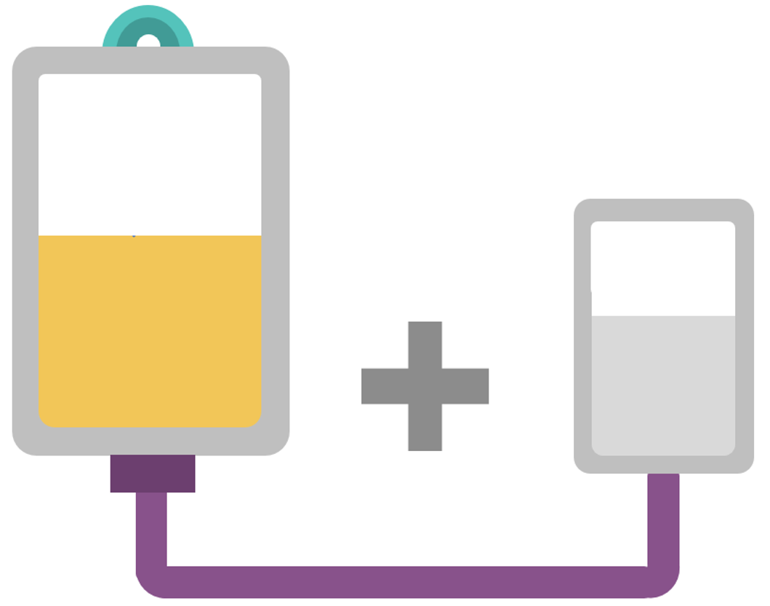
Platelet additive solution (PAS)

Slide 15
What is platelet additive solution (PAS)?
PAS was developed to partially replace plasma in platelet components
The selected PAS solution (PAS-E) that is used in our manufacturing of pathogen-reduced platelets is SSP+ by Macopharma
Composition of SSP+: Acetate, citrate, phosphate, potassium, magnesium and NaCl
Source: Canadian Blood Services’ professional education website, profedu.ca
Notes:
PAS is a crystalloid nutrient media designed to replace a portion of plasma within platelet units. The ratio of PAS-E:plasma in PPPT, APPT, untreated apheresis platelet in PAS-E are all approximately 60:40 percent. The formulation of PAS used at Canadian Blood Services is called PAS-E. The PAS-E solution utilized with the INTERCEPT system is the Macopharma SSP+, which contains (read slide)

Slide 16
Benefits of PAS
Inert solution compared to suspension with plasma
Dilutes plasma proteins, cytokines, iso-agglutinins (anti-A, anti-B, anti-A/B), and other bioactive molecules
Reduces allergic and febrile non-hemolytic transfusion reactions^{1,2}
No differences in hemostasis and transfusion intervals³
Source: Canadian Blood Services’ professional education website, profedu.ca
Notes:
PAS is an inert solution compared to suspension with plasma. Because it dilutes plasma proteins, cytokines, iso-agglutinins, and other bioactive molecules in the component - PAS stored platelets have a reduced risk of allergic and febrile non-hemolytic transfusion reactions and reduces iso-agglutinin titers in the component. There are no differences reported in hemostasis and transfusion intervals when compared to platelets suspended in plasma in clinical studies.

Slide 17

Indications and contraindications
Benefits and drawbacks

Slide 18
Indications
Pathogen-reduced platelets have the same indications as untreated platelets with the following additional considerations:
Irradiation not required/indicated
CMV negative
Source: Canadian Blood Services’ professional education website, profedu.ca
Notes:
(Read slide)

Slide 19
Contraindications
Pathogen-reduced platelets have the same contraindications as untreated platelets with the following additions:
Contraindicated for patients with a history of hypersensitivity reaction to amotosalen or other psoralens
Contraindicated for neonatal patients treated with phototherapy devices that emit a peak energy wavelength less than 425 nm, OR have a lower bound of the emission bandwidth <375 nm, due to the potential for erythema resulting from interaction between ultraviolet light and amotosalen
Source: Canadian Blood Services’ professional education website, profedu.ca
Notes:
(Read slide)
It should be noted that phototherapy with blue-green light is the current standard of care for treatment neonatal hyperbilirubinemia in Canada. Blue-green light has a peak wavelength of 450-460nm, which is the safe wavelength range. For patients with these contraindications, Canadian Blood Services will continue to offer non pathogen reduced platelet components as needed.

Slide 20
Benefits: Reduced risk of transfusion-transmitted infections
Reduces risk of bacterial transmission^{4,5}
Reduces risks of other transfusion-transmitted infections
  Additional layer of safety against broad range of viruses, bacteria, and protozoan parasites
  Complements donor selection criteria and pre-transfusion pathogen testing performed for all donations
No need for BACT bacterial screening before release into inventory
  Earlier release to hospitals compared to untreated platelets
Source: Canadian Blood Services’ professional education website, profedu.ca
Notes:
Pathogen reduced platelets are associated with multiple benefits.
Pathogen reduced platelets significantly reduces the risk of bacterial transmission. Hemovigilance data has strongly supported a reduced risk of transfusion-transmitted bacterial infections following PIT implementation. PIT also reduces the risk of other transfusion transmitted-infections. Since amotosalen non-specifically intercalates in the DNA and RNA of organisms and viruses, PIT provides an additional layer of safety for platelet components against known and unknown pathogens. PIT complements the donor selection criteria and pre-transfusion pathogen testing performed for all donations.
As PIT eliminates the need for platelets to undergo bacterial testing, pathogen reduced platelets are released approximately 24 hours earlier in their shelf life than untreated platelets

Slide 21
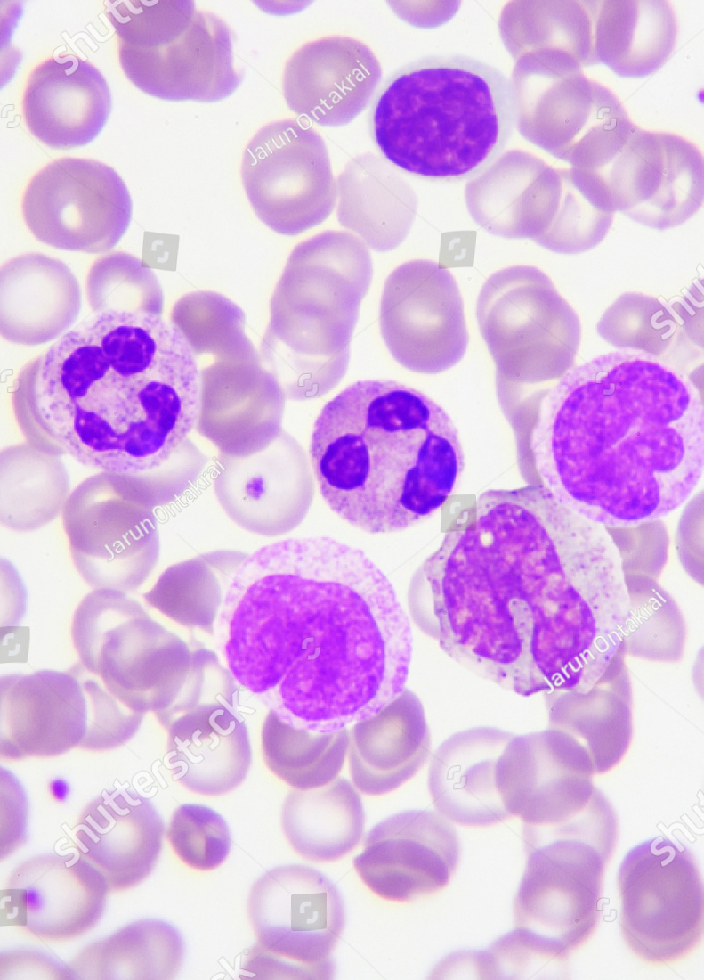
Benefits: Inactivates white blood cells
White blood cell (leukocyte) replication and cytokine production inhibited
White blood cell inactivation – irradiation is NOT required
  Contributes toward reducing the risk of Ta-GvHD*
  Simpler ordering process and inventory management
Considered CMV negative
*Ta-GvHD: Transfusion-associated graft versus host disease
Source: Canadian Blood Services’ professional education website, profedu.ca
Notes:
Because pathogen inactivation inhibits white cell replication and cytokine production, irradiation to prevent transfusion-associated graft versus host disease is no longer needed. This simplifies the ordering process and inventory management for hospitals. Similarly, the need for cytomegalovirus (CMV)-negative blood components, already limited, is removed because pathogen inactivated platelets are considered CMV-negative.

Slide 22
Benefits: Favorable safety profile
Safety endpoints from clinical trials and published hemovigilance data shows favourable adverse reaction and safety profile^{4,6}
Fewer allergic and febrile non-hemolytic transfusion reactions^{7,8}
Signals of safety (compared to untreated platelets) – 2017 Cochrane review⁶:
  No change in thromboembolism, anaphylaxis, acute transfusion reactions
  No increase in adverse events in clinical trials
Source: Canadian Blood Services’ professional education website, profedu.ca
Notes:
(Read slide)

Slide 23
Benefits: Favorable safety profile
Initial trial (SPRINT) suggested increased ARDS with large volume transfusions⁹
    5/318 treated vs 0/327 untreated
    Secondary analysis of study data showed no difference
PIPER trial (15 US sites, 2291 patients with over 10,000 platelet transfusions)¹⁰
  No difference in mechanical ventilation or pulmonary injury
  No significant difference was detected for ARDS or other adverse events
Swissmedic Hemovigilance post-implementation reporting reviewed TRALI⁸ events:1:31,000 untreated platelets vs 1:30,000 with INTERCEPT platelets
Short-term safety and efficacy have been demonstrated in pediatric patients¹¹ and in neonates.¹²
ARDS: Acute Respiratory Distress Syndrome
TRALI: Transfusion-related acute lung injury
Source: Canadian Blood Services’ professional education website, profedu.ca
Notes:
From a respiratory risk perspective, a randomized trial (SPRINT) which randomized 645 patients with thrombocytopenia to INTERCEPT or untreated platelet transfusions, suggested a risk of ARDS. The authors reported that 5/318 INTERCEPT versus 0/327 patients transfused with untreated platelets developed ARDS. However, Secondary analysis of the data revealed no differences between the two groups.
More recently, the PIPER trial – a phase IV post-market surveillance study - evaluated platelet transfusions in hematology-oncology patients at 15 U.S. sites. The study included over 2000 patients (9% were less than 18 years of age) with over 10,000 platelet transfusions. There was no difference in treatment-emergent assisted mechanical ventilation or pulmonary injury between pathogen reduced versus untreated platelets. No significant difference was detected for ARDS or other adverse events.
Swiss hemovigilance data have also failed to detect a difference - reporting a TRALI risk of 1:31,000 for conventional and 1:33,000 for pathogen reduced platelets.
The safety and efficacy of the pathogen reduced platelet have also been reported in among pediatric patients and neonates.

Slide 24
Clinical outcomes and drawbacks
Pathogen-reduced vs untreated platelets
No differences in mortality, any bleeding event (WHO Grade 1-4), clinically significant bleeding (Grade 2/more) or severe bleeding (Grade 3/4)⁶
Platelet count increments and transfusion requirements
Lower correct count increment (CCI) at 1 and 24 hours
7% more platelet transfusions (published ranges from 0-30%)
Shorter transfusion interval between platelets (avg. 0.5 days less between transfusion)
Platelet refractoriness was observed more often (not HLA Ab-mediated)
Source: Canadian Blood Services’ professional education website, profedu.ca
Notes:
With regards to clinical outcomes, there have been no differences reported in mortality, any bleeding event, clinically significant bleeding or severe bleeding when pathogen reduced platelets are compared to untreated platelets.
Studies have shown that pathogen reduced platelets lead to lower corrected count increments, increase in the number of platelet transfusions, and a shorter time interval between transfusions compared those who received untreated platelets . These differences, however, are small as outlined on the slide. Non-immune platelet refractoriness is also more frequently observed.
.

Slide 25
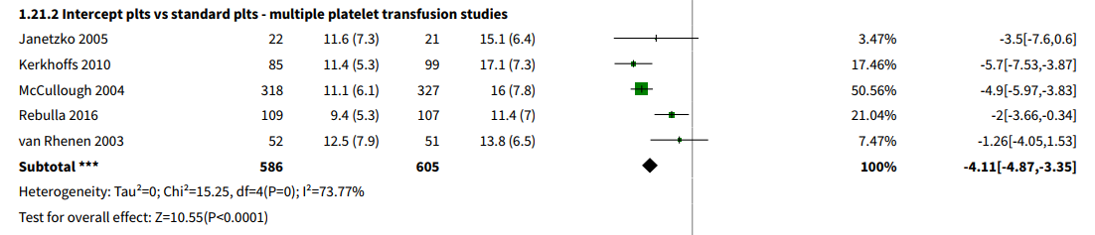
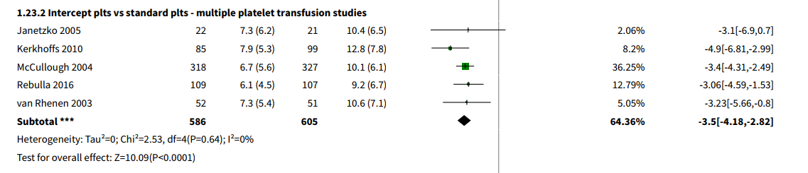
INTERCEPT vs Untreated⁶
1 hour CCI
1 hr
CCI
24 hr
CCI
Note: These studies are a mix of PAS and plasma PRT components; pooled and apheresis platelets
Source: Canadian Blood Services’ professional education website, profedu.ca
Notes:
These forest plots are from the 2017 Cochrane systematic review comparing INTERCEPT versus untreated platelets. Differences in the 1 hour and 24 hour corrected count increment (CCI)s are shown. The mean CCI differences are about -4.1 for the 1 hour CCI, and -3.5 for the 24 hour CCI when INTERCEPT platelets were compared to untreated platelets.

Slide 26
A note about clinical efficacy - PLADO trial¹³
Method
  Prophylactic platelet transfusion to hematologic cancer and solid tumor patients
  Received low (1.1x10¹¹), medium (2.2x10¹¹), or high (4.4x10¹¹) dose when platelet count was less than 10,000/L
  Primary endpoint: Grade 2 or higher bleeding defined by WHO
Result
  Significant bleeding did not differ between groups
  Trials with pathogen-reduced platelets also did not observe an increased bleeding risk due to fewer platelets in a platelet dose.⁸
Source: Canadian Blood Services’ professional education website, profedu.ca
Notes:
While the count increments may be lower following transfusion with pathogen reduced platelets, it is important to remember – as shown by the landmark PLADO trial of variable platelet doses – that while more platelet doses may be required, clinical bleeding is NOT increased. Again, trials with pathogen reduced platelets also did not observe an increased bleeding risk.

Slide 27
Platelet refractoriness and alloimmunization
SPRINT trial¹⁴
  Refractoriness tended to be transient, persisting at end of study in 6% of INTERCEPT and 9% of control refractory patients
  Alloimmune platelet refractoriness and the need for HLA-matched platelets were uncommon, similar in both groups
IPTAS trial¹⁵
  Patients were assessed for the presence of HLA antibodies prior to and following platelet transfusion with either pathogen reduced or untreated platelets
  Underpowered but no statistically significant differences were observed in the rates of HLA alloimmunization
Most consistent with non-immune causes
Source: Canadian Blood Services’ professional education website, profedu.ca
Notes:
With respect to platelet refractoriness, a large randomized controlled trial comparing INTERCEPT to untreated platelets – the SPRINT trial – detected that refractoriness tended to be transient in both arms of the study. The INTERCEPT arm did require more platelet transfusions, but there were no significant differences in HLA alloimmunization or platelet-specific antigens between study arms. Alloimmune platelet refractoriness and need for HLA matched platelets were uncommon and comparable in both groups.
In another trial called the IPTAS trial, patients were assessed for the presence of HLA antibodies prior to and following platelet transfusion with either pathogen reduced or untreated platelets. No statistically significant differences were observed in the rates of HLA alloimmunization although the study was underpowered. Overall, evidence to date suggest that refractoriness following pathogen reduced platelet transfusion is most consistent with non-immune causes and can likely be overcome with additional platelet transfusions.

Slide 28
Neonatal and intrauterine transfusions
Several studies have described pathogen reduced platelet use in pediatrics and neonatal populations
No indications of harm
  Largest study Delaney et al. > 3800 pediatric patients across 4 centres, 2013-2019 (1,188 patients under 4 months)¹⁶
No long-term studies
No published studies in intrauterine transfusions
Benefit and risks should be assessed and balanced before using pathogen reduced platelets in these settings
Source: Canadian Blood Services’ professional education website, profedu.ca
Notes:
Since the approval of INTERCEPT treated platelets internationally, several studies have described the safety of these components in pediatric and neonatal patient populations. There is no indications of harm in published studies. The largest of these is published by Delaney and colleagues, who reported on 1,188 patients under 4 months who received pathogen reduced platelets without issue. Short-term safety data have demonstrated safety, but long-term data are currently limited. There is no published evidence for the use of INTERCEPT platelets for intrauterine platelet transfusions – for which non pathogen reduced components will remain available. Benefit and risks should be assessed and balanced before using pathogen reduced platelet in these settings

Slide 29

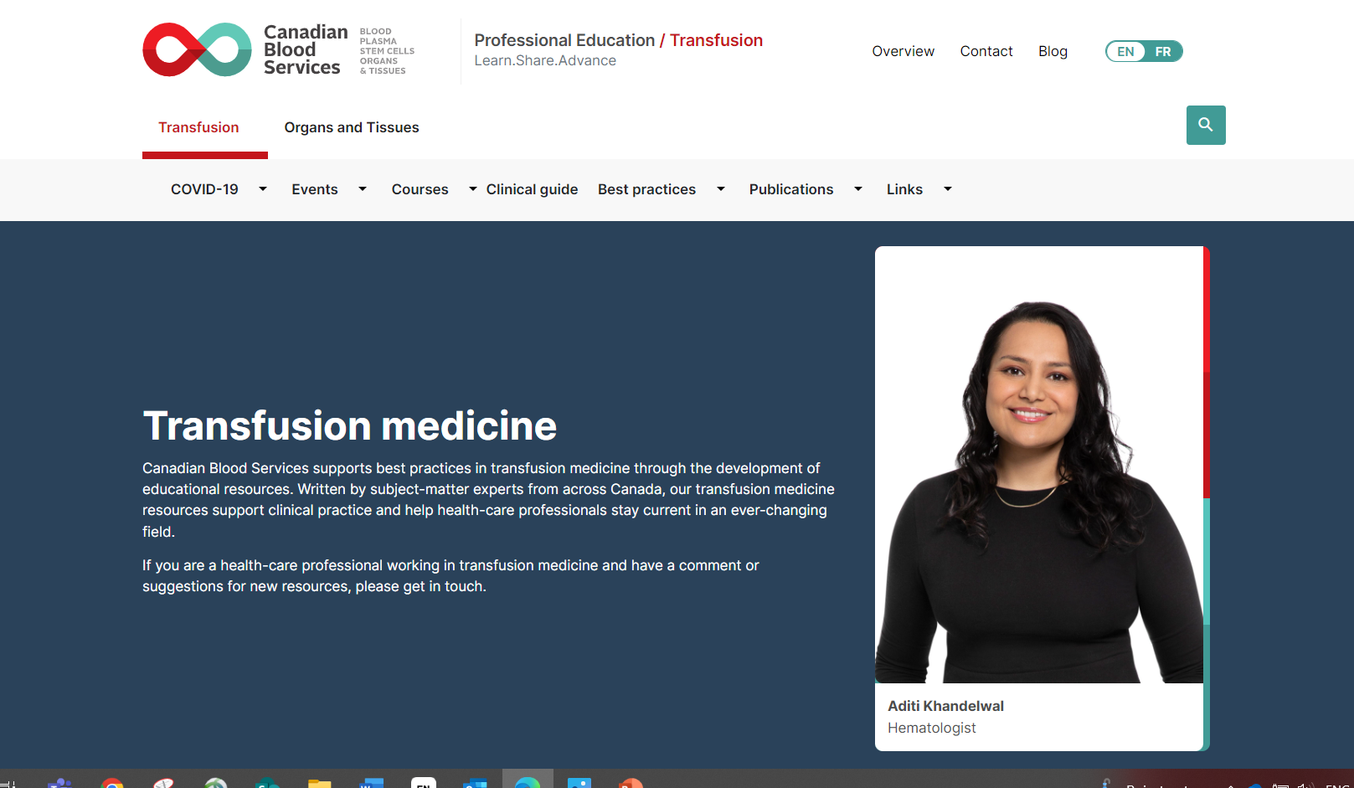
Additional resources

Slide 30
Resources
Canadian Blood Services professional education website (profedu.ca)
  Clinical Guide to Transfusion, Chapter 19, Pathogen-reduced platelets
  Clinical slide deck (also available as narrated video)
  Component slide deck (also available as narrated video)
  Clinical highlights slide deck (also available as narrated video)
  FAQ: Information for health professionals on pathogen-reduced platelets
Canadian Blood Services website (blood.ca)
  Circular of Information
INTERCEPT package insert: intercept-canada.com
Ontario Regional Blood Coordinating Network (ORBCoN) information on pathogen-reduced pooled platelets: Information on Pathogen Reduced Pooled Platelets – Transfusion Ontario
Source: Canadian Blood Services’ professional education website, profedu.ca
Notes:
To point out:
If surfing on Web, beware of different regulatory requirements applicable depending on jurisdictions.

Slide 31
References
1. Mertes PM et al. Hypersensitivity Transfusion Reactions to Platelet Concentrate: A Retrospective Analysis of the French Hemovigilance Network. Transfusion 2020;60:507-12.
Mowla SJ et al. A Comparison of Transfusion-Related Adverse Reactions among Apheresis Platelets, Whole Blood-Derived Platelets, and Platelets Subjected to Pathogen Reduction Technology as Reported to the National Healthcare Safety Network Hemovigilance Module. Transfus Med Rev 2021;35: 78-84.
Kerkhoffs J-LH et al. A Multicenter Randomized Study of the Efficacy of Transfusions with Platelets Stored in Platelet Additive Solution Versus Plasma.
Blood 2006;108:3210-5.
4. Knutson F et al. A Prospective, Active Haemovigilance Study with Combined Cohort Analysis of 19,175 Transfusions of Platelet Components Prepared with Amotosalen-UVA Photochemical Treatment. Vox Sang 2015;109:343-52.
5. Benjamin RJ et al. Hemovigilance Monitoring of Platelet Septic Reactions with Effective Bacterial Protection Systems. Transfusion 2017;57:2946-57.
6. Estcourt LJ et al. Pathogen‐Reduced Platelets for the Prevention of Bleeding. Cochrane Database of Systematic Reviews 2017.
7. Garban F et al. Comparison of the Hemostatic Efficacy of Pathogen-Reduced Platelets Vs Untreated Platelets in Patients with Thrombocytopenia and Malignant Hematologic Diseases: A Randomized Clinical Trial. JAMA Oncology 2018;4:468-75.
8. Jutzi M, Mansouri Taleghani B, Rueesch M, Amsler L, Buser A. Nationwide Implementation of Pathogen Inactivation for All Platelet Concentrates in Switzerland. Transfus Med Hemother 2018;45:151-6.
9. Snyder E et al. Clinical Safety of Platelets Photochemically Treated with Amotosalen Hcl and Ultraviolet a Light for Pathogen Inactivation: The Sprint Trial. Transfusion 2005; 45:1864-75.
10. Snyder EL et al. The Piper Phase 4 Study: Pathogen Inactivated Platelets Entering Routine Practice. 2021 AABB Annual Meeting. Virtual, Transfusion 2021.
11. Schulz WL et al. Blood Utilization and Transfusion Reactions in Pediatric Patients Transfused with Conventional or Pathogen Reduced Platelets. J Pediatr 2019;209:220-5.
12. Jimenez-Marco T et al. Use and Safety of Riboflavin and Uv Light-Treated Platelet Transfusions in Children over a Five-Year Period: Focusing on Neonates. Transfusion 2019;59:3580-8.
13. Slichter SJ, et al. Dose of prophylactic platelet transfusions and prevention of hemorrhage. N Engl J Med 2010;362(7):600-13.
14. McCullough J et al. Therapeutic Efficacy and Safety of Platelets Treated with a Photochemical Process for Pathogen Inactivation: The Sprint Trial. Blood 2004;104:1534-41
15. Norris PJ et al. Ultraviolet Light-Based Pathogen Inactivation and Alloimmunization after Platelet Transfusion: Results from a Randomized Trial. Transfusion 2018; 58:1210-7.
16. Delaney M et al,. Multinational Analysis of Transfusion Reactions in Children Transfused with Pathogen Inactivated Platelets. 2021 AABB Annual Meeting, Virtual, Transfusion 2021.
Source: Canadian Blood Services’ professional education website, profedu.ca

Slide 32
Together, we are Canada’s Lifeline

